Slide 1
MAYS Coaches Meeting
Spring 2017
Shawn Harty
SportsManager Solutions, Inc.
Support@sportsmanager.us

Slide 2
Coach Jobs in SportsManager
What will you use SportsManager for ?
View Schedules and Standings
Regular season and Playoff Schedules
Send Emails +Text messages to Parents/players
Score Games
Get Approved Rosters
Fill Out the Ref Evaluation Forms
Request Game Cancellations
Process rescheduling request

Slide 3
Coach Login options
Town SportsManager Site
Login with Email and Personal Password
View Roster/Update Jersey Numbers
Email Team/Email History
Get Approved League Roster
View Schedules
Score Games
Team Information Package
Request a Game Cancellation -- New

Slide 4
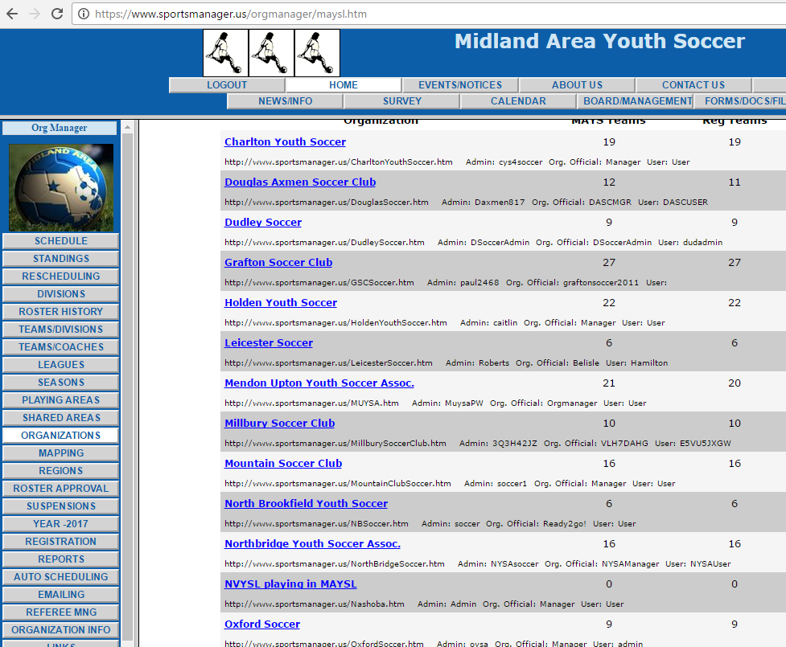
How to find your SportsManager site www.maysl.com, Click Organizations

Slide 5
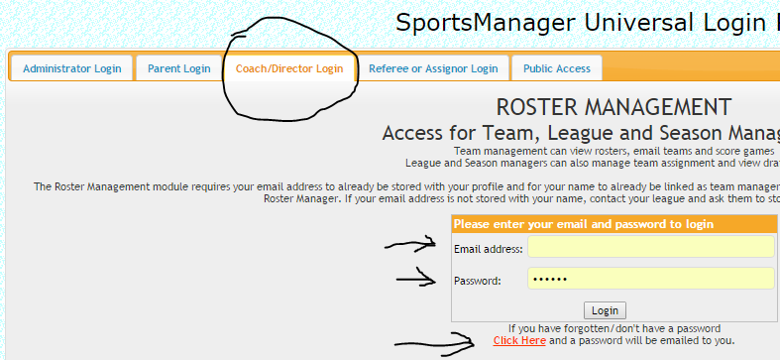
SportsManager Login Page
Open your town site, Click Login

Slide 6
Automated Emails to the Coach
The roster will be emailed once Approved , you will get a notice if it becomes un-approved.
When you email parents the future game and practice schedule will be automatically appended.
You will get a email the day after the game to score the game. (unless scored before)
You will get an email to evaluate the refs day of game
Game Cancel Approval/Denial
Rescheduling Status/Approval
Game Change Notices to coaches and refs

Slide 7
Game Scoring, Ref Scoring, Referee Evaluations
Either coach can login and score the game the day of the game.
If the game is not scored an automatic scoring email is sent to both coaches the next day. They click the link to score the game.
The ref will also enter a score on the game report. If there is a difference it will appear on the score discrepancy page and the league admin can choose to use the coach or ref score.
Referee Evaluations done with automated email.

Slide 8
Referee Evaluations by Coaches
Each coach will receive an email after the game with a link to the referee evaluation form.
They click the link and then answer the evaluation questions.
Should be done by both coaches for each game.
Is done only for the Center Referee (not Ars)

Slide 9
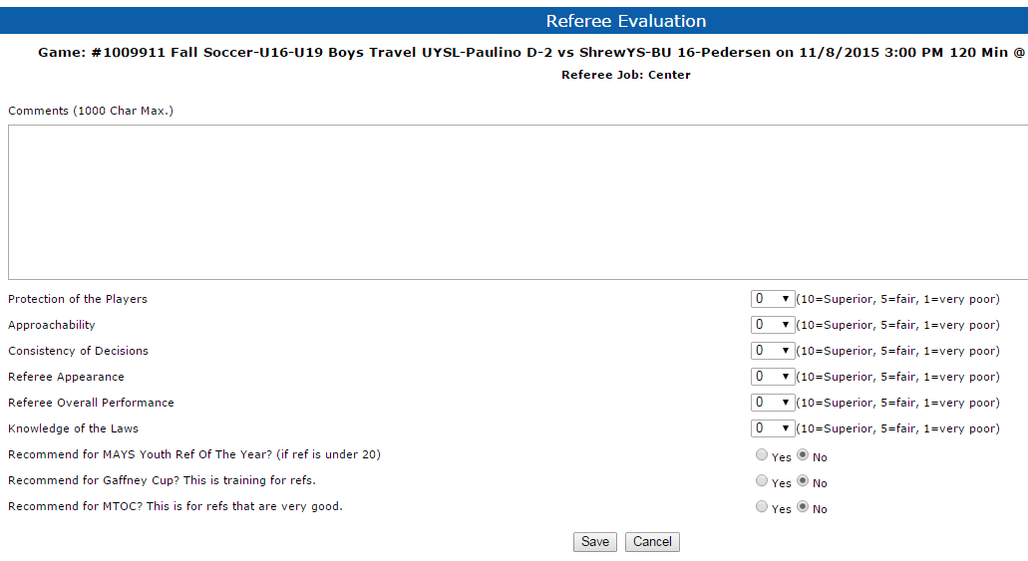
The Ref evaluation entry form

Slide 10
How games can become cancelled
Rain Outs or Field Closings
Coach Cancel Request
All cancelled game enter the rescheduling module
Town Admins cannot cancel a game directly
League Admin
Manual edit

Slide 11
New - Coach Cancellation Request
Coach can click the “Cancel Request” button
Must enter the valid reason and be within minimum time requirements
This will send the request to MAYS
If MAYS Approves it the game is cancelled
Cancellation notices will go out and the game will start the rescheduling process
Email to Coach if Not Approved
Tracking in MAYS and Smgr Rescheduling Module

Slide 12
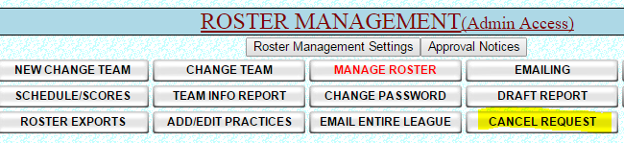
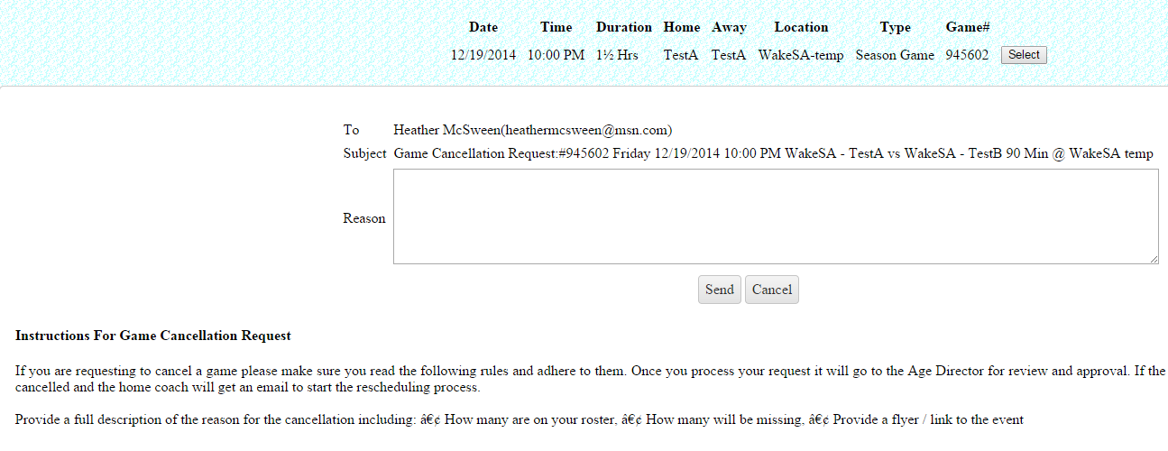
Where to find Game Cancel Option
A page requiring the reason pops up for the Coach to fill out. Instructions and rules
Are displayed on the page so the coach knows what is required to Cancel.

Slide 13
Rescheduling Module
Game is Cancelled (Rain Out or League Cancellation)
Home Coach received email to click a link to start the rescheduling process. Is given field availability and is asked to pick 3 dates/times.
Away coaches gets email and is asked to pick one date/time or to request new dates.
Once the Away coach accepts the League president gets an email to click to approve.

Slide 14
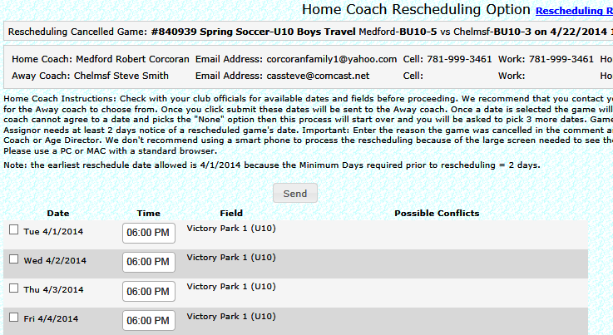
Rescheduling Home Coach Options

Slide 15
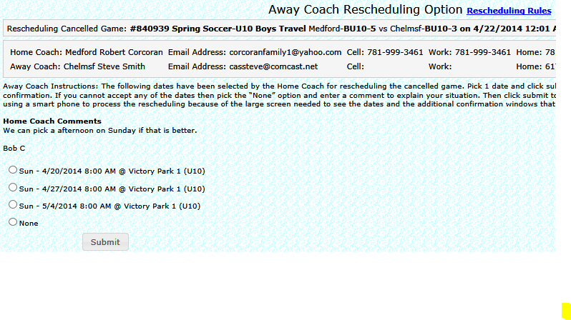
Rescheduling Away Coach Choice

Slide 16
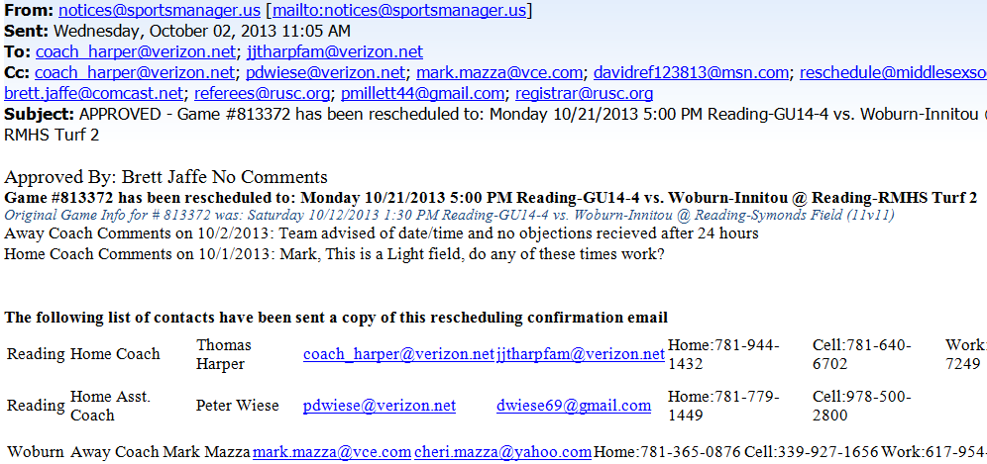
Final Approval Notice of Game Chg

Slide 17
Town Rep Jobs/Task
Cancelling Games/Rain Outs
Reviewing the Rescheduling Process
Reviewing game cancel request by coaches
Approving out of town waivers
Getting Approved Rosters

Slide 18

Field Cancellations and Rain outs
SportsManager has a field closing module that the site administrator can use to close fields.
Individual Fields can be closed or All Fields.
Email Notices sent to Home and Away Coaches, Players, Refs
To use it click on :
Then click on :

Slide 19
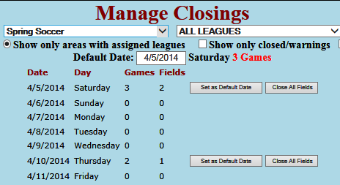
Field Closing Page 1

Slide 20
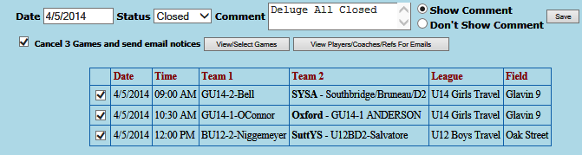
Field Closing - All Fields

Slide 21
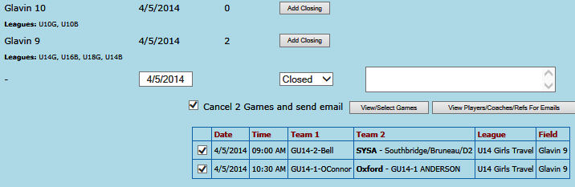
Field Closing
Close Individual Fields

Slide 22

Field Closing Status Notice
When a field is closed the following happens:
Game status is changed to Cancelled. This puts the game in the Rescheduling Queue.
Email notices are sent to all players/parents/coaches/Refs for both teams.
A closing notice will appear on the town website and on the League.

Slide 23
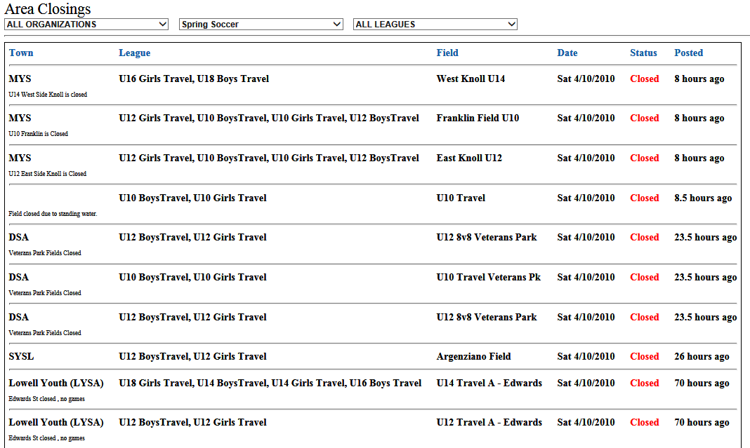
Example of League Closing List

Slide 24
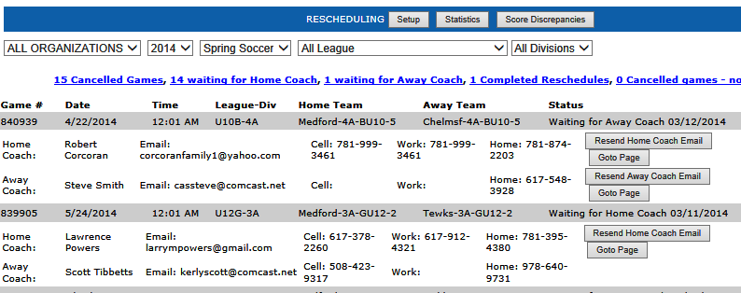
Rescheduling MAYS Status Page

Slide 25
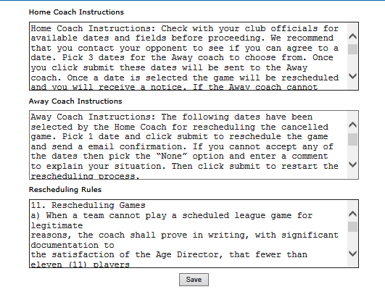
Rescheduling Coach Instructions

Slide 26
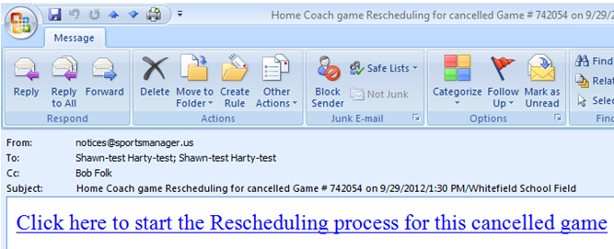
Rescheduling Home Coach Email

Slide 27
Key Tips for Rescheduling
The Town Rep can:
1. Click on town Rescheduling button to view.
2. Resend the Home or Away Coach email
3. Answer and select dates for the Coach
Note:
A rescheduling game will replace a Practice
Notices to practice coaches will be sent

Slide 28
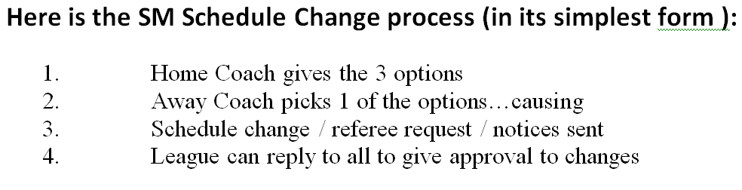
Rescheduling Summary

Slide 29
Recurring Practice Wizard
Automating the Practice Scheduling
Allows Coaches to pick their practice night
Gives them all the practices times for season
Can have 2 teams per field
Works automatically
Makes sure each team has at least one practice before allowing a 2nd practice.
Teams can see other teams Practice Schedule
Coach clicks Add/edit Pratice in roster mng area

Slide 30
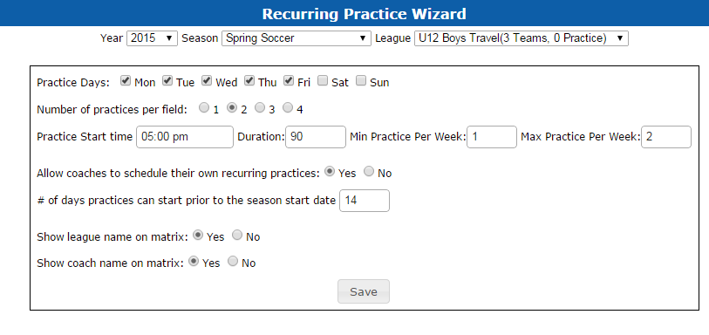
How to set up Practice Wizard
Click on the Auto-Schedule button
Click on the Recurring Practice Button

Slide 31
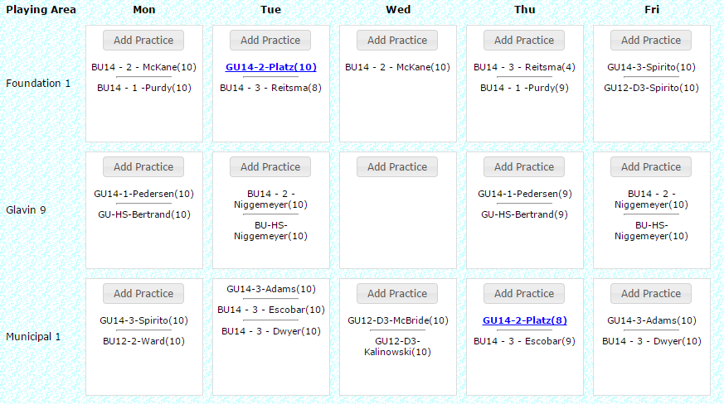
Practice schedule view
Coaches or admins can see this

Slide 32
Final Summary
Contact us for Support or Questions
Shawn Harty, SportsManager Solutions
508-423-2444
Support@sportsmanager.us
Use the Help area
MAYSL Town Coordinator/Town organization handbook
www.sportsmanager.us/orgmanager/MAYSL.htm
New Site Design – Team pages - Mobile

