Slide 1




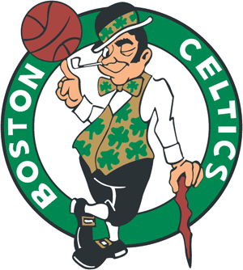

Every Sports Team has a logo,
Dracut Soccer Association wants your help creating our NEW logo!
If you want to see every DSA player wearing something YOU created, here is what to do. Submit a photo of your logo idea to travel@dracutsoccer.com by April 22, 2016. Entries will then be placed on the Dracut Soccer Facebook Page by April 29, 2016 and let the “Liking or Voting” begin. Players and parents of DSA are encouraged to vote, in many cases players under parents supervision. The logo with the most “likes” will win. If you are not so confident about your drawing skills, don’t worry, we want the creativity and ideas, we can polish up the logo later. DSA Uniform Committee will narrow entries to ten. Must be a current player in DSA to enter. Winning entry will be at discretion of DSA BOD.
Voting will close May 15, 2016.
GRAND PRIZE: Aside from seeing your art work on every DSA player…the designer of the logo with the most “likes” and chosen as the winner will receive a Gift Card to Dick’s Sporting Goods for $150.00

