Slide 1

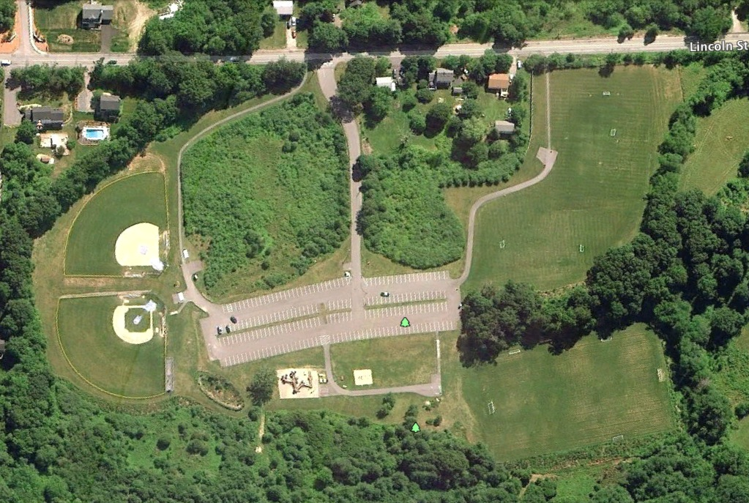
FRANKLIN YOUTH SOCCER ASSOCIATION – Dacey Field Layout – Spring 2012
Lincoln Street
Lincoln Street
Please DO NOT Park on Lincoln Street
Upper
Middle
Parking
Lower

