Slide 1
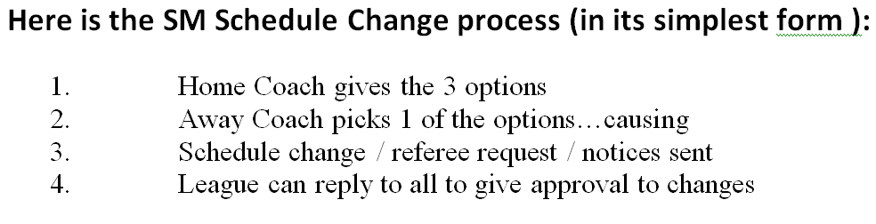
Rescheduling Summary

Slide 2
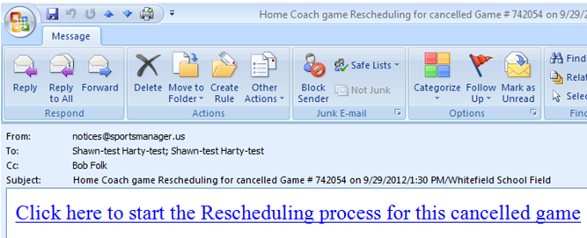
Rescheduling Home Coach Email

Slide 3
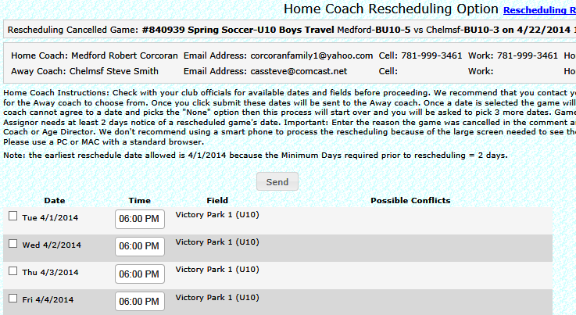
Rescheduling Home Coach Options

Slide 4
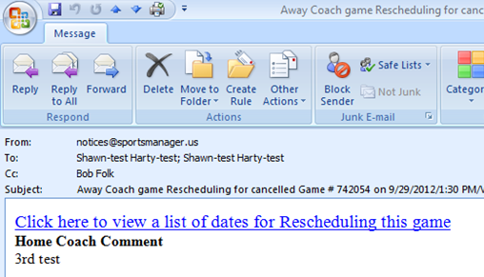
Rescheduling Away Coach Email

Slide 5
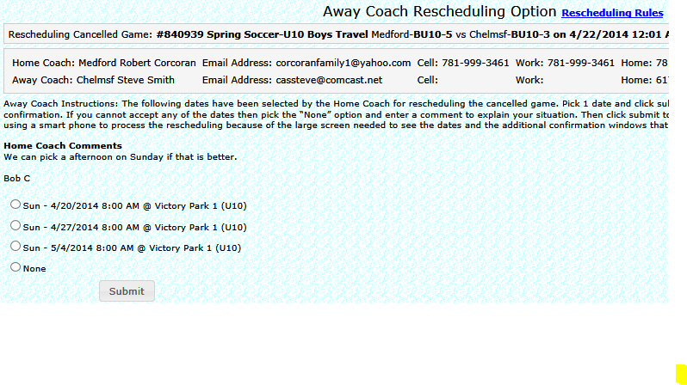
Rescheduling Away Coach Choice

Slide 6
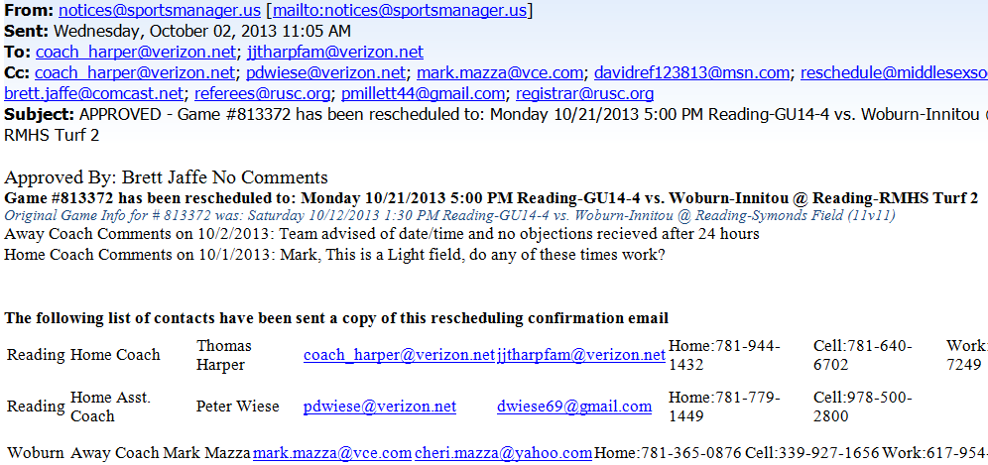
Final Approval Notice of Game Chg

