Slide 1
Automated Emails to the Coach
The roster will be emailed once Approved , you will get a notice if it becomes un-approved.
When you email parents the future game and practice schedule will be automatically appended.
You will get a email the day after the game to score the game. (unless scored before)
You will get an email to evaluate the refs day of game
Game Cancel Approval/Denial
Rescheduling Status/Approval
Game Change Notices to coaches and refs

Slide 2
Game Scoring, Ref Scoring, Referee Evaluations
Either coach can login and score the game the day of the game.
If the game is not scored an automatic scoring email is sent to both coaches the next day. They click the link to score the game.
The ref will also enter a score on the game report. If there is a difference it will appear on the score discrepancy page and the league admin can choose to use the coach or ref score.
Referee Evaluations done with automated email.

Slide 3
Referee Evaluations by Coaches
Each coach will receive an email after the game with a link to the referee evaluation form.
They click the link and then answer the evaluation questions.
Should be done by both coaches for each game.
Is done only for the Center Referee (not ARS)

Slide 4
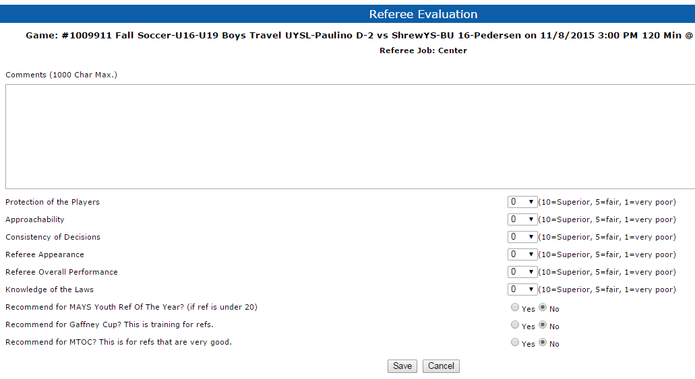
The Ref evaluation entry form

Slide 5
New - Coach Cancellation Request
Coach can click the “Cancel Request” button
Must enter the valid reason and be within minimum time requirements
This will send the request to MAYS
If MAYS Approve it the game is cancelled
Notices will go out and the game will start the rescheduling process
Email to Coach if Not Approved
Tracking in MAYS and Smgr Rescheduling Module

Slide 6
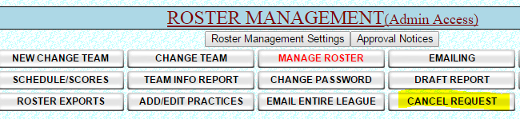
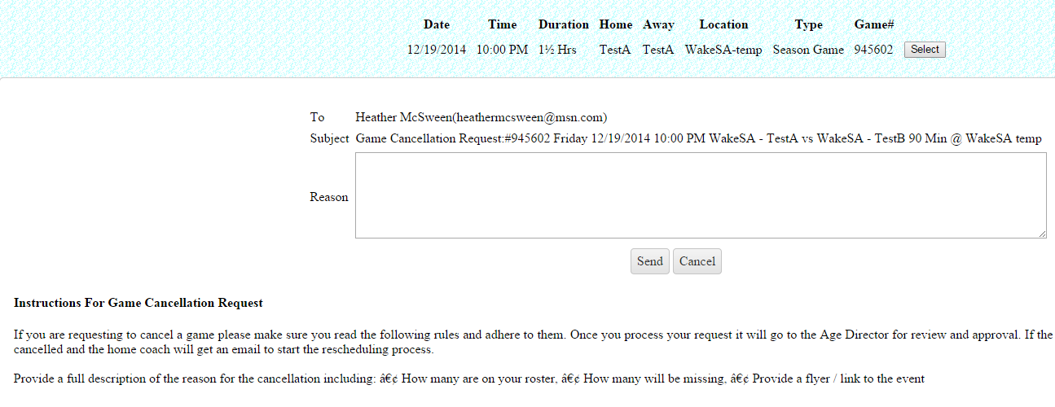
Game Cancellation Cont.
A page requiring the reason pops up for the Coach to fill out. Instructions and rules
Are displayed on the page so the coach knows what is required to Cancel.

Slide 7
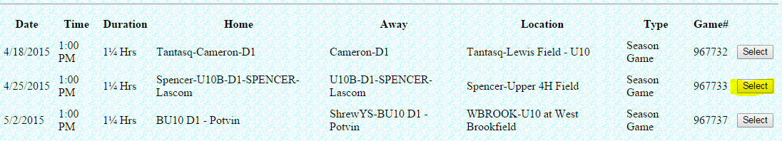
Game Selection page for cancellation request – Click the Select button

Slide 8
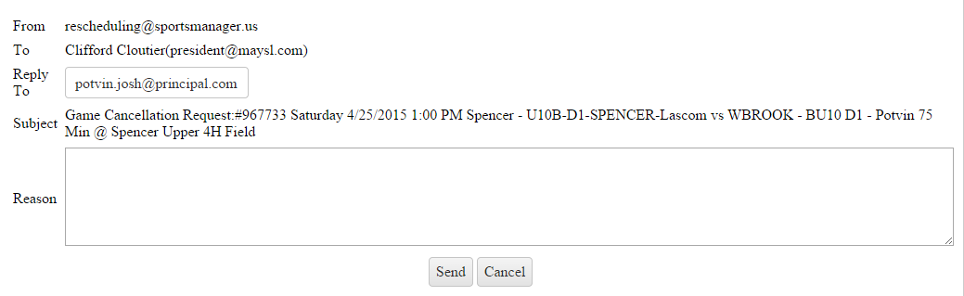
Enter reason for cancellation request and click send.

Slide 9
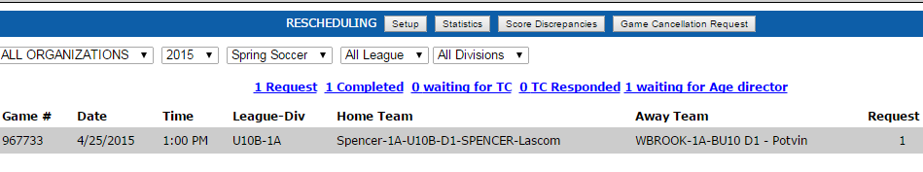
The request is shown in the queue on the MAYSL site as waiting for approval

Slide 10
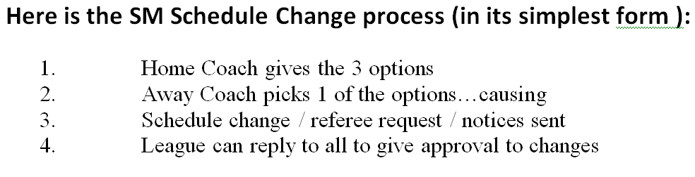
Rescheduling Summary

Slide 11
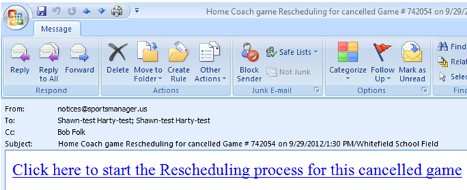
Rescheduling Home Coach Email

Slide 12
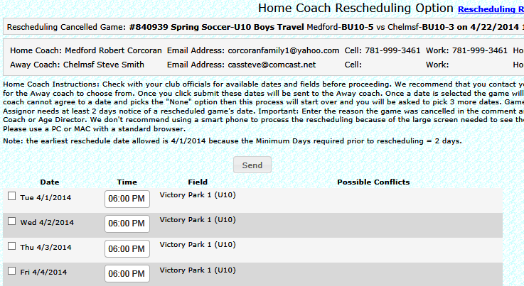
Rescheduling Home Coach Options

Slide 13
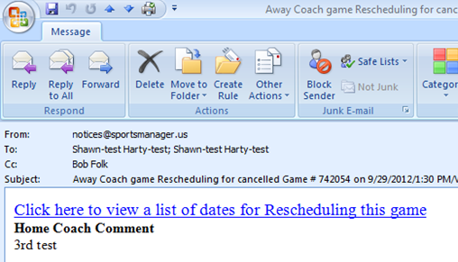
Rescheduling Away Coach Email

Slide 14
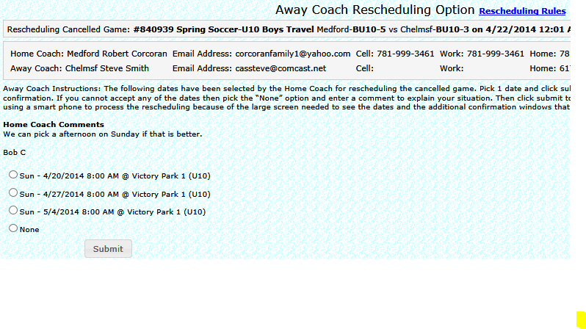
Rescheduling Away Coach Choice

Slide 15
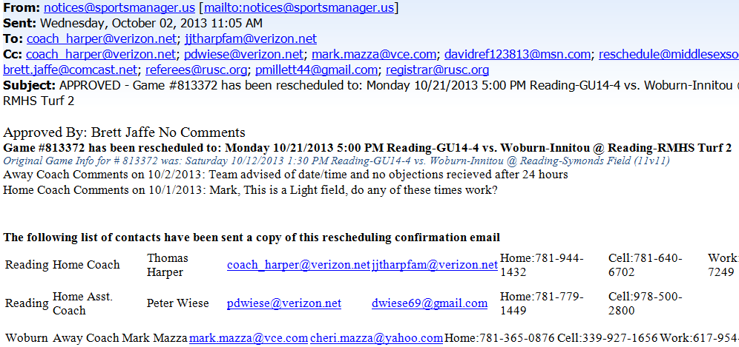
Final Approval Notice of Game Chg

