Slide 1
How to Blackout times you can’t Ref

Slide 2
Time Block
If you coach, ref or for any other reason you might not be able to ref on any given day you should be using the block out dates or time.

Slide 3

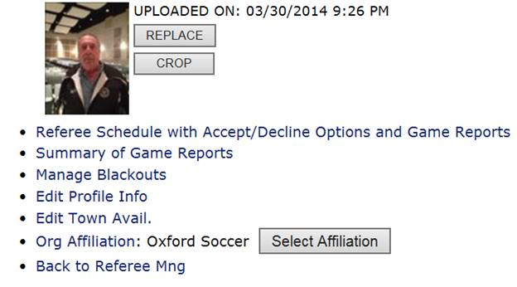
Time Block
First you need to login into your account and select “Manage Blackouts”

Slide 4
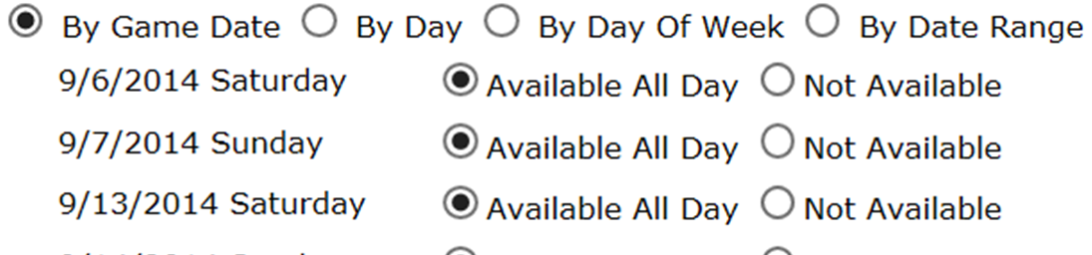
Time Block
You will get a list of days with games like below

Slide 5
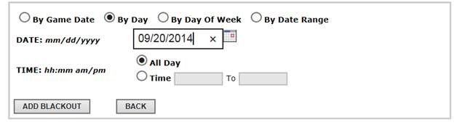
Time Block
If you are blacking out when your team plays click on a “By Day”, then another box opens. Now type in a date of your game you want to block yourself from reffing. I pick this weekend 9AM game.

Slide 6
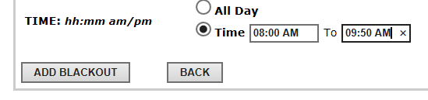
Time Block
Now on time hh:mm am/pm click on time. I put in 08:00 AM To 09:50
Now click on Blackout

Slide 7

Time Block
You now see this on that date.
You should not receive any games on 9/20 during the time of 8AM to 9:50AM

