Slide 1
MYSL Coaches Meeting
FALL 2017
AUGUST 30th, 2017

Slide 2
Introduction
Welcome all coaches
  U10-U14 Season starts 9/9 and ends on 11/4 - (9 game schedule)
The 2017/2018 MYSL Rule book is also available online at www.middlesexsoccer.org under [Forms/Docs/Files] tab
CORI/MYSA Registration – Every adult associated with all organizations who may have the opportunity to have direct and unmonitored access to children is required by state law to complete the CORI certification process.
http://www.mayouthsoccer.org/programs/cori/

Slide 3
Schedule/Rosters/Identification
Fall Game Schedule goes live tonight, on August 30th
  Scheduled Mid-Week games
    Mid-week games are placeholders only – these games MUST be treated as canceled games and coaches shall use the make-up game process to reschedule the match (see Rule 11).
MYSL Rule 17 (FALL SEASON)
  A certified roster shall be that roster approved by the appropriate Commissioner’s, have “APPROVED” in the title and a watermark diagonally across the page.
  All adult coaches, assistant coaches, town/league Board members (18 years old and older) that will be on the team’s sideline MUST display a valid 2017/2018 Mass Youth identification on a lanyard. The match referee shall remove all other observers to the parents sideline or bleachers.
  ALL coach(es) and assistant coach(es) will have in their possession a 2017/2018 town passcard for themselves approved by the appropriate Commissioner. Passcards shall be made available to the referee.

Slide 4
Roles and Responsibilities
Role of Age Director
  Let them know if you having any issues at the games
  Talk to them prior to canceling games
  Be prepared for cross over games
Role of Town Coordinator
  They are the town’s liaison with League officials
  The only ones that can Add and Remove players from teams/rosters
  They will cancel games in Sportsmanager as needed
Role of the Local Referee Assignor Fall Season – assigns all U10-U14 Center Referees and U10-U14 Assistant Referees

Slide 5
COMMUNICATION IS KEY
Coach to Coach (phone calls and emails)
  about games - date, time and verify field location
Coach to Parents (pre-season meeting)
  Your expectations - Game Day, Practices
  Code of Conduct
Coach to Players
  Expectations
  Code of Conduct
Coach to Referee
  NO COMMUNICATION – Rule 21
    except to indication a safety issue on the field or substitution

Slide 6
Code of Conduct
Coaches Code of Conduct & Parents and Players Guide to a Great Experience can be found online at www.middlesexsoccer.org under [Forms/Docs/Files] tab.

Slide 7
Rescheduling Games
Causes and what qualifies (Rule 11)
    i) A coach should know his/her players’ availability for the whole season; ignorance will not be accepted as an excuse. Legitimate reasons may include, but not be limited to:
      graduation,
      sanctioned invitational tournament, (Columbus Day Weekend tournaments for example)
      school trip, or
      religious activity.
    ii) Lack of players due to a vacation is not a legitimate reason to reschedule a game.
Rain Outs - Who is authorized to cancel games or close a field (Rule 12)
    Initial responsibility for determining the above lies with the home team’s administration (not the coach). A town organization (club or park’s department) can close a field or all of its fields for the full day up to when the referee starts the match or determines that the field is unplayable.
    After this, it is each game’s assigned referee’s responsibility to determine if a game can be played or continued
    Once a field is declared unplayable, it is closed for the day.

Slide 8
Rescheduling Games
Rescheduling Process (Rule 13)
    The home team coach must give the opposing coach three (3) reasonable dates, within seven (7) days of the original game date, on which the game may be made up. The make-up scheduling process in SportsManager is preferred or the home team coach will confirm the date, time and place for the make-up game by calling both the Age Director and the opposing coach at least three (3) days prior to the scheduled make-up date.
    In cases where both coaches cannot agree on a make-up date, the Age Director will have the authority to set the date, time and place of the make-up game.
    Games played without the prior knowledge and consent of the Age Director could result in a forfeit to both teams. Games not made up before the last weekend of the season will be ruled a forfeit for one or both teams as determined by the Age Director.
The Rescheduling procedure can be found on www.middlesexsoccer.org under [Forms/Docs/Files] tab.

Slide 9
Reporting score after your game
Process (Rule 26)
  The home and visiting team coaches and the match referee shall enter the results of each game in SportsManager (or call the Age Director if necessary within two (2) days of the completion of the match) to report the game results.
Wrong Score Entered?
  Contact your Age Director
  Once you input and save the score – coaches cannot change it
Age Directors
  The Age Director shall review the results posted on the websites and resolve any discrepancies. They are the only ones that can change/update a score. In cases where there is a discrepancy between coaches input – the referee’s score will take precedence.

Slide 10
Coaches Referee Evaluations
Referee Evaluations (Rule 31)
  Each coach is urged to complete a referee evaluation after each match. Referee quality is an important factor in the success of the program. It is only through the regular receipt of evaluations that the Referee Committee and the Board can actively monitor the referees.
  Referee ratings and no-show complaints should be submitted online to the Referee Coordinator using the proper procedure.

Slide 11
Adding/Removing players from your team
Process (See Rules 5, 6 and 7)
  The town coordinator is permitted to add players to a team’s roster any time prior to the roster freeze date in order to get to the maximum roster size. (See Rule 15)
    Note: Once the roster is at the max, only 3 adds will be allowed.
Timing
  Rosters are frozen on the first Tuesday in October for the Fall Season (See Rule 5)
Who can add/remove players from rosters
  Town Coordinators only – not the coach
  In order for a player to be removed from the roster, the town must provide the Commissioner a letter/email from the player’s parent/guardian stating the reason for the player leaving the team. (See Rule 5)

Slide 12
Game Day
On Field Specifics (Rule 16 and 17)
  Your team should arrive at the field 15 to 30 minutes prior to game time
  Players should be properly dressed to play, all have the same uniform with numbers, shin pads, socks and cleats. No jewelry or casts. If your player(s) are not properly dressed, the referee will not allow that player to participate in that match. (Law 4 – The Players Equipment)
  Coaches shall have two copies of the roster with the uniform numbers listed for each player and the Coach Passcards. (See Rule 17)
  If a coach forgets their roster, see Rule 17 approve roster substitutes (handwritten Game Day Roster)
Coaches, Players, Parents/Spectators and Expectations
  Codes of Conduct for coaches, players and parents/spectators
Zero Tolerance Policy/Sportsmanship
  Abusive and obscene language, violent play, violent conduct, fighting, harassment, intimidation/taunting, racial or ethnic slurs and other behavior detrimental to the game will not be tolerated and that player and/or coach will be immediately asked to leave the field. (See Rules 21, 22 and 23)

Slide 13
TOWN PLAYER PASS
Game Day Procedures for ‘Town’ Pass:
    Each coach will provide a roster to the opposing coach that indicates if using a ‘Town’ pass player from within their ‘Town’ and who the “’Town’ Player Pass” players are.
    The team official (coach/manager) must communicate their use of ‘Town’ pass players before the game or as soon as practicable following the game, to the:
        League Registrar, Age Director and Coach/Manager
    The coach shall give the referee two copies of the player’s original team roster in addition to the 2 copies of his/her team’s game day roster - indicating on the player pass player’s roster which player is playing up on the Player Pass.
    A team having a league match may select up to 4 players from within their own ‘Town’ to play for that team.
    The number of players on the sideline, however, may not exceed the maximum “game roster” roster size.
Town Player Pass can now be accessed online at the Coach’s Login area – see the following slides for more info.
Please see the instructions at the back of the Rule Book. The rule book can be found on www.middlesexsoccer.org under [Forms/Docs/Files] tab at the top of the page.

Slide 14
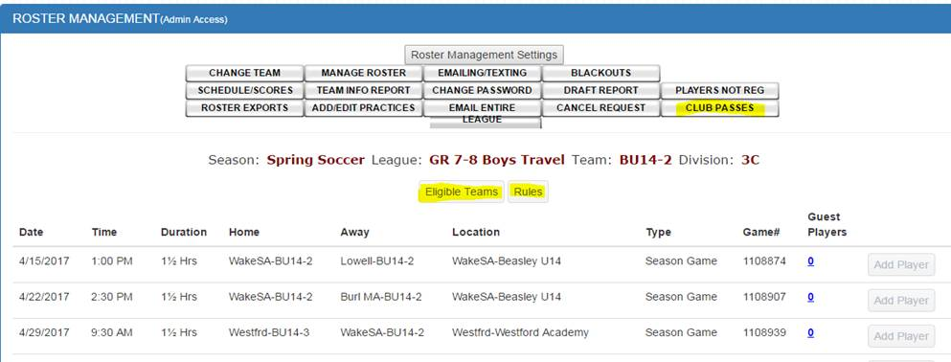
COACHES CAN SELECT/CREATE THE CLUB PASSES
After the coach logs into their teams Roster Mng page, they will click the “Club passes” button they see the list below which shows how many passes they have already used and they click “Add Player” to add new guest players to future games.
Once they click Add Player and select an eligible team to add players from then they see this page:
The yellow area shows how times the player has already guest played for this team in the column for TEAM (this value cannot exceed 3), how many total guest games they played in for the SEASON (this value cannot exceed 6) and how many GAMES they are already playing on this date where they are looking for players. This number cannot exceed 2. In this case the player below Michael Arria cannot be selected since he is already playing 2 games that day, 1 for his regular team, one as a guest player. The program is also already checking to make sure not more than 4 players can be selected for a game and they cannot conflict with existing games.

Slide 15
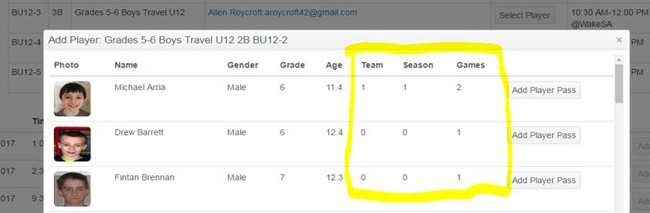
Please review the “Rules” below. This shows the coach what the rules of player selection are.
Keep in mind that the software automatically enforces all rules. As long as the software is working correctly and the rules are set up correctly there shouldn’t be any errors.

Slide 16
Rules for Player selection for Club Passes
The Club passes module for this league is: On
Club passes is the ability for a coach to select players from other teams in their town/club organization to guest play at a specific game. Club passes can be selected by the Coach or site administrator by logging in as the coach and clicking on "Club Passes" or login as admin and click on Roster mng, then click on the Club Passes Button. All rules and min/max requirements stated below are automatically enforced by SportsManager. Reports for Club Pass usage are available at the League level to see total passes per player or team, etc.
Age group/League Restrictions:
Current League/Age Group: Yes Note: Division selected from can be the same division or lower
Younger Age group: Yes Note: Division selected from can only be one Div. higher, I.e. Div 4 can select from Div 3 but not Div 2 or 1
Same Gender Groups: Same Note: Male teams can select from other Male or Female teams, Female from Female teams only.
Player Restrictions: Note: Cannot exceed max roster size requirement
Max Players selected per game: 4
Max Team Size Restriction: Cannot exceed max roster size requirement
Players selected per team: 3 (A player can be a guest player up to 3 times for a team)
Max Guest Games per Player: 6 (A player can guest play up to 6 times per season)
Max Games per day: 2 (A guest player cannot exceed 2 games per day, their own team plus a guest team)
Please note: The current team the player is on and the games they are scheduled for will take priority. Player Pass games must end an hour before or start an hour after existing team games.

Slide 17
Lightening/Severe Weather Conditions
1. Lightning
  a. Recognizing the threat (1) Apply the 30-30 rule When you see lightning, count the time until you hear thunder. If this time is 30 seconds or less, seek proper shelter. If you can't see the lightning, just hearing the thunder is a good back-up rule. Wait 30 minutes or more after hearing the last thunder before leaving shelter. (2) Know and heed warning systems and community rules Many communities or park systems have lightning detection and warning systems. Use this information and obey the rules established by the community or park system. (3) Know and apply the rules or procedures established by the competition authority (4) Minimize the risk of being struck Protect the safety of all participants by stopping game activities quickly, so that participants and spectators may retire to a safer place before the lightning threat becomes significant. Remember, if you can hear the thunder, you are within reach of lightning.
  b. Seeking proper shelter (1) No place outside is safe near thunderstorms (2) The best shelter is a large, fully enclosed, substantially constructed building. A vehicle with a solid metal roof and metal sides is a reasonable second choice.
  c. If there is no proper shelter, avoid the most dangerous locations: Higher elevations; wide open areas, including fields; tall isolated objects, such as trees, poles, or light posts; unprotected open buildings; rain shelters; bus stops; metal fences and metal bleachers.
  d. If you cannot avoid these locations, crouch down on the balls of your feet, with your head tucked into your chest and your hands over your ears. If someone is hit, remember that all deaths from lightning result from cardiac arrest and stopped breathing. CPR and mouth-to-mouth resuscitation, respectively, are the recommended first aid. Referees should become involved in such assistance only if they have proper training. e. Remain calm. A calm official will often be able to prevent panic by young players.
2. Other types of severe weather For all other types of severe storms, such as tornadoes, hurricanes, and hail, obey local rules and heed warnings. Clear the field and seek proper shelter immediately – see above. Remember, according to standard weather warning terminology a "warning" represents a more immediately likely occurrence than a "watch."

Slide 18
U10 Rules - Reminders
Rules for U10s
  U10’s
    A match is played by two teams, each consisting of not more than seven (7) players (7V7), one of whom is the goalkeeper. A match may not start, or continue, if either team consists of fewer than five (5) players who are able to play.
    The Offside rule will apply in an under-10 match
    Keeper distributions (punts, drop kicks and throws) may not travel in the air over the halfway line. An Indirect free kick from midfield is awarded to the other team if this happens.
    The Goal Kick - Opposition players to retreat into their own half of the playing field on goal kicks. The team taking the goal kick does not have to wait for the opposition to retreat and has the option to restart the game beforehand should they so choose. The ball is in play when it is kicked directly out of the penalty area.
    A good rule to understand: No penalty kicks shall be awarded to or taken by either team. All fouls committed inside the penalty area that would normally result in a penalty kick will be moved outside the penalty area to the point parallel to the goal line closest to where the foul was committed and a direct free kick awarded.
    Please remember – NO HEADING

Slide 19
Concussion Awareness
MYSL strongly encourages all coaches to take an online concussion course to further educate oneself to recognize, respond to, and minimize the risk of concussion or other serious brain injury.
Coaches and Parents
  http://www.mayouthsoccer.org/coaches/concussions/
Concussions are a serious health concern in youth sports. We’re committed to the safety of our players and to educate our players, parents, coaches, referees and administrators in the dangers of concussion-related injuries.
  http://www.cdc.gov/headsup/index.html

Slide 20
Other Notes
Understand the league and competition level
Download and Read the MYSL Rule Book – It can be found at www.middlesexsoccer.org under [Forms/Docs/Files] tab.
If there is one take away we want you to carry with you and that is:
  Communication is key

