Slide 1

Malden Youth Soccer Association
Coaches meeting
August 22, 2019

Slide 2
Agenda
Administrative
  CORI/Concussion Training/Abuse Training
  Zero Tolerance Policy
  Middlesex Rule Changes
Events
  Malden Night at the Revolution
  Revolution Player Q&A/Meet & Greet
Logistics & Sportsmanager Overview
Development
  Coaches Training
  Friday night Clinics (U10, U12, U14)

Slide 3
Administrative Topics

Slide 4
CORI/Concussion & Abuse Training
Online through Stack Sports Connect – email link from Helen Murphy/Registrar
Mandatory to complete before start of season – takes approx. 2 hours
CORI badges from Spring 2019 will be used until new badges can be printed at the end of September. New coaches will receive a coaches card with a green sticker on the bottom – must display that at all games

Slide 5
Zero Tolerance Policy (Rule 21 MYSL)
It is the responsibility of ALL coaches to maintain the highest standards of conduct for themselves, their players and spectators (supporters) in all matches. Abusive and obscene language, violent play, violent conduct, fighting, harassment, intimidation/ taunting, racial or ethnic slurs and other behavior detrimental to the game will not be tolerated. A coach’s responsibility for referee support and spectator control includes the times prior to, during and after the game at the field and surrounding areas. Failure to do so will undermine the referee's authority and has the potential of creating a hostile environment for players, the referee and all other participants and spectators
Therefore, the basic policy is that persons responsible for a team and spectators will not address the referee at all during the play of the game.
  Exceptions for persons responsible for a team (Coaches and Assistant Coaches) During the game:
    Responding to a referee initiating communication
    Making Substitutions
    Pointing out emergencies or safety issues
  Exceptions for Spectators: During the game:
    Pointing out emergencies or safety issues

Slide 6
Middlesex Rule Changes
Substitutions can now be done on any stoppage in play
Middlesex Rule Book will be updated and available next week for the official wording

Slide 7
Events

Slide 8

MYSA Night at the Revs

Slide 9
Revolution Player Q&A - Meet & Greet
Hosting an intimate player appearance for U14 age group and up
Who: TBD – asked for one of the top players (Diego Fagundez, Carles Gills)
When: September 9, 2019
Time: 7:00 pm to 8:30 pm
Where: South Broadway Field
Format
  Discussion about the path to becoming a professional soccer player in the MLS
  What it’s like to play in the MLS – commitment, workout regimen, diet, etc.
  Q&A Session
  Meet & Greet – Autograph’s, 1 on 1 time

Slide 10
Logistics & Sportsmanager Overview

Slide 11
U14 Fall Season
(Cam)
Good practices/Basic things to remember
Educating and helping our Parents understand
Developmental goals/ Upcoming Coaching Sessions take away

Slide 12
Good practices/ basic things to remember
Practice
  Try to arrive before your players whenever possible
  Keep your practice organized, have your practice written down
  After practice, if no one is using the goals or box, lock everything down
  Cleanup after yourself
Games:
  Ask your players to arrive 45 minutes prior to game start
  If playing home and opening the field, arrive at least 15 minutes earlier than your players, as you will need to setup the field.
  If closing, or have last game: put away nets (lock against fence), sand bags, and corner flags. If you don’t see anyone, or other teams getting ready for the next game, especially your age group, you are the last team.

Slide 13
Educating and helping our Parents understand
How can we help our parents understand and cooperate with us?
  Have a parents meeting if possible
  Get to meet your parents
  Let them know what to expect
  Learn about their expectation and goals
  Get them to understand your philosophy, approach and so on…
Provide Documents, information and keep your parents updated:
  League info
  Up coming events
  Weekly game and practice information
  change to the schedule and so on

Slide 14
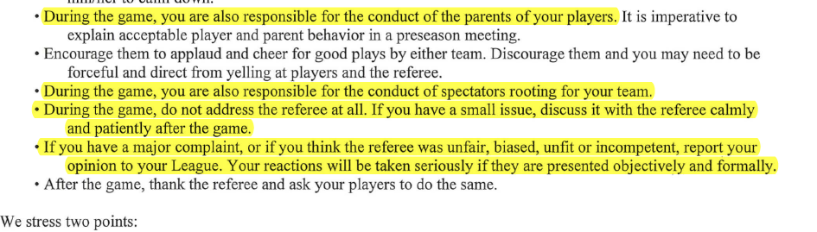
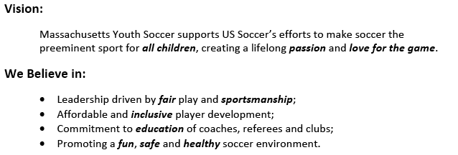
Two important documents to provide to parents
  MYSA/Malden Youth Soccer code of Conduct
  Massachusetts Safe Soccer Policies

Slide 15
Developmental goals/Upcoming coaching sessions take away
  Grass root Coaching Session what to expect
Play Practice Play Methodology (PPP)
Organized
(is the activity organized in the right way?)
Game Like
(Is the activity game like?)
Repetition
( is there repetition, when looking at the overall goal of the session)
Challenging
(Are players being challenged?)
Coaching
(Is there effective coaching, based on age and level of players)

Slide 16
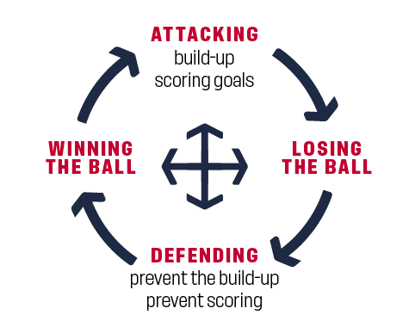
Grass Root Road Map

Slide 17
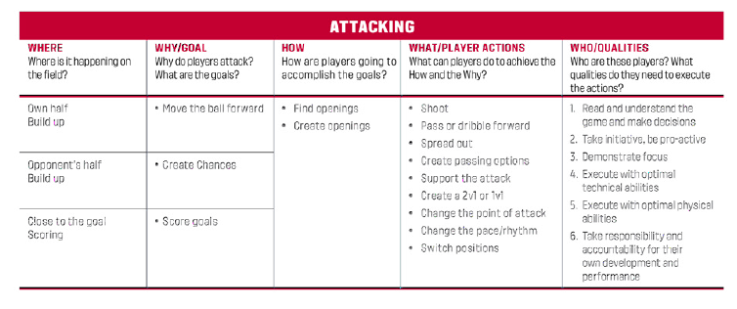
Attacking GRM

Slide 18
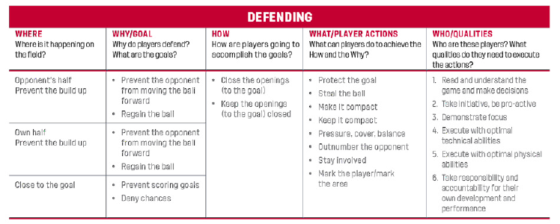
Defending GRM

Slide 19
A few suggestions:
  Make practice inclusive: Make sure all your players participate and contribute one way or another
  Use guided questions instead of telling players what to do
  Find out about what they were thinking before make a suggestion/correction
  Meet them at their own level; see the game through their eyes, not yours
  Goals
  Create at least 3 team goals
  Make sure players participate in creating those goals
  Each player should have at least 2 individual goals (things they would like to improve upon)
THANKS

Slide 20
Sportsmanager Overview
Player/Parent contact information
Emailing
Schedule
Game Scoring and Referee Report

Slide 21
Development

Slide 22
Coaches Training Sessions
August 24, 2019
  What: 7 v 7
  Where: Community Room, Malden Police Station
  Time: 9am to 1:30pm
  Registration Link: https://learning.ussoccer.com/coach/courses/available/21/details/5073
September 7, 2019
  What: 4 v 4
  Where: Linden School
  Time: 9am to 1:30pm
  Registration Link: https://learning.ussoccer.com/coach/courses/available/21/details/5101
September 8, 2019
  What: 9 v 9 / 11 v 11
  Where: Linden School
  Time: 9 v 9: 9am to 1:30pm / 11v 11: 2:30pm to 6:30pm
  Registration Link 9 v 9: https://learning.ussoccer.com/coach/courses/available/21/details/5100
  Registration Link 11 v 11: https://learning.ussoccer.com/coach/courses/available/21/details/5099

Slide 23
Friday Night Clinics (U10, U12, U14)
What: Skills Clinics being run by New England Futbol Club (NEFC) with professional coach
When: Every Friday, September 6 – November 1
  U10: 6pm – 7pm
  U12 – U14: 7pm – 8pm
Where: Linden School
Content: Various skills will be worked on during the 9 week clinic like striker, shooting, dribbling, defending, defending in groups, 1 v 1, 1 v 2, learning about different formations, etc. Players will walk away with a well rounded set of skills.
Great compliment to regular weekly practices
Good opportunity for coaches to come down and observe

