Slide 1

MYS Coaches Training
For U12 Coaches
U12 Director: Javi Bauer
Contact Info: javi@javibauer.com

Slide 2
What is our mission?
Our mission is to develop players to their full potential through game-like experiences in an enjoyable environment that supports individual growth.

Slide 3
What is your coaching philosophy?
What is a coaching philosophy? A coaching philosophy is a set of values that reflects the standards you set for yourself and your team -
and it serves as the foundation for your coaching approach.
When setting up your team’s philosophy think about:
Your personal values
Our mission
The kids age
Their technical abilities
Your season’s goals
Make it FUN!

Slide 4

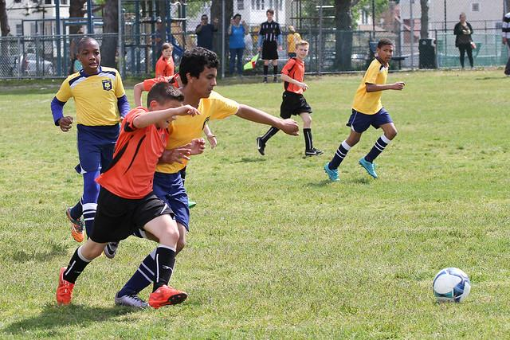
Developmental Goals
They need to learn the fundamentals given his/ her role, position, and tasks in a 9v9 team.

Slide 5
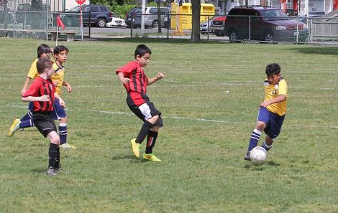
Developmental Needs
Gaining fundamental understanding of the meaning of role, position and task in a team
Experiences in game-like situations for the task of attacking and defending
Experiences of position specific task execution during defending and attacking

Slide 6
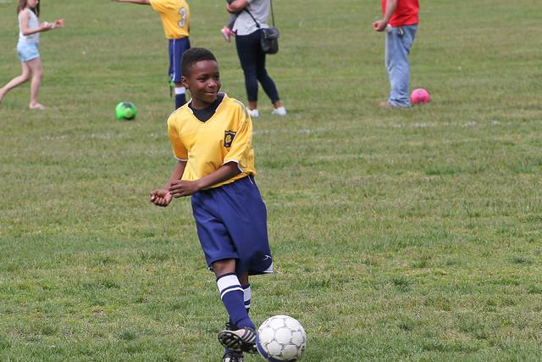
Key Qualities
U9/10 Player Qualities:
Aligns own actions with the other players, positions
Challenges opponents
Deals with adversity
Is proficient in 1v1 situations to create or to steal/regain the ball
U12 Player Qualities:
Remains calm and composed
Is technically proficient to be effective
Is coordinated in their movement
Is adaptable and flexible in dealing with (unexpected) challenges and problems
Articulates their own learning needs

Slide 7
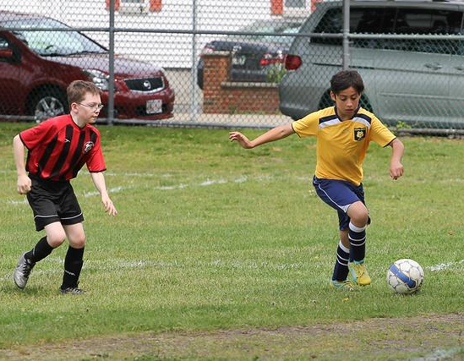
Attacking Player Actions
U6
Shoot
Pass or dribble forward
U7
Spread out
Create passing options
Support the attack
U9/U10
Create a 2v1 or 1v1
Change the point of attack
U12
Change the pace/rhythm
Switch positions

Slide 8
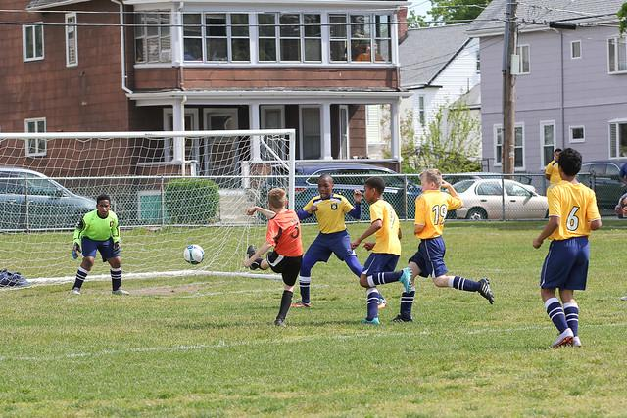
Defending Player Actions
U5
Protect the goal
Steal the ball
U7
Make it compact
Keep it compact
U9/U10
Pressure, cover,balance
Outnumber the opponent
U12
Stay involved
Mark the player / mark the area

Slide 9
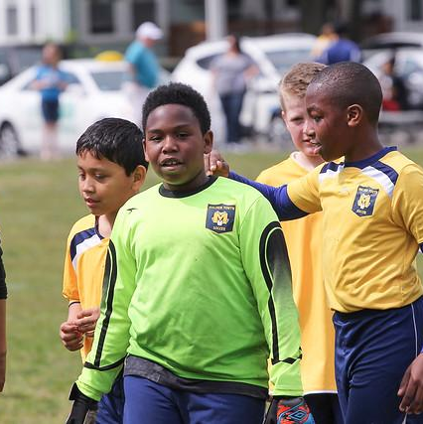
Player Behaviours
Ready and eager to learn
Will try more complex tasks
Notice indifferences and unfair treatment
Players will develop at different rates (gender differences in maturation)
Like to organize themselves without the coach

Slide 10
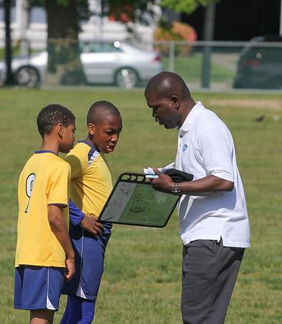
The coach should:
Come to training prepared with ideas to guide your players
Encourage players to be creative and try new things
Be consistent in what you say and how you treat individuals/the team
Organize groups to guarantee fun and challenge for every player
Support their being independent and self-responsible

Slide 11
Drills & Educational Resources
Mass Youth Soccer Session Plans
US Soccer Coaching Resources
SoccerXperts
YouTube

Slide 12
Soccer Dictionary
Ball: the main piece of equipment used in soccer
Goal: the target players shoot the ball in to score a goal (offensive/ defensive)
Shin Guards: protective gear worn that covers the area between the ankle and the knee
Referee: the person on the field with the whistle who makes sure everyone follows the rules
Substitution: substituting/switching players on the field for those waiting on the sidelines
Kick Off: game starts off with a “kick off” at the center of the field, the visiting team starts with the ball. The team has 2 players lineup on the half line (opposing players must stand at least 5 ft away). One player passes to the other player OR kicks the ball into the opposing team’s half. Double touches are not allowed. The ball must travel one full revolution to count
Out of Bounds: when the ball travels out of the field of play
Free Kick: a free kick restarts play after an out of bounds, hand ball or a foul
Kick-In: ball goes out of bounds along the sideline by one team, play stops. The team who did not kick it out will kick-in the ball at the spot where it went out. If the kick does not go inbounds, it will be retaken
Goal Kick: a free kick taken by the defense when the offense kicks the ball out at the goal line. Ball is kicked in from the side of the goal where the ball went out and 5 ft off the goal line
Corner Kick: a free kick taken by the offense when the defense kicks the ball out at the goal line. Ball is kicked from the corner where the sideline and goal line meet closest to where the ball went out

Slide 13
Soccer Dictionary ( Part 2 )
Offense/ Forward: position on the field that lines up closest to the half and tries to score goals
Defense: position on the field that lines up closest to the team’s goal and tries to stop the other team from scoring
Goal Side: defensive player’s body is positioned between the doal they are defending and the other team’s forward
Shoot: term used a player kicks the ball at the net trying to score a goal
Pass: term used when a player kicks the ball to a player on his own team
Dribble/ Dribbling: using your feet to move the ball around the field.
Sideline: the lines that run along the side of the field
Goal Line: the lines that run across the ends of the field on which the goals are placed
Half Field/Center Circle/ mid-field: the line that runs across the middle of the field from one sideline to the other. Kick offs happen from this line. On a soccer field, there is also a circle that identifies the middle of the field.
Foul: fouls are called when a player makes a mistake or breaks a rule. The team not making the mistake gets a free kick
Hand-Ball: when a player touches the ball with their hands to stop or redirect the ball
Good Sportsmanship: when a player wants to make sure that everyone is having fun and playing by the rules. A good sport will congratulate another player on your team or the opposing team for doing something well (example: “Nice Goal!”. A good sport will check to make sure another player is OK when they are hurt. A good sport will say I’m sorry if they accidentally bump or if the ball hits them. A good sport will ALWAYS line up after a game and shake hands and say “GOOD GAME” to the other team- no matter if you win or lose.

