Slide 1




Mansfield Youth Soccer 2nd Grade 7 v 7 Development Plan

Slide 2
©Kraft Soccer LLC, 2019
The following content is the copyright of Kraft Soccer LLC and certain of its affiliates. All rights reserved. This content, or any portion thereof, cannot be reproduced, modified, transferred, distributed, republished, posted or transmitted in any form or by any means without the express, written consent of Kraft Soccer LLC. Unauthorized use and/or duplication of this content is strictly prohibited.
Copyright

Slide 3

It is important to note what we are trying to achieve within a season so we can re-evaluate at the end to see if we have accomplished our goals. The pathway to success depends on how well we execute the follow philosophy in every session we take:
• To help each 2nd grade player to reach their full potential in the sport of soccer.
• To develop players that are comfortable with the ball at their feet
• To Improve each players knowledge and understanding of the game.
• To create a positive and fun atmosphere where players can learn and develop at their own pace.

Slide 4

•Heel / Toe Roll : - Roll ball up and down sole of foot from heel to toe keeping contact with the ball at all times
•Inside Outside Roll : - Same but now but moving ball from inside to outside of sole of foot
•Circle Roll : - Moving ball with same foot in a circular motion
•Front foot Dribble :- Small touches using the front of the foot only (laces)
•Big Toe / Little Toe : - Move ball with Inside of big toe, followed by outside of little toe in a zig zag fashion
•Big Toe, Big Toe / Little Toe Little Toe :- Same but now 2 touches with big toe followed by two touches of little toe
•Side Sprints:- Ball in between feet moving ball from side to side in a pendulum fashion
•Side Sprints forwards / backwards :- Same but now moving ball forwards and backwards
•Side Sprints Side to Side :- Now move body to left whilst performing 3-4 side sprints and then back to the right in a zig zag
•Pull Push :- Pull ball back from heel to toe and push forward with the laces
•Pull Push Inside / Outside :- Pull ball across body using the pull and out of body using the push, repeat both sides
•Pull Push Behind :- Pull ball to side & behind standing foot and using inside of big toe push across to control with other foot
•Side sprints w / pull push combo :- As described above
•Sole Taps :- Little touches on ball using front of the sole of the foot
•Sole Taps forwards / backwards :- Same, moving ball backwards and forwards
•Sole Taps w / pull push behind combo :- Same but now add a pull push behind
•Sideways Rolls :- Body square to the ball, roll whole foot over the ball inside of foot first and quickly repeat
•Sideways Rolls change over left to right :- Same but change ball from left to right with a roll across body
•Sideways Rolls w/ roll over step over :- Same but now roll across body while performing a step over
•Figure 8 dribbling :- Dribbling ball in a figure 8 between two cones

Slide 5
Movement Sheet
Dynamic Movements
•Heel Flicks
•High Knees
•Open Gate
•Closed Gate
•Inside Volley
•Left leg to right arm
•Side to Sides (left to right)
•Karaoke
•Arms across body
•Arms up and down
•Arm Circles Forwards
•Arm Circles Backwards
•Arms Side to Side
•Quick sprint, hamstring stretch
•Lunge
Fast Footwork
•Side to Side Shuffles Forwards
•Side to Side Shuffles Backwards
•Forward / Backward Shuffles
•Two Feet in Sideways
•Two Feet in Forwards
•One Foot in Forwards
•Figure 8 forwards
•Forwards 2, Backwards 1
•Feet together jump & bounce forwards
•Feet together jump & bounce sideways
•Feet together jump & bounce forwards 2, backwards 1

Slide 6

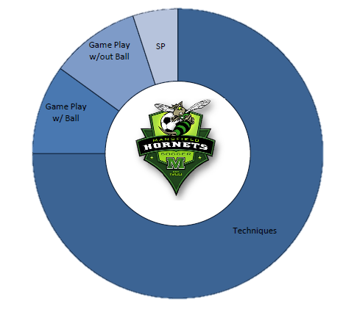
7 v 7 Development Band
Development Band
Te c h n i q u e s :
B a l l Ma s t e r y
Turns
R e c e i v e s
C omb i n a t i o n P l a y
C r e a t i n g S p a c e
Game Play With Ball :
Build Up
Unbalance
Finishs
Game Play Without Ball :
H i g h P r e s s u r e
C o l l e c t i v e D e f e n d i n g
D i r e c t i n g P l a y
Sports Performance :
P h y s i c a l
P s y c h o l o g i c a l

Slide 7
Session Plan
Each session will follow the same format. The format is designed to get the player into game situations right from the start of the practice. There are 4 phases that the session will go through, progressively getting more challenging and competitive:
1. Related Warm-Up (Ball work/Dynamic x3, 90 seconds each)
2. Small Sided Game (3 sets of 4 minutes)
3. Expanded Small Sided Game (2 sets of 7 minutes)
4. Game (2 half’s 25 mins) the timings are only recommendations.
IMPORTANT: Keep explanations short. Keep the players active. NO LAPS! NO LINES! NO LECTURES!

Slide 8
Educate – Connect - Inspire
Session One: Dribbling
Change of Direction

Slide 9
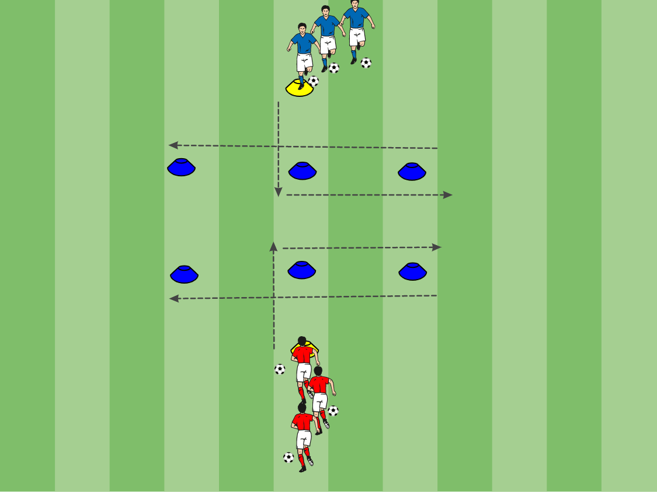
Turning Dynamic
Area: Two starting points are 10 yards apart (yellow cones) , Blue cones are 5 yards in from start point and run 10 yards in length
Description: 2 groups of 3/4 maximum players. Both players dribble in to the central cone, turn up to desired cone, turn back and speed dribble to the final cone. Change routine as needed. (Groups alternate Ball work/Dynamic/Ball work/Dynamic/Ball Work /Dynamic ) Check movement sheet for dynamics.
Progression: Use the other foot Make it a race
Coaching Points: Drive quickly with ball (Pace, Power and Purpose), Turn sharply with as few touches as possible, Always protect the ball, Scan before turning

Slide 10
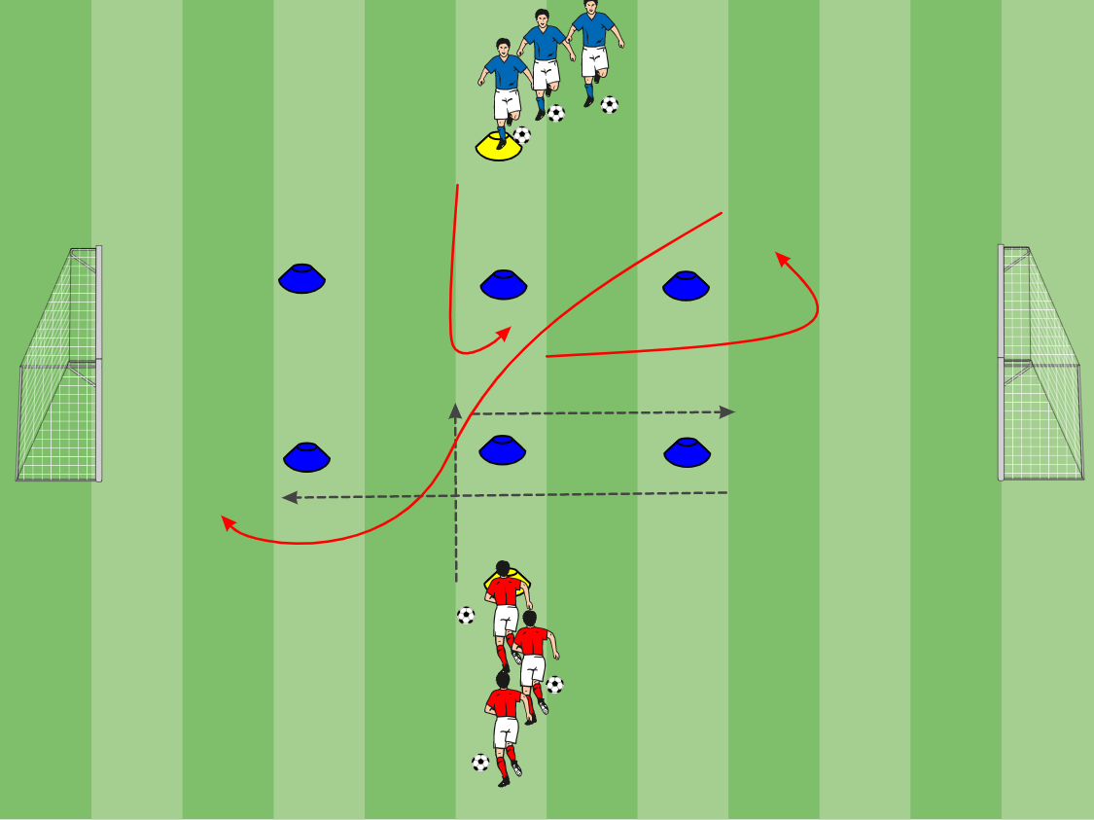
1 v 1 Turning to Goal
Area: Two starting points are 10 yards apart (yellow cones) , Blue cones are 5 yards in from start point and run 10 yards in length. Goals are a further 5 yards back.
Description: 2 groups of 3/4 maximum players. One player dribbles in to the central cone, turn up to desired cone, turn back and speed dribble to the final cone before scoring in the goal. One defender does the same movement but without the ball and defends the goal. If they win possession, they can counter into the other goal.
Progression:
Change routine,
Force change of direction moves
Coaching Points: Drive quickly with ball (Pace, Power and Purpose), Turn sharply with as few touches as possible, Always protect the ball, Scan before turning

Slide 11
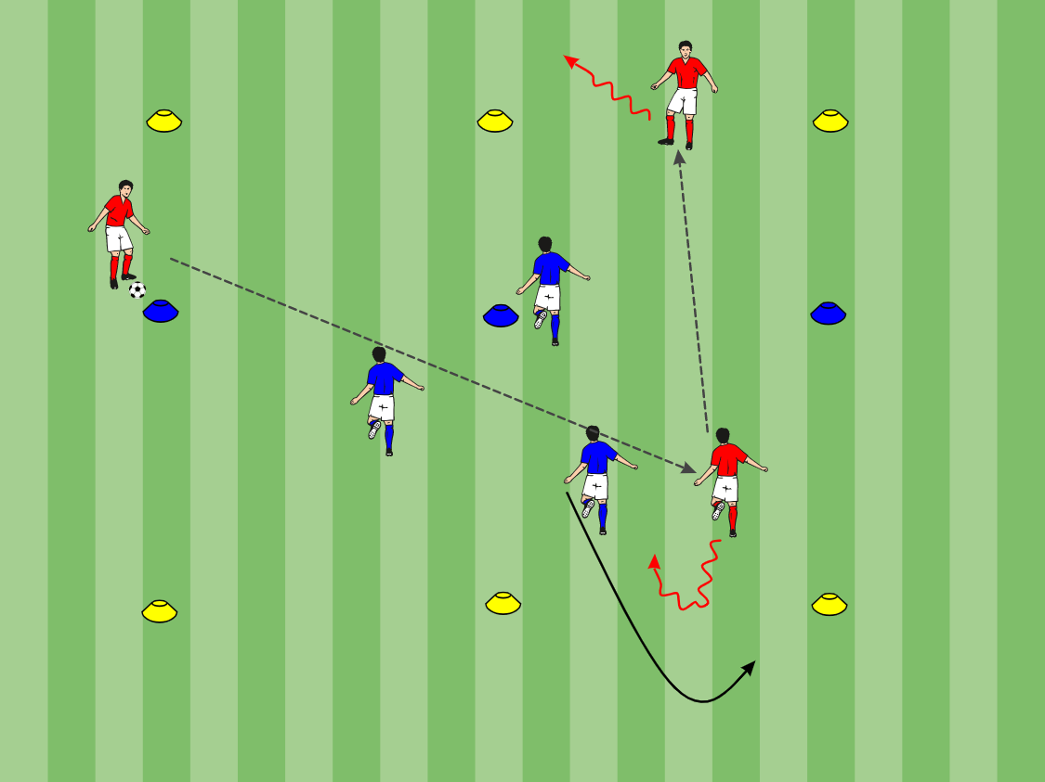
3 v 3 Turning End Zone
Area: 20x30 yard grid
Description: Separate group into teams of 3, place 2 teams on 1 field. This is a regular game of soccer however to score a goal players do not shoot to a goal, they must dribble into the end zone. There is a halfway line in this game which allows teams, once crossed, to double back and attack the end zone they were originally defending.
Coaching points: Be positive, be creative, utilize teammates and understand where to speed dribble and where to keep the ball close.

Slide 12
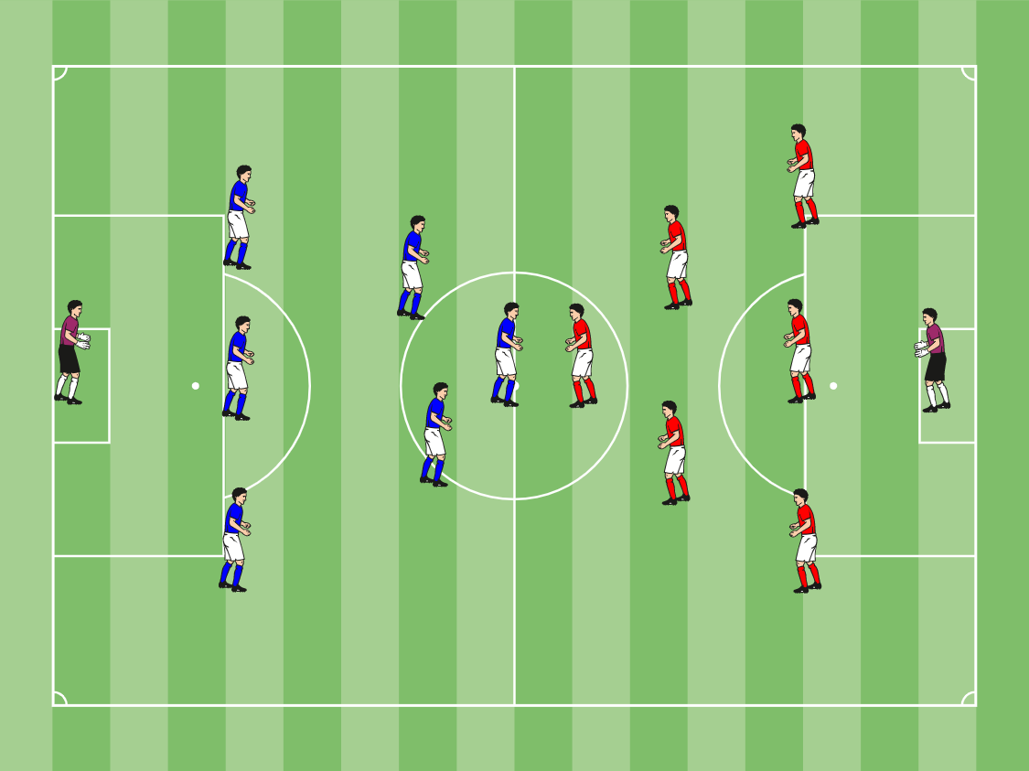
7 v 7 Game
Area: 50x30 yard field
Description: Games should be played 7v7, This is a regular soccer game.
Progression: Conditions can be implemented to force skills to be performed.
Coaching Points: Re-enforce Coaching Points from this session and recap from previous sessions, now is the time to demonstrate some game situations but it is very important that you let the game flow.

Slide 13
7 v 7 Game
Area: 50x30 yard field
Description: Games should be played 7v7, This is a regular soccer game.
Progression: Conditions can be implemented to force skills to be performed.
Coaching Points: Re-enforce Coaching Points from this session and recap from previous sessions, now is the time to demonstrate some game situations but it is very important that you let the game flow.

Slide 14
Educate – Connect - Inspire
Session Two: Passing With Purpose

Slide 15
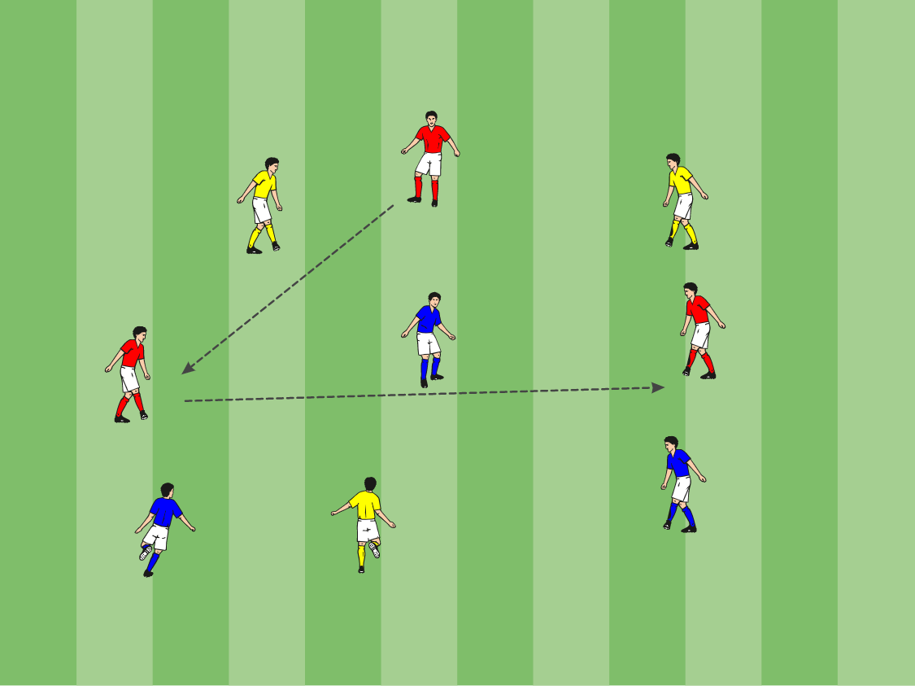
Colored Passing
Area: 20x30 yard grid
Description: Separate team into 3 groups, each with a different color pinnie. Player must pass and move around the grid, encouraging 2 touch play. Yellows pass to yellows, reds to reds and blues to blues. (Groups alternate Ball work/Dynamic/Ball work/Dynamic/Ball Work /Dynamic ) Check movement sheet for dynamics.
Progressions:
Make players pass in a colored sequence (red to blue to yellow to red).
Players must perform a combination play (overlap, wall pass).
Players must perform lofted pass.
Coaching points: Balanced body position, lock ankle, head steady, follow through in direction of target. After a pass the player MUST run to a different area of the grid.

Slide 16
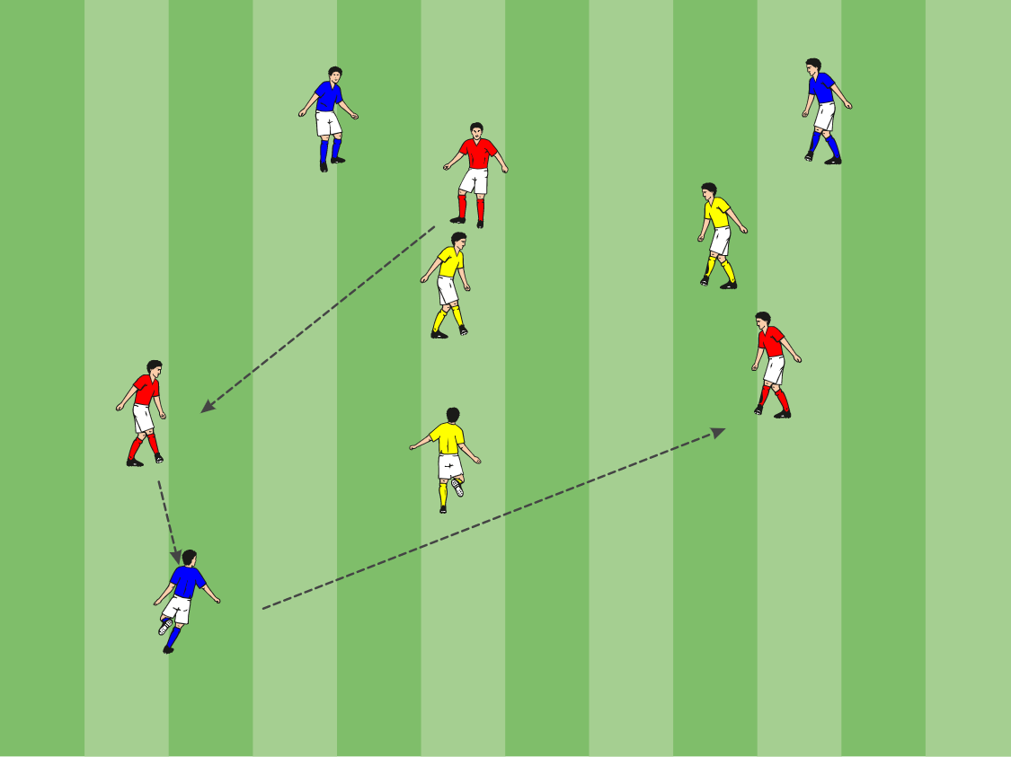
3 v 3 + 3 Passing
Area: 20x30 yard grid
Description: Separate group into 3 teams. 2 teams will try to keep possession of the ball while the other team will be defending. Whichever player makes the mistake to lose possession then their team becomes the new defenders.
Progressions:
Players get 1 point for each completed pass.
Players get 2 points for splitting the defense. Players get 3 points for completing a lofted pass.
Coaching points: Relax in possession, balanced body position, lock ankle, head steady, follow through in direction of target. Communicate to help the player on the ball

Slide 17
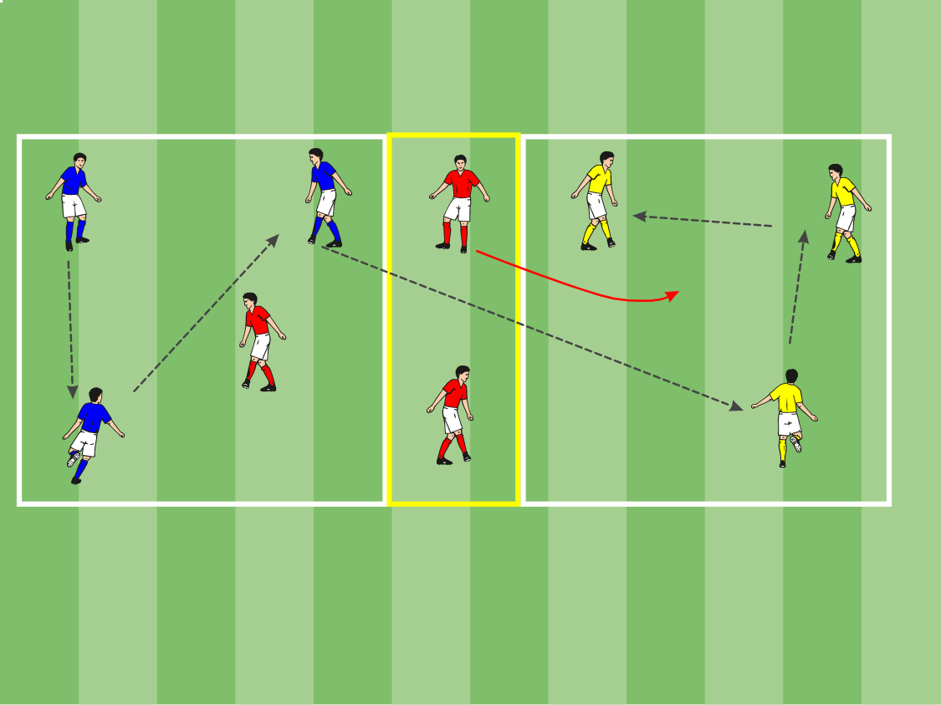
3 v 3 + 3 Passing with Zone
Area: 20x30 yard grid with a 4 yard zone in the middle
Description: Separate group into 3 teams. Place a team in each side of the field and 1 in the center zone. Players try to complete 3 passes on their side of the grid and then pass it over to the other side. However 1 player from the center zone can become a defender and will pressure the ball and attempt to win it, if successful the deposed side become the defenders, if unsuccessful, the ball will go to the other end and the defender will return to the center zone.
Progressions:
1- Increased the number of defenders .
2- Players must complete 5 passes before passing the ball to the opposite side.
Coaching points: Moving off the ball is vital. Be direct if the opportunity arises, reiterate passing technique.

Slide 18
3 v 3 + 3 Passing with Zone
Area: 20x30 yard grid with a 4 yard zone in the middle
Description: Separate group into 3 teams. Place a team in each side of the field and 1 in the center zone. Players try to complete 3 passes on their side of the grid and then pass it over to the other side. However 1 player from the center zone can become a defender and will pressure the ball and attempt to win it, if successful the deposed side become the defenders, if unsuccessful, the ball will go to the other end and the defender will return to the center zone.
Progressions:
1- Increased the number of defenders .
2- Players must complete 5 passes before passing the ball to the opposite side.
Coaching points: Moving off the ball is vital. Be direct if the opportunity arises, reiterate passing technique.

Slide 19
7 v 7 Game
Area: 50x30 yard field
Description: Games should be played 7v7, This is a regular soccer game.
Progression: Conditions can be implemented to force skills to be performed.
Coaching Points: Re-enforce Coaching Points from this session and recap from previous sessions, now is the time to demonstrate some game situations but it is very important that you let the game flow.

Slide 20
Educate – Connect - Inspire
Session Three: Receiving the Ball with Different Surfaces

Slide 21
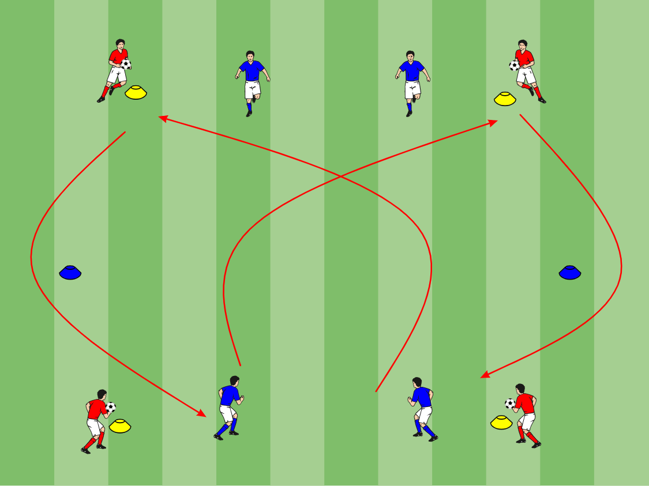
Receiving Dynamic
Area: 15x15 yard grid
Description: Place four players on the corner cones and the remaining players in pairs on the end line. In 2’s, players run diagonally to receive a 1-2 before turning and sprinting back around the blue cone. (Groups alternate Ball work/Dynamic/Ball work/Dynamic/Ball Work /Dynamic ) Check movement sheet for dynamics.
Progressions: Use different surfaces to receive the ball. All four blues run at the same time Make it a race
Coaching points: Balanced body position, lock ankle, head steady, follow through in direction of target. Get the ball to the ground as quickly as possible.

Slide 22
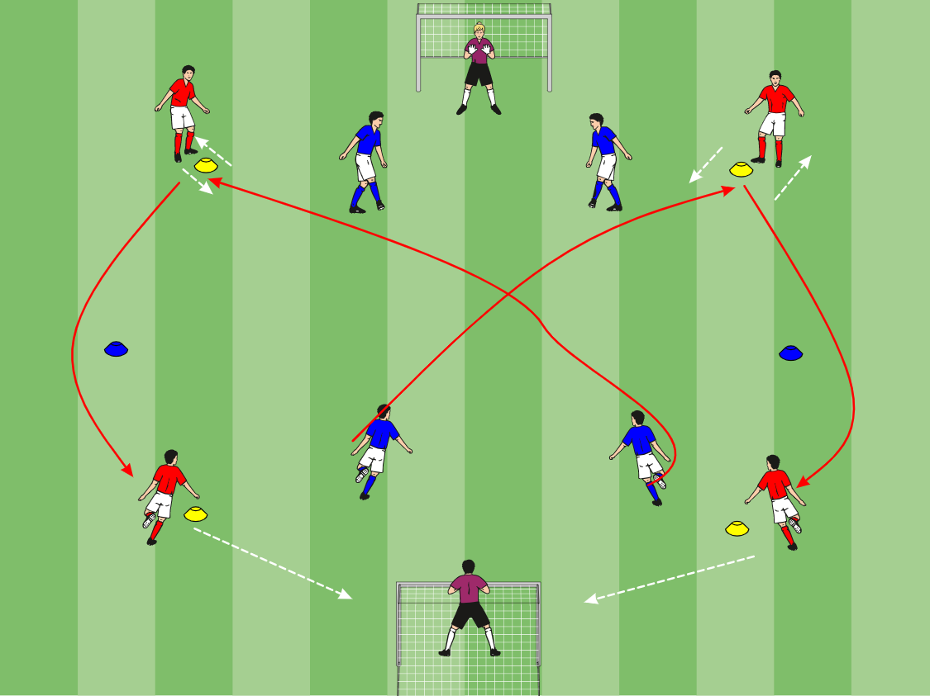
1 v 1 Receiving Race to Goal
Area: 15x15 yard grid + a further 10 yards to goal
Description: Place four players on the corner cones and the remaining players in pairs on the end line. In 2’s, players run diagonally to receive a 1-2 before turning and sprinting back around the blue cone to receive a ball from the corner then finish past the goalkeeper.
Progressions: Use different surfaces to receive the ball. All four blues run at the same time Make it a race
Coaching points: Balanced body position, lock ankle, head steady, follow through in direction of target. Get the ball to the ground as quickly as possible.

Slide 23
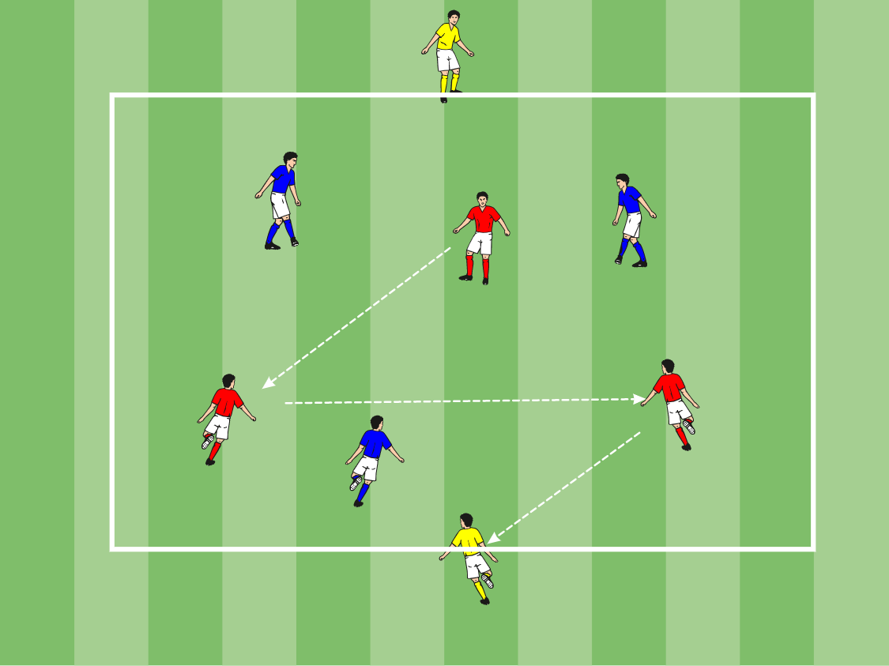
3 v 3 + Targets
Area: 20x15 yard grid
Description:
In groups of 8, create 2 teams of 3 and 2 Target players that play for any team in possession of the ball. A goal is scored when a player passes to a target player who is stuck on the end of the field.
Coaching points: Positive touch, movement off the ball,

Slide 24
7 v 7 Game
Area: 50x30 yard field
Description: Games should be played 7v7, This is a regular soccer game.
Progression: Conditions can be implemented to force skills to be performed.
Coaching Points: Re-enforce Coaching Points from this session and recap from previous sessions, now is the time to demonstrate some game situations but it is very important that you let the game flow.

Slide 25
Educate – Connect - Inspire
Session Four: Finishing, Placement or Power

Slide 26
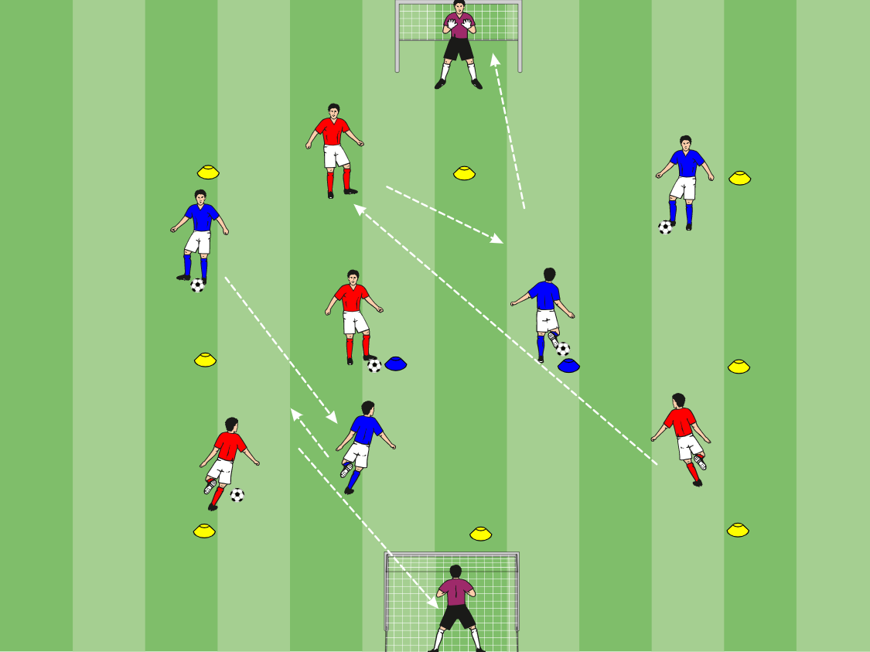
Combination Number Shot
Area: 20x20 yard grid
Description: Separate group into two teams. Place each team in one half of the grid, number each player and give them each a ball. Take one player from each team to move in the opponents side of the grid with no number or ball “Playmaker”. On the command of their number, the player should complete a 1-2 combination with their playmaker before finishing in the opponents goal. (Groups alternate Ball work/Dynamic/Ball work/Dynamic/Ball Work /Dynamic ) Check movement sheet for dynamics.
Progressions: Make it a race between teams Play the ball in the air to volley into the goal
Coaching points: Balanced body position, lock ankle, head steady, follow through in direction of target.

Slide 27
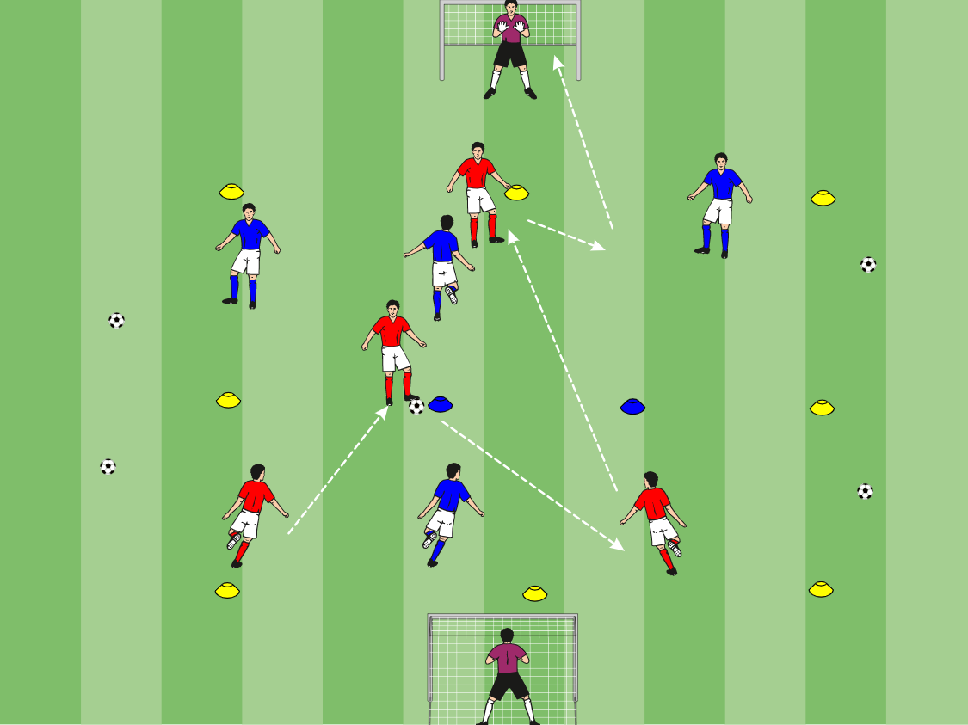
3 v 1 to Combination Shot
Area: 20x20 yard grid + a further 10 yards to goal
Description: Separate group into two teams. Place each team in one half of the grid. Take one player from each team to move in the opponents side of the grid “Playmaker”. Players must keep possession of the ball until they can pass to their playmaker and complete a 1-2 combination before finishing in the opponents goal. The defenders in their grid are passive and can’t defend the playmaker or the oncoming attacker.
Progressions:
Active defenders (can defend playmaker) Send an extra defender to win the ball in the attackers half
Coaching points: Balanced body position, lock ankle, head steady, follow through in direction of target. Keep the ball

Slide 28
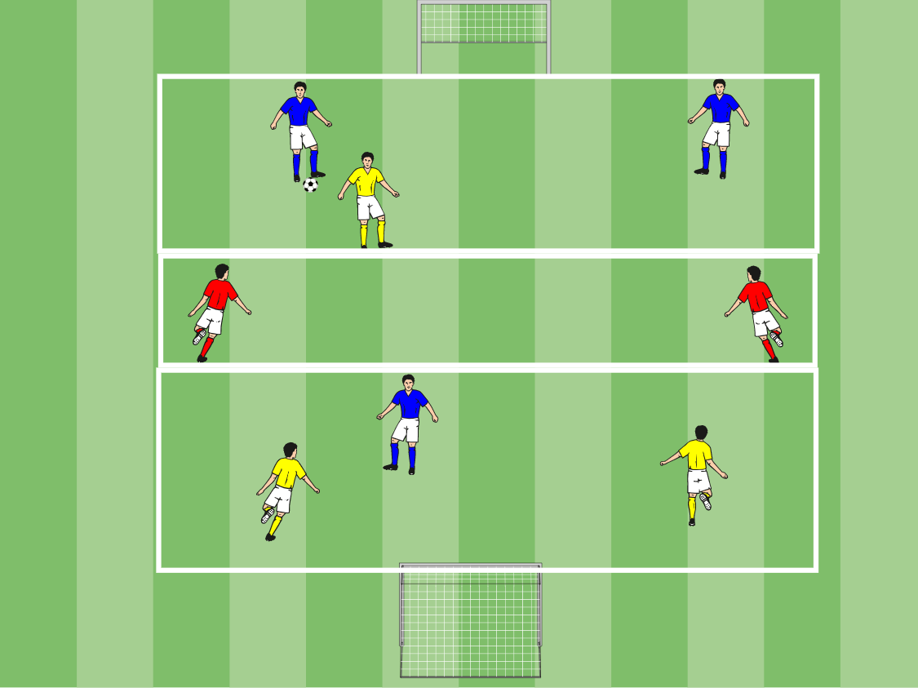
3 v 3 + 2 With Zone
Area: 30x20 yard field, 8 yard grid in the center of field.
Description: Players play 3v3 +2, This is a regular game of soccer however play must go through the 2 playmakers before scoring, teams score 1 point for each goal scored.
Progressions: Finish off a first time shot Double points if you score from you own half
Coaching points: Balance body before striking, bend knee over the ball, body weight moving forward, strike through the center of the ball, inside of foot for placement, laces for power. Aim for corners

Slide 29
7 v 7 Game
Area: 50x30 yard field
Description: Games should be played 7v7, This is a regular soccer game.
Progression: Conditions can be implemented to force skills to be performed.
Coaching Points: Re-enforce Coaching Points from this session and recap from previous sessions, now is the time to demonstrate some game situations but it is very important that you let the game flow.

Slide 30
Educate – Connect - Inspire
Session Five: Defending

Slide 31
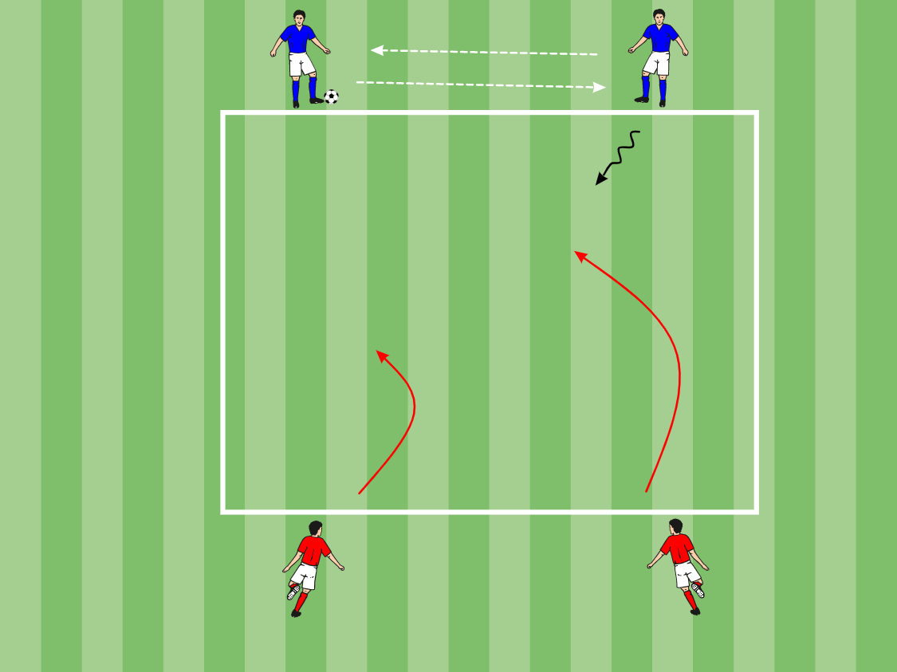
2 v 2 Defending
Area: 16x16 yard grid
Description: Separate group into two teams. Place each team on either end line. The attackers inter-pass 3 times before advancing. They begin passive (don’t attack at full speed). The defenders must prevent the attackers from dribbling over their line. (Groups alternate Ball work/Dynamic/Ball work/Dynamic/Ball Work /Dynamic ) Check movement sheet for dynamics.
Progressions: Attackers play at game speed Defenders can counter and dribble over attackers line for a point
Coaching points: 4 P’s of defending: Pressure, Position, Patience, Pivot. 3 moments to stop an attack: Incept, Spoil, Deny

Slide 32
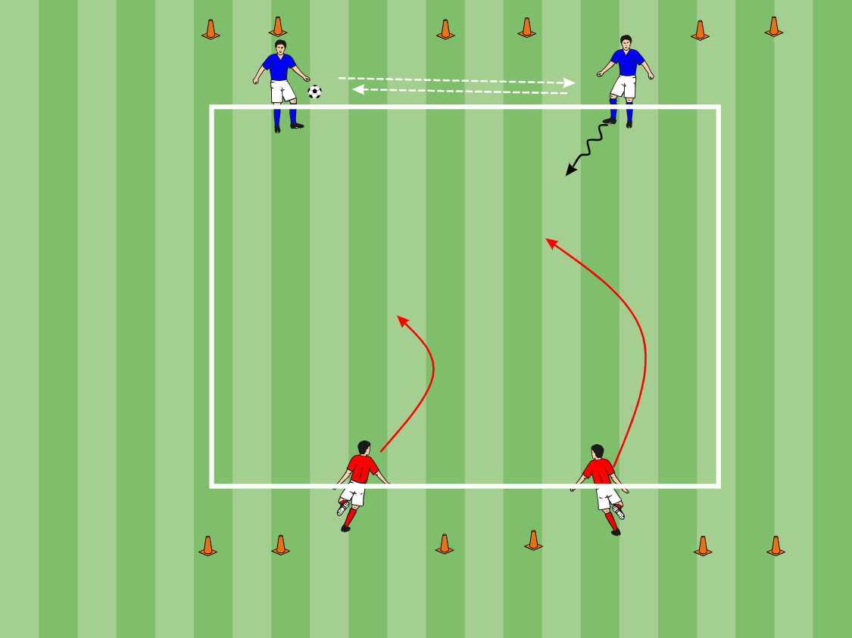
2 v 2 Defending Goals
Area: 16x16 yard grid + 5 yards to goals
Description: Separate group into two teams. Place each team on either end line. The attackers inter-pass 3 times before advancing. The defenders must prevent the attackers from dribbling over their line. Attackers cannot score in the goals until they pass the end line
Progressions: Defenders can counter Add a third attacker Players can shoot from further out
Coaching points: 4 P’s of defending: Pressure, Position, Patience, Pivot. 3 moments to stop an attack: Incept, Spoil, Deny

Slide 33
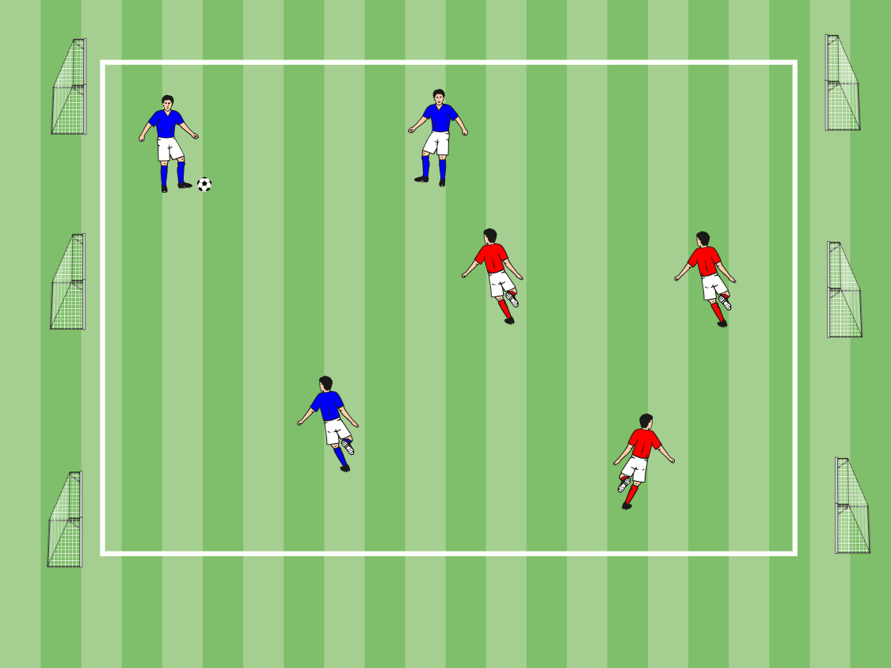
3 v 3 Six Goal game
Area: 20 x 30 yard field, 3 goals at either end of the field.
Description: Playing 3v3/4v4, players must try to score in their opponents 3 goals for a point.
Coaching points: This is a defending exercise and all points should be made to the defenders. Re-enforce defending as an individual as well as part of a team. Players must constantly look to deny the space and try not to be split.

Slide 34
7 v 7 Game
Area: 50x30 yard field
Description: Games should be played 7v7, This is a regular soccer game.
Progression: Conditions can be implemented to force skills to be performed.
Coaching Points: Re-enforce Coaching Points from this session and recap from previous sessions, now is the time to demonstrate some game situations but it is very important that you let the game flow.

Slide 35
Educate – Connect - Inspire
Session Six: Change of Direction Moves

Slide 36
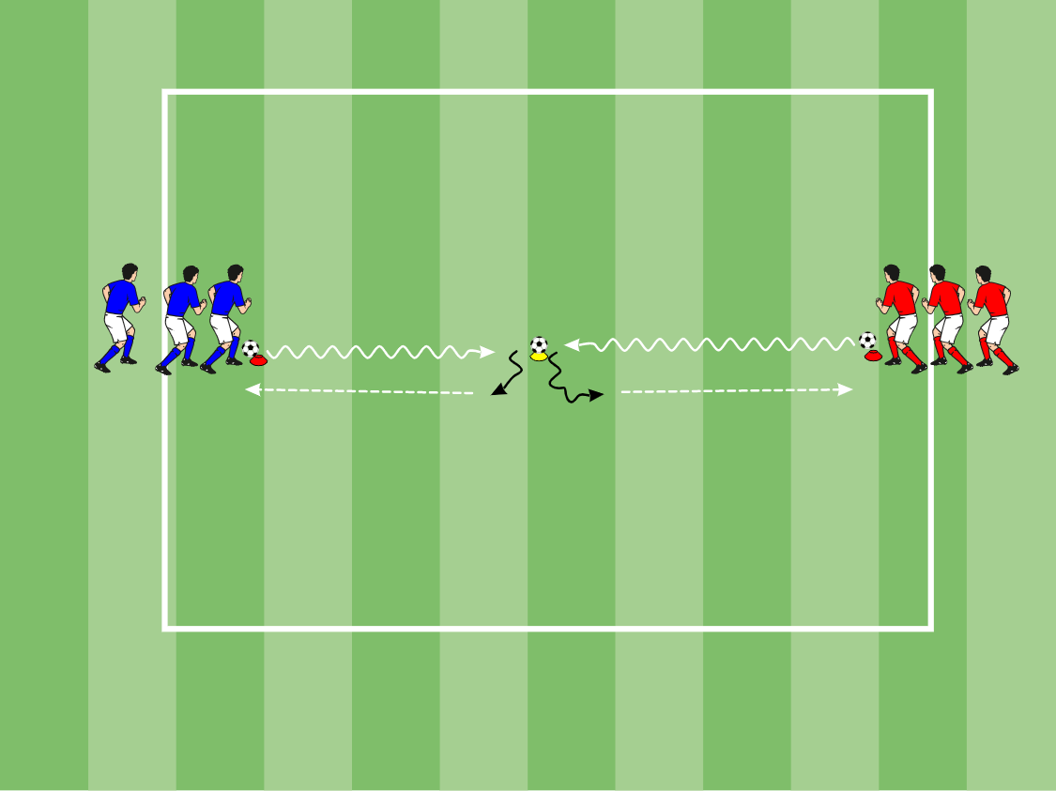
Scalesy
Area: 20x20
Description: 3 – 5 players per line, multiple groups set up. First player in front of each line perform ball mastery toward center cone with ball placed on top. Player then does a change of direction move prior to reaching the center ball. After COD move, passes to next person in line, and follows their pass.
Coaching Points:
Ball Mastery: Keep touches close to body, knee over the ball (don’t reach for ball). Ball must zig /zag side to side. Every step should be a touch, how many touches can you get before you reach the center cone.
Change of Direction Moves: Sharp COD move, move ball 12 o’clock to 6 o’clock. Get ball out of feet in order to make a quick pass after turn. Scan over shoulder before COD. Accelerate after COD.

Slide 37
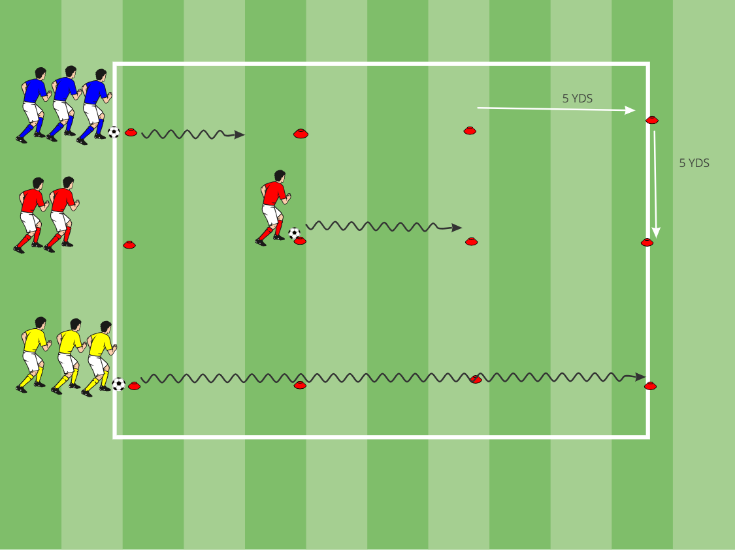
Revs Relay
Area: 15 X 20
Description Player 1 dribbles ball 1 to any 3 cones,
runs back to start; brings ball 2 to any 3 cones,
runs back to start; brings ball 3 to final cone, runs back to start and
tags 2nd player
Player 2 runs out and retrieves ball 1, dribbles it to start; runs out to ball 2, dribbles to start; runs out to ball 3, dribbles to start and 3rd player
Player 3 does as 1st
Player 4does as 2nd
Team that retrieves all their balls and sits at
starting cone wins
( Note: add change of direction moves within skill drill 1. must use a pull back to retrieve balls at start 2.must use a stop turn to leave balls at cones 3.must use an inside cut to retrieve balls at cones )
Coaching Points
-sharp, quick turns
-controlled touch’s while dribbling
-dribble straight line
-run with ball (using laces) in control on
longer distances
-Scan over shoulder before changing direction

Slide 38
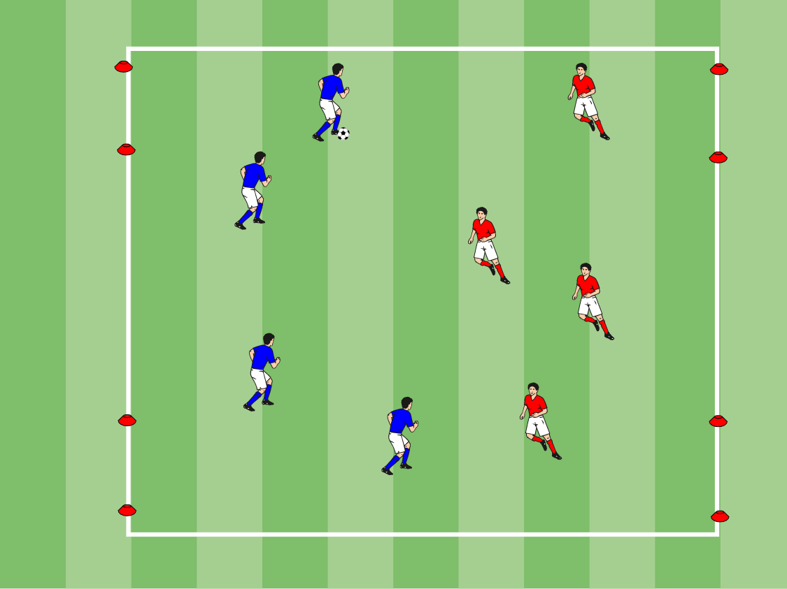
4 Goal Game
Area: 25 X 30
Description
-4v4 to two goals each -End line friendly, no corners -Kick in’s from sideline
Coaching Points
--Use moves to possess and beat defenders -Keep good team shape, especially width -Look to make runs to get in behind, diagonal -Good support angles and splits -Don’t force, there are two goals -Look to create 1v1 and numbers up opportunities

Slide 39
7 v 7 Game
Area: 50x30 yard field
Description: Games should be played 7v7, This is a regular soccer game.
Progression: Conditions can be implemented to force skills to be performed.
Coaching Points: Re-enforce Coaching Points from this session and recap from previous sessions, now is the time to demonstrate some game situations but it is very important that you let the game flow.

Slide 40
Educate – Connect - Inspire
Session Seven: Hitting The Target

Slide 41
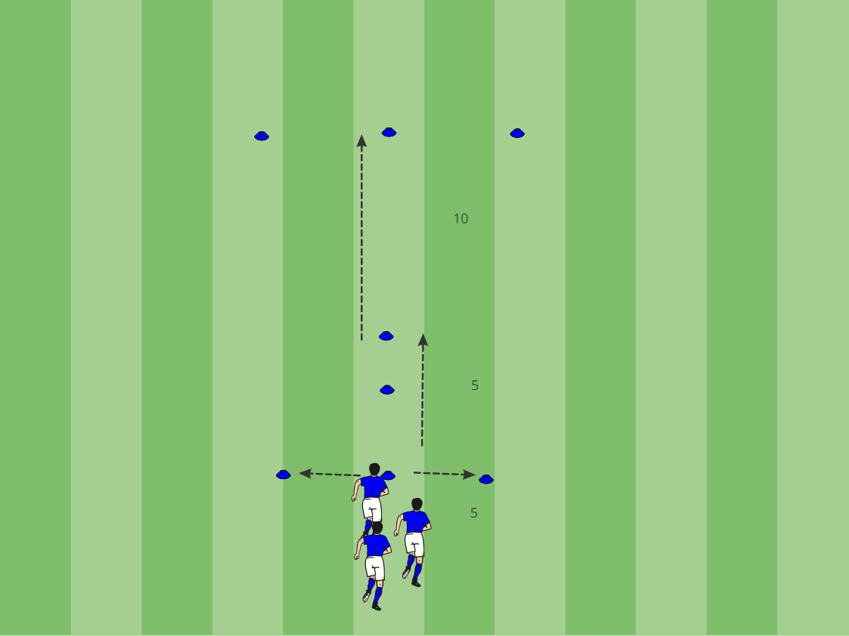
Revs Dynamic
Area: Place cones as stated
Description: Players perform figure of 8 around first 3 horizontal blue cones, perform fast feet through the 3 vertical blue cones and finish with a sprint to the final blue cone. Players recover on the way back.
Coaching Points: Players must correctly perform the different dynamic techniques, load quads by 10-15% for fast turns and movements.

Slide 42
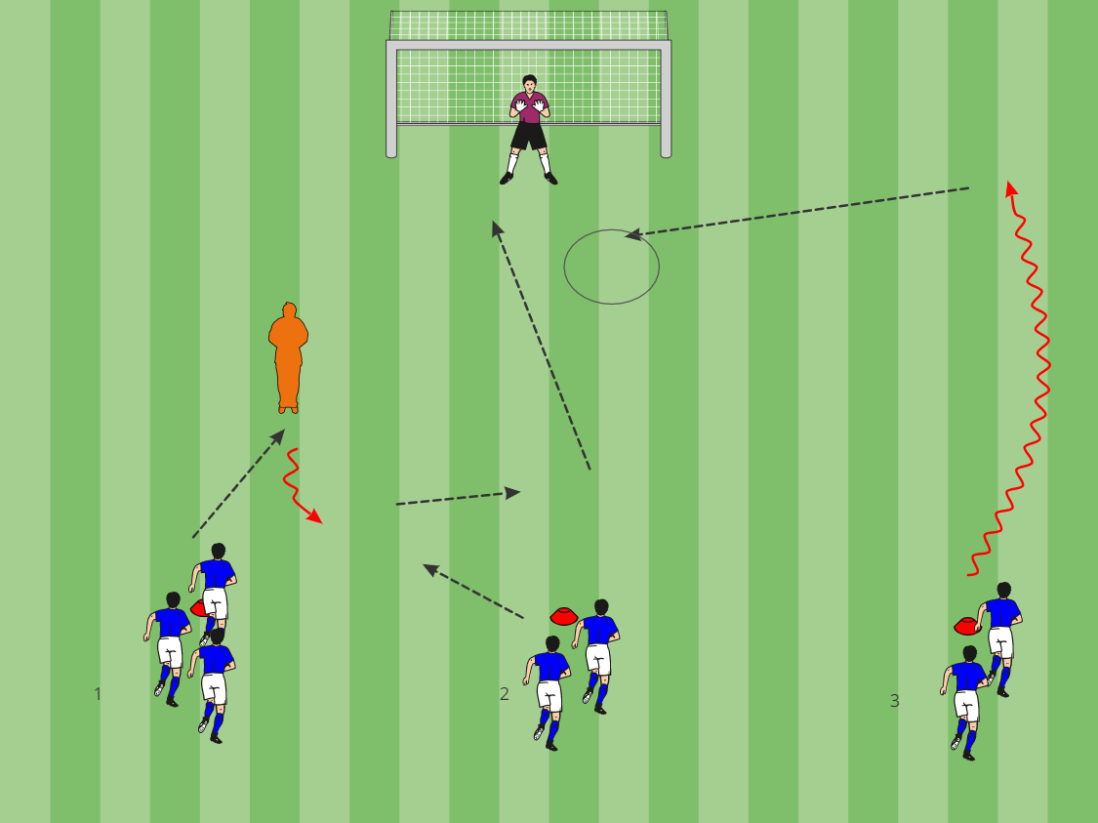
Finishing Exercise
Area: 30x25yard field.
Description: Separate players into 3 sections as shown. Player 1 Attacks the defender, and strikes on goal. Player 1 then turns to play a 1-2 combination with Player 2. Player 2 shoots on goal. After the shot, Player 3 dribbles down the wing and crosses for player 1 and 2 to score. Each player moves 1 spot down. After they play.
Coaching Points: Visual and Verbal Communication between players. 1: Attack defender by taking the ball one way and exploding to the other. Strike low hard and across the keeper. 2:Supporting angle should not be in straight line. Set the pass. The finish shoot be composed and either placed by using the inside of the foot or drilled by using the laces. 3: Cross should be whipped in. Movement should by from deep out side the box to come onto the ball.

Slide 43
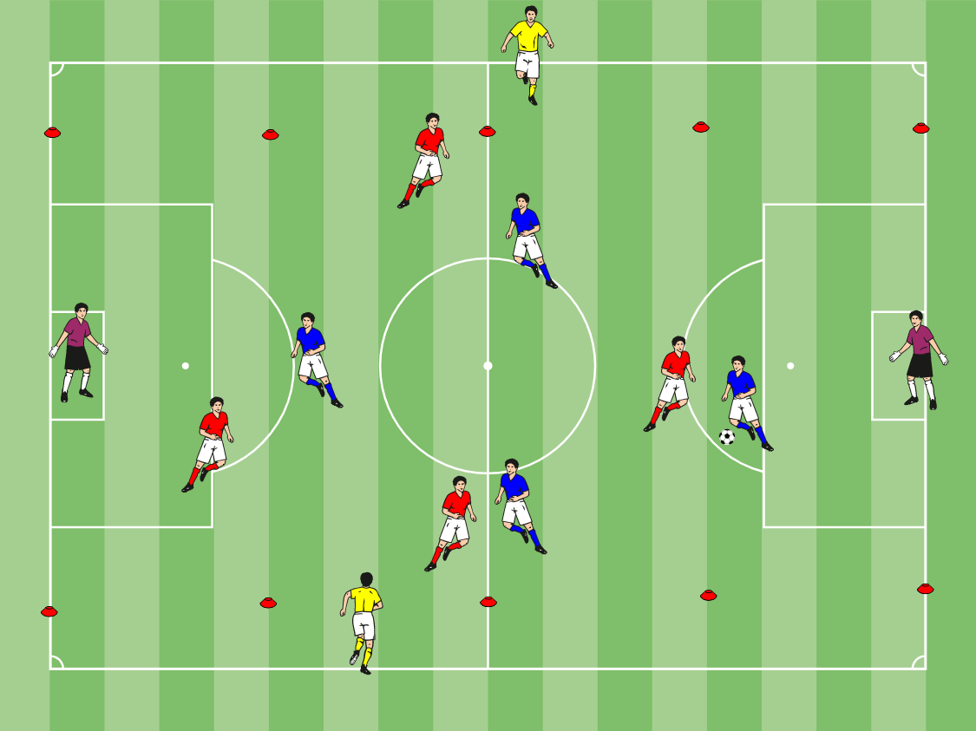
5 v 5 + Wingers
Area: 30x25 yard field, Create a channel 5 yards in from the touch line.
Description: Players play 5v5 plus 2 wingers in the channel. This is a regular game and the wingers give an advantage to the attacking team. Goals can be scored like a regular game.
Coaching Points: Quick on the ball in front of goal, connect with wingers, forwards time run for cross, hit the target, aim for the corners

Slide 44
7 v 7 Game
Area: 50x30 yard field
Description: Games should be played 7v7, This is a regular soccer game.
Progression: Conditions can be implemented to force skills to be performed.
Coaching Points: Re-enforce Coaching Points from this session and recap from previous sessions, now is the time to demonstrate some game situations but it is very important that you let the game flow.

Slide 45
Educate – Connect - Inspire
Session Eight: Dribbling Close Touch and Speed

Slide 46
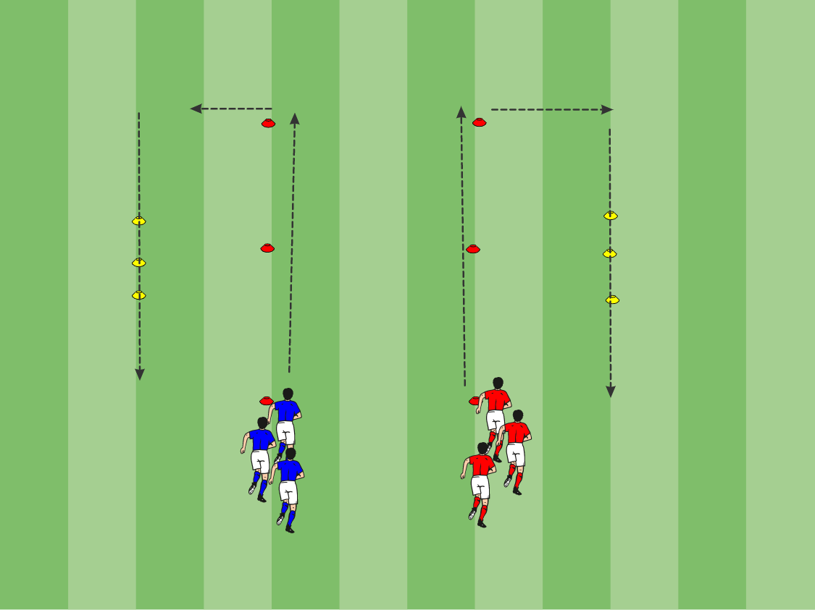
Revs Dynamic 2
Area: 12x6 yard area
Description: Separate players into 2 groups.
Mix dynamics & ball mastery throughout warm up. Players must jog down the grid and turn at the end as shown. When players reach the red cones they must shuffle through. Change the jog to different dynamic movements (see “movement sheet” for different dynamics) Add ball mastery through cones.
Coaching Points: Both rows should move at the same time, the next 2 cannot go until the pair in front have reached the first set of yellow cones. Stay light on the feet and go nice and slow at the start.

Slide 47
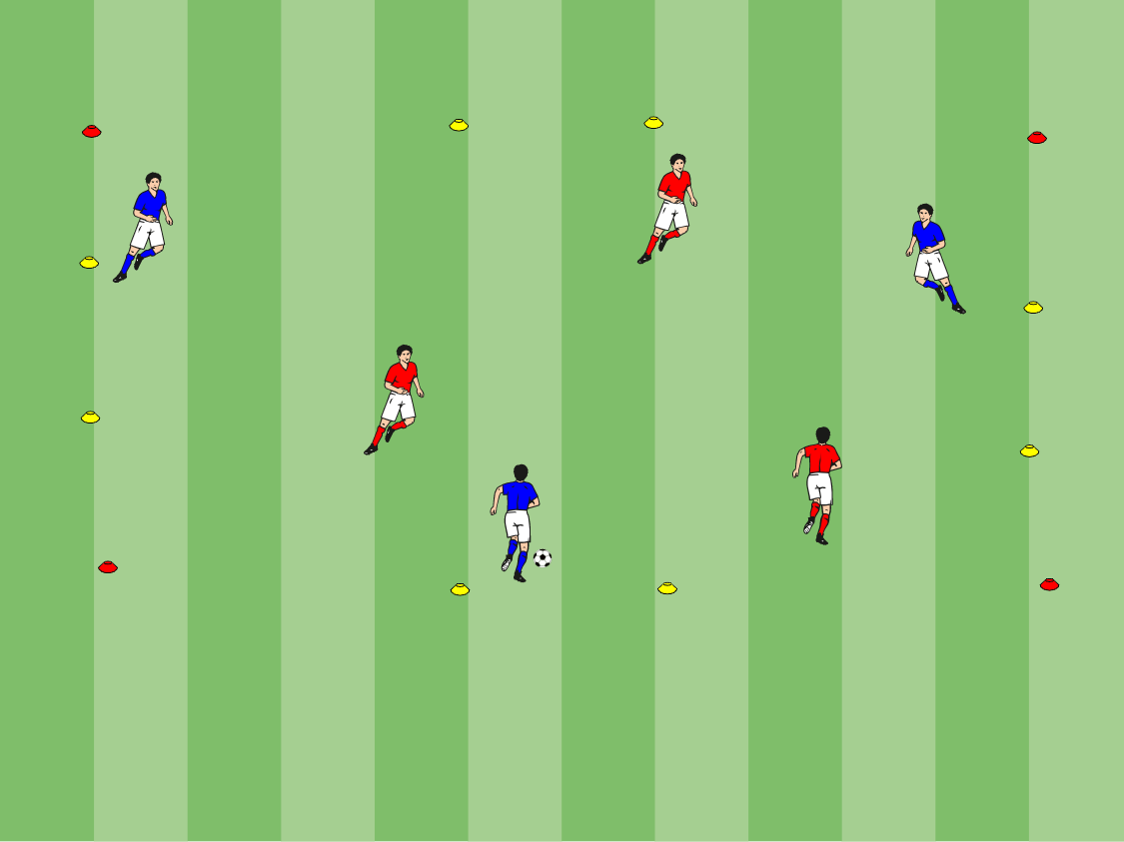
3 v 3 Recognizing 1 v 1 Opportunities
Area: 15x15 yard grid, 4 gates on the sides of the grid.
Description: Players play 3v3 and must try to successfully dribble through 1 of the 4 yellow gates. Once a goal has been scored the opposition gets the ball to restart.
Coaching points: Use the correct foot, always put your body between the defender and the ball, use your arm for protection and balance, be creative, utilize teammates whenever possible.

Slide 48
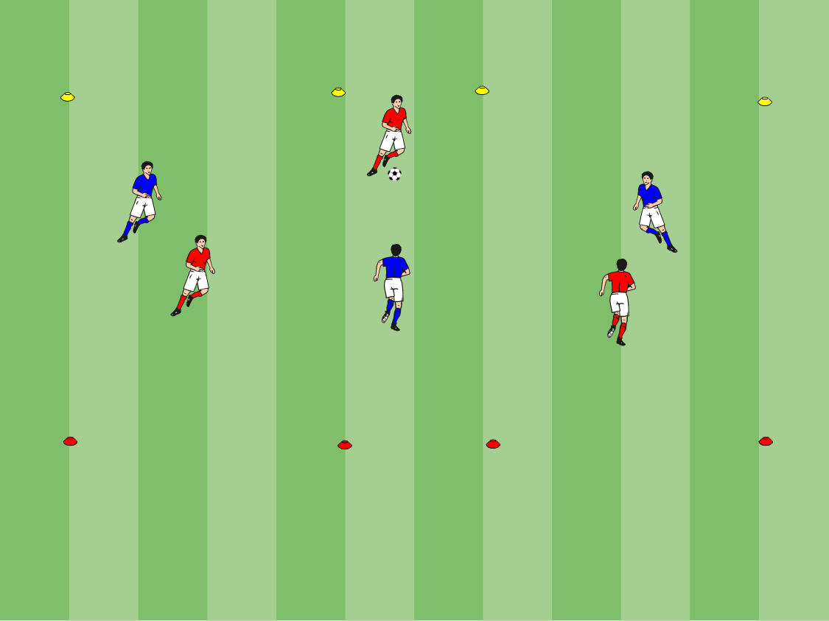
3 v 3 End Zone
Area: 20x30 yard grid
Description: Separate group into teams of 3, place 2 teams on 1 field. This is a regular game of soccer however to score a goal players do not shoot to a goal, they must dribble into the end zone.
Coaching Points: Be positive, be creative, utilize teammates and understand where to speed dribble and where to keep the ball close.

Slide 49
7 v 7 Game
Area: 50x30 yard field
Description: Games should be played 7v7, This is a regular soccer game.
Progression: Conditions can be implemented to force skills to be performed.
Coaching Points: Re-enforce Coaching Points from this session and recap from previous sessions, now is the time to demonstrate some game situations but it is very important that you let the game flow.

