Slide 1

MYS
Coaches Meeting
Fall 2022

Slide 2

Agenda
Introductions
Events
Coaching Credentials/CORI
Basic Logistics for Fall
Field Map
Field Set-up
Uniforms and Equipment
Zero Tolerance
COVID
Questions?

Slide 3
Introductions:
MYS Board of Directors and Support
President – Jess Grey
Vice President – Dan Cooper
Registrar – Doug LaCamera
Travel Director – Desmond Doyle
In-Town Director – Amie Gardner
Treasurer – Mark Powers
Fundraising Director – Danie Correia
Secretary – Teri Fleming
Equipment Director – John McPherson
Field Director – OPEN
Public Relations – Amie Gardner
Referee Director – Paul Flynn
Events Director – Danie Correia
At Large – Amanda Waldron
Tournament Director – Danie Correia
Compliance – Amanda Waldron
Scheduling – Brian Znoj
Director of Coaching – Aaron Salter

Slide 4
Age Group Coordinators (AGCs)
Pre-K – Nicole Mannarino
Grade K Boys – Carrie Dunn
Grade K Girls – Erika Miao
Grade 1 Boys – Jen Gentili
Grade 1 Girls – Amy Trout
Grade 2 Boys – Amie Gardner
Grade 2 Girls – Michelle Sexton
Grade 3-5 Co-ed – Michelle Sexton

Slide 5
Events
Coupon Book Fundraiser – bought us 10 new soccer goals for In-Town!
Important upcoming dates:
  Coaching Clinic – September 8th at 5pm and 5:30pm
  Restaurant Series – Starts September 12th
  Family Night at the Revs – September 17th – FREE ticket for all MYS Players
  Columbus Day Cup – October 8th through 10th (You don’t want to miss this!)
Sponsorships
Volunteer Opportunities

Slide 6
Coach Requirements
Credentials reset every year in July, so you need to check in for the year and see what you need to do:
  Upload headshot
  Complete CORI background check (New coaches need to show their license as well)
  Complete Concussion Training or Health & Safety course (both fulfill the requirement)
  Complete Safe Sport Abuse Prevention Training
Questions? Email Amanda at corimys@gmail.com

Slide 7
Basic Logistics
Season starts Saturday, September 10th and goes 9 weeks through November 12th.
  No Games Columbus Day Weekend due to the Columbus Day Cup
  November 19th is a Make-up Weekend (in case it rains)
  Detailed Schedule will be out soon
Time Slots
    8:15 AM – Grade 2
    8:30 AM – Grades 3rd thru 6th
    9:45 AM – Grade K
    11:00 AM – Grade 1
    12:30 PM – Grade PK

Slide 8
Basic Logistics (cont.)
Session Break-Down
  Lessons follow the Play-Practice-Play that USYSA is currently practicing
  We do have a Legacy coach on-site until 1pm, but not available for 2nd grade.
Field Logistics
  All fields at Plymouth Street Complex
  PK through Grade 2 will play on Small Sided Fields
  Note: Grade 2 will play on 7 v 7 fields (in the Spring – not Fall)
  In-Town Co-ed 3-6 will play on 7v7 and 9 v 9 fields

Slide 9
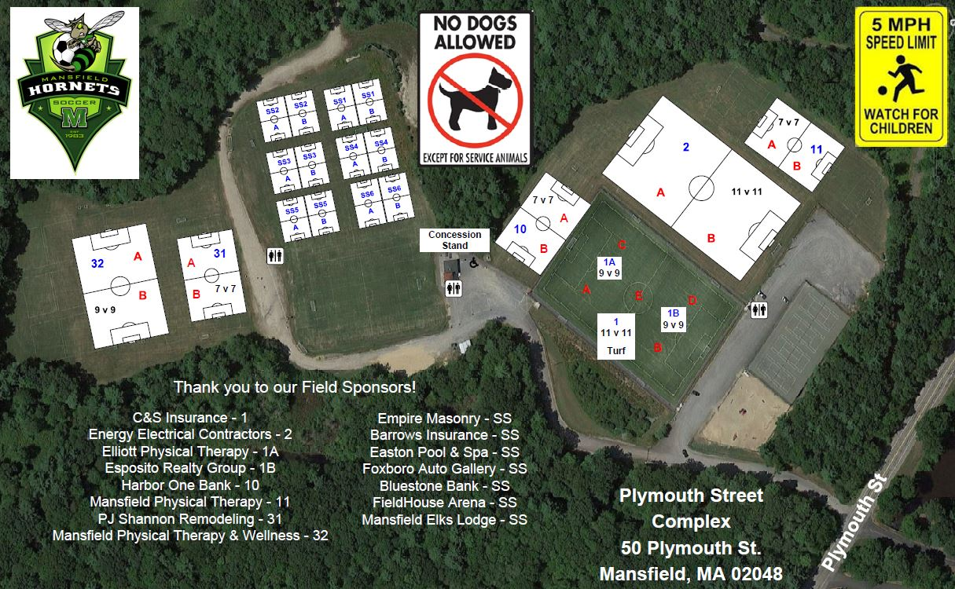
Field Map

Slide 10
Field Set Up
Goals – we have 10 brand new goals that have wheels on the backs plus pugs and the older white goals.
  Grade 2 – Please Help put out the goals each week
  Grade K – Will need to rearrange the goals (see in a minute)
  Grade PK – please help put away the goals each week
Where do parents stand?
  PK thru Grade 1 – will practice and play two small sided games with kids in the middle and parents on the outside.
  Grade 2 – will practice on halves of the SS field, and play scrimmages on the FULL SS field. (We move to 7v7 in the SPRING.)
  Grade 3rd thru 6th – Kids and coaches on one side of the field and parents on the other.

Slide 11
Uniforms
If a uniform was ordered BEFORE August 12th, then it should be here in time for handing out the first day. Please come to the InTown table a little early on the 1st day of games to pick-up your uniforms.
If a uniform was ordered AFTER August 12th, then it will arrive a few weeks into the season. Players should wear a white shirt and we can use pinnies for the opposite color.

Slide 12
Equipment
  Coaches Bag
      Cones
      1 Ball
  Pinnies
    If they are used, must be washed before next use

Slide 13
Zero Tolerance
WHAT IS IT: Neither parents, coaches, or assistants should question or criticize the refs. There should be no shouting or talking to the refs.
Please remember that these Referees are TWEENS and TEENS and learning themselves.
Any notice to the In-Town Director or Director of Coaching will result in a ZT-1 and Coaches/Parents will be asked to take a week off from the fields. Multiple ZTs and we will ask you to take the Season off from the fields.
We ask Coaches to be a good role model to players and parents. If you are having trouble with a parent or another coach, please contact me or the Director of Coaching.
Please make parents aware that yes, even In-Town, has a Zero Tolerance policy.

Slide 14
Covid19 – Requirements MYSA
MYS Points of Contact
MYS Director of Coaching – Aaron Salter
  MansfieldYSDOC@gmail.com
MYS President – Jess Grey
  MansfieldYSPresident@gmail.com

Slide 15
QUESTIONS

