Slide 1

GETTING THE MOST OUT OF THE NEW SEASON
Pre K - K
Fall 2023
SESSION PLAN PACK
MANSFIELD YOUTH SOCCER

Slide 2
At the grassroots level, children learn and develop to their full potential through game-like experiences in an enjoyable environment that supports individual growth.

Slide 3
GETTING PLAYERS READY TO PLAY
Each week, think about how you can make it slightly harder for the players by increasing the complexity of an activity.
Respect each child as an individual and adapt the session or challenge to meet their ability level.
Throughout the season try to pair or
group players together for different
outcomes so that their individual needs are met more often.
Warm-ups for our young players should be engaging, enjoyable and active.
Start with small sided games
Always end with a game/scrimmage. Allow players the opportunity to execute the session objectives.
Stick to one session topic (for example scoring goals to allow players the opportunity to execute the desired task
Allow players the opportunity to learn through guided discovery, using key words and guided questions.
All sessions should be as close to the game as possible. Ensure all activities are fun and include the ball.

Slide 4
Week One

Slide 5
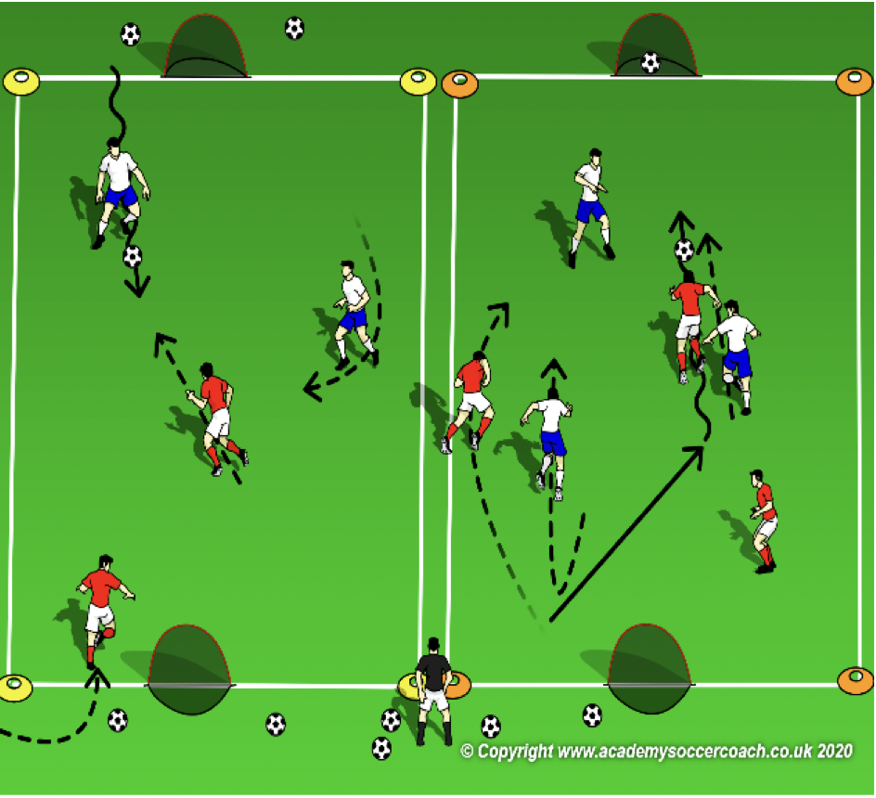
PLAY 1 – Pre K - K
ORGANIZATION
Mark out two fields. (Field size dependent on age group)
Free play:
Field 1: Teams play 2v2/3v3 or 4v4 (Depending on age group and number of players.
Field 2: Teams play 2v2/3v3 or 4v4 (Depending on age group and number of players.
Allow players to play freely introducing key words
PLAYER ACTIONS
-Pass/dribble -Spread out -Pass options
KEY WORDS
Use space, hips open, pass, dribble

Slide 6
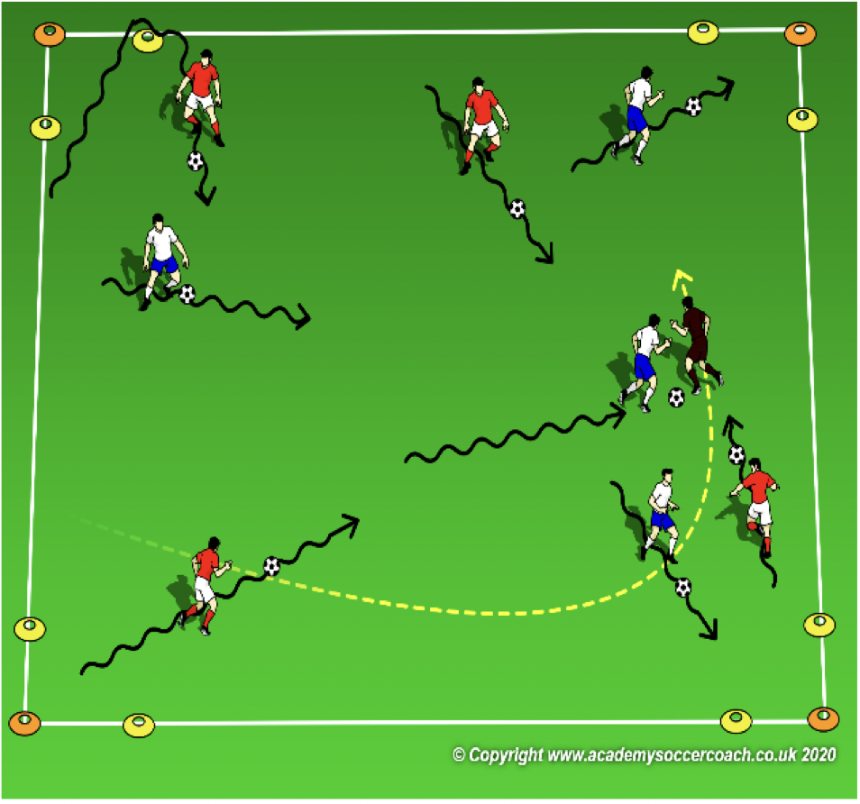
Activity 1 – Pre K – K
ORGANIZATION
In a 15W x 20L grid, a small cone goal in each corner & all players with a soccer ball; dribble within the space. The coach(es) walk around the space. When the coach say “RED LIGHT,” the players must stop the ball with their feet. If the coach says “GREEN LIGHT,” the players must dribble again.
If a player cannot stop their ball on red light, they must dribble their ball to the any of the 4 corner goals then start playing again. Coach controls the frequency of the lights to allow players time to respond. VARIATION: YELLOW LIGHT – dribble slow, BLUE LIGHT – toe taps on the ball or PURPLE LIGHT – hop on 1 foot around the ball. RULES: on green light, players try to dribble toward the coach. Once close enough, player tries to tag the coach. If a coach gets tagged, either award points or start a new game.
KEY WORDS: Laces (to go forward), bottom of the foot (to stop), outside/little toe or inside/big toe (to turn)
GUIDED QUESTIONS: Which part of the foot can you stop the ball with? How can you go faster with the ball?
ANSWERS: Get close to the ball then softly touch the top of the ball with the bottom of your foot. Point your toe down and push the ball further in front of you to go faster.
Note: Stopping and turning the ball is challenging. Try not to call out the lights too fast. If the players respond to the lights quickly, call out the colors even faster.

Slide 7
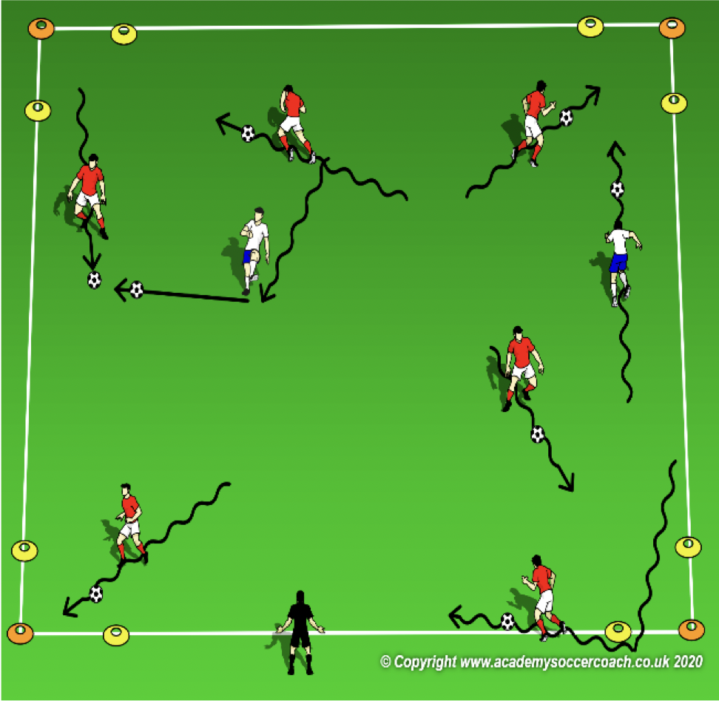
Activity 2 Pre K - K
OBJECTIVE: Move the ball toward the goal through dribbling. Pass the ball toward a teammate.
PLAYER ACTIONS: Pass or dribble forward
ORGANIZATION: In a 15W x 20L grid, a small cone in each corner & all players with a soccer ball; All but 2 players are trying to kick their ball into as many goals as possible in 45 seconds. 2 players do not try to score but try to WRECK the goal scorer’s points, they are the WRECK IT RALPHS. If Ralph hits a goal score’s ball with their own, they demolish the points & the goal scorer has to start scoring points over again. RULES: Play begins when coach says “GO.” Players score by dribbling or kicking their ball through any of the 4 goals.
KEY WORDS: Go for it, go to goal, stay away from Ralph
GUIDED QUESTIONS: If you want to go faster, should you kick the ball harder or softer? What
can you do if Ralph is guarding one of the goals?
ANSWERS: Kick it harder so you can run faster and catch up to the ball (kick it softer when you need to slow down or turn). Turn away from Ralph and find a goal that Ralph is not guarding.
Note: You can use 1 Ralph if needed. Coach can start as a Ralph to allow more goal scoring success if needed. Encourage players to go to goal & avoid the Wreck it Ralphs.

Slide 8
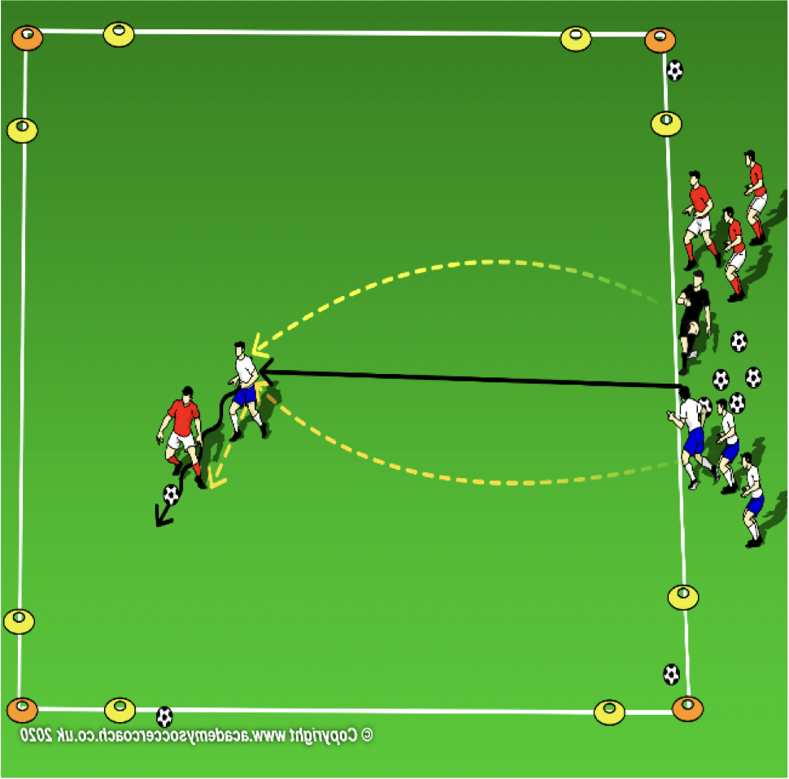
Activity 3 Pre K – K
OBJECTIVE: Move the ball forward toward the opponent’s goal
PLAYER ACTIONS: Pass or dribble forward
ORGANIZATION: In a 15W x 20L grid, a cone goal in each corner & the coach starts at the center of the field with all the soccer balls. Divide the group into 2 teams; 1 team on the coach’s right and 1 on the left. Once the coach plays the ball onto the field, 1 player from each team goes after the ball and tries to score by striking the ball into any of the 4 goals. RULES: Play starts when the coach passes a ball onto the field. Coach can make the game 1v1, 2v1 or 2v2 by telling the players prior to kicking the ball onto the field. Once a goal is scored or the ball goes out of play, game is over and all players leave the field. The coach then serves another ball onto the field for the next players to play.
KEY WORDS: Find the open goal, block the defender
GUIDED QUESTIONS: What should you do if you get to the ball first? What can you do to block the other
player from getting the ball?
ANSWERS: Kick the ball toward the closest open goal and try to score. Put your body between the ball and the other player so they can’t get it.
Note: Keep the game at 1v1 until most players have had a chance to score at least once. Instead of playing the ball down the middle, it is ok to play the ball closer to a player who hasn’t had a chance to score yet. A 2v1 game in favor of a struggling player could help the player score.

Slide 9
PLAY 2 – Pre K - K
ORGANIZATION
Split players into two teams and play
PLAYER ACTIONS
Pass/dribble, Spread out, Pass options
KEY WORDS
Use space, hips open, pass, dribble, get open

Slide 10
Week Two

Slide 11
PLAY 1 – Pre K - K
ORGANIZATION
Mark out two fields. (Field size dependent on age group)
Free play:
Field 1: Teams play 2v2/3v3 or 4v4 (Depending on age group and number of players.
Field 2: Teams play 2v2/3v3 or 4v4 (Depending on age group and number of players.
Allow players to play freely introducing key words
PLAYER ACTIONS
-Pass/dribble -Spread out -Pass options
KEY WORDS
Use space, hips open, pass, dribble

Slide 12
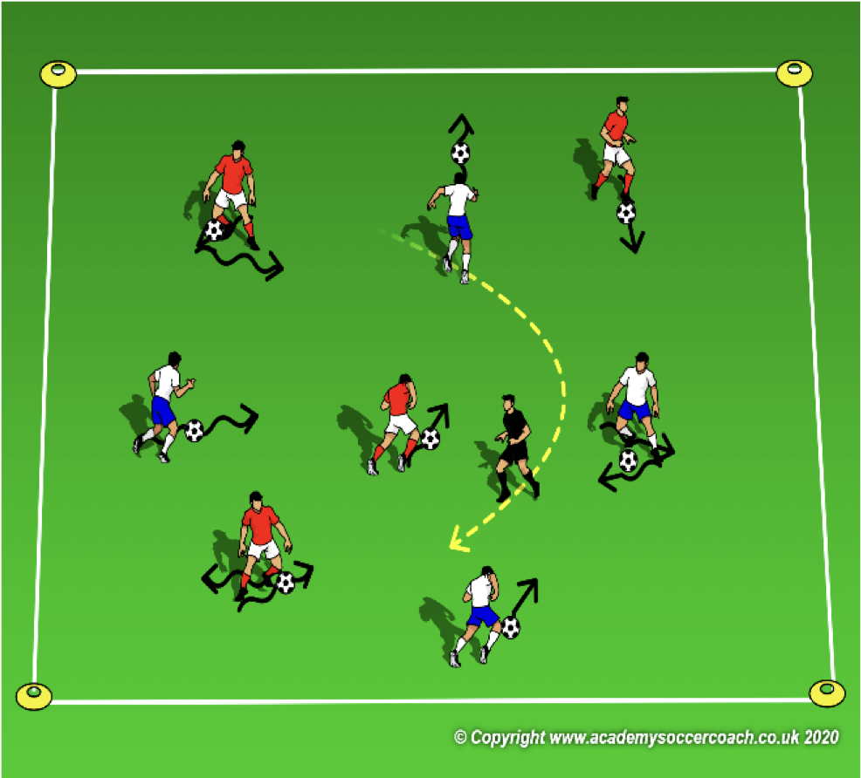
Activity 1 – Pre K – K
OBJECTIVE: Improve the player’s ability to dribble their soccer ball and change direction
PLAYER ACTIONS: Pass or dribble forward
ORGANIZATION: In a 15W x 20L grid, all players with a soccer ball (their ship) & the coach is the captain of all the ships. The players will dribble their ball and change speed or direction based on the weather; high winds=dribble faster, no wind=go slow, hurricane=dribble in a circle & rogue wave=go backward. Each round, add 1-2 new directions. Coach can even try to combine some of the movements such as dribble forward then turn in a circle.
RULES: Play starts when the captain says, “ahoy mates, set sail.”
KEY WORDS: Turn in a circle, use the bottom of your foot to go backward
GUIDED QUESTIONS: Can you list 2 things your foot would have to do to turn in a circle? Who can show me
what they would have to do to go backwards?
ANSWERS: Quickly look over your shoulder, get close the ball, take little touch so each touch turns the ball a little, use your big toe or little toe (inside or outside of the foot) to turn the ball. Gently put your foot on top of the ball, pull the ball back toward you, while keeping your foot on top of the ball, hop backwards with your foot that is on the ground & pull backward again.
Note: Try to allow the players to demonstrate the turns or change of speed. This will give a good indication of who understands as well as who can complete the task.

Slide 13
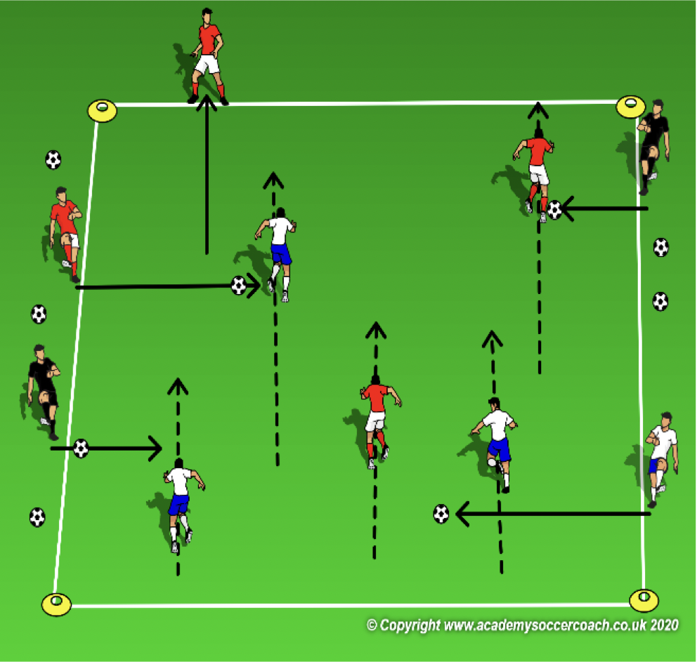
Activity 2 Pre K - K
OBJECTIVE: Move the ball toward the goal through dribbling. Pass the ball toward a teammate.
PLAYER ACTIONS: Pass or dribble forward
ORGANIZATION: In a 15W x 20L grid (the ship), place all the players on one end line without a soccer ball (Captain Jack Sparrows.) All soccer balls (cannon balls) are lined up on either side of the grid. Captain Jacks will try to run to the other side of the ship without out getting hit by a cannon ball below the knee. Coaches (Barbosa) will start as the shooters.
RULES: When the coach says “make it across or walk the plank,” the players start across the grid. Captain Jacks who get hit below the knee become Barbosas also and fire cannon balls in the next round.
KEY WORDS: Strike through the middle of the ball, touch the ball to the side to set up your pass
GUIDED QUESTIONS: What happens to the ball if you kick it close to the bottom? When Captain
Jack is too far away, what can you do with the ball to get closer?
ANSWERS: The ball goes up in the air so try to kick through the middle of the ball to keep it on the ground. Touch the ball to the side or dribble up the side before shooting it.
Note: make the field narrower if players are struggling to kick far enough but not so narrow that the kicks become too hard. Monitor all Barbosas to keep the shots low (safety first.)

Slide 14
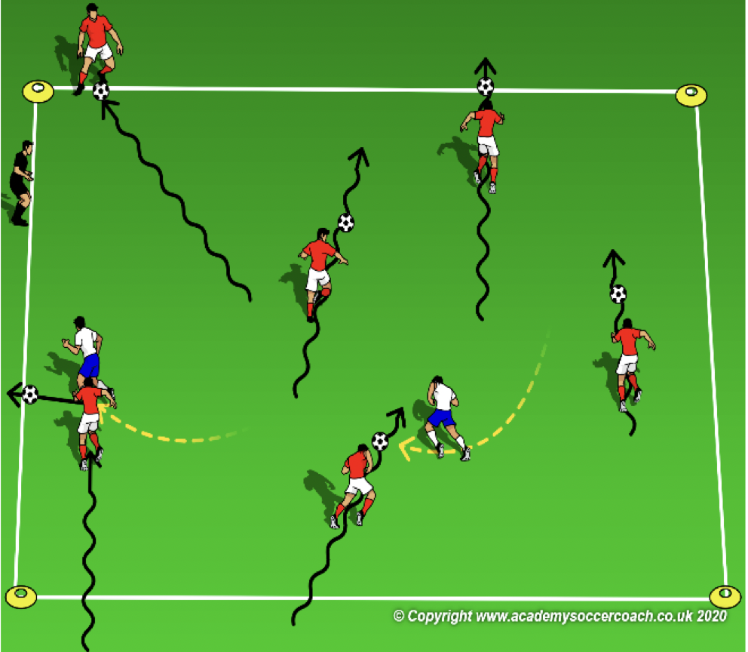
Activity 3 Pre K – K
OBJECTIVE: Move the ball forward to get past the opponent’s
PLAYER ACTIONS: Dribble forward
ORGANIZATION: In a 15W x 20L grid, all players except for 1-3 start with their soccer ball on one end line. Select 1-3 players to be Bruce the Sharks. They do not need a soccer ball (coaches can start as sharks too). The players on the end line are Nemo or Dori. They must swim (dribble their soccer ball) to the other side and stop it on the opposite end line without losing it to Bruce the Shark.
Rules: Game starts when Sharks yell, “Nemo, Nemo cross my ocean.” Once a dribbler has reached the other side, he/she is safe.
KEY WORDS: Swim away from the sharks, try to fool the sharks
GUIDED QUESTIONS: How do you know where it is safe to cross the ocean? What can you do if a shark
blocks your opening to the other side?
ANSWERS: If the sharks are not looking or if they are not close to you, swim past them. Try to find a new opening to get across.
Note: Coaches can be Bruce the Sharks to allow for more dribbling and player success. This game can be continuous by asking the players to get across as many times as possible in 1 minute. Remember to allow for longer rest after the extended work.

Slide 15
PLAY 2 – Pre K - K
ORGANIZATION
Split players into two teams and play
PLAYER ACTIONS
Pass/dribble, Spread out, Pass options
KEY WORDS
Use space, hips open, pass, dribble, get open

Slide 16
Week Three

Slide 17
PLAY 1 – Pre K - K
ORGANIZATION
Mark out two fields. (Field size dependent on age group)
Free play:
Field 1: Teams play 2v2/3v3 or 4v4 (Depending on age group and number of players.
Field 2: Teams play 2v2/3v3 or 4v4 (Depending on age group and number of players.
Allow players to play freely introducing key words
PLAYER ACTIONS
-Pass/dribble -Spread out -Pass options
KEY WORDS
Use space, hips open, pass, dribble

Slide 18
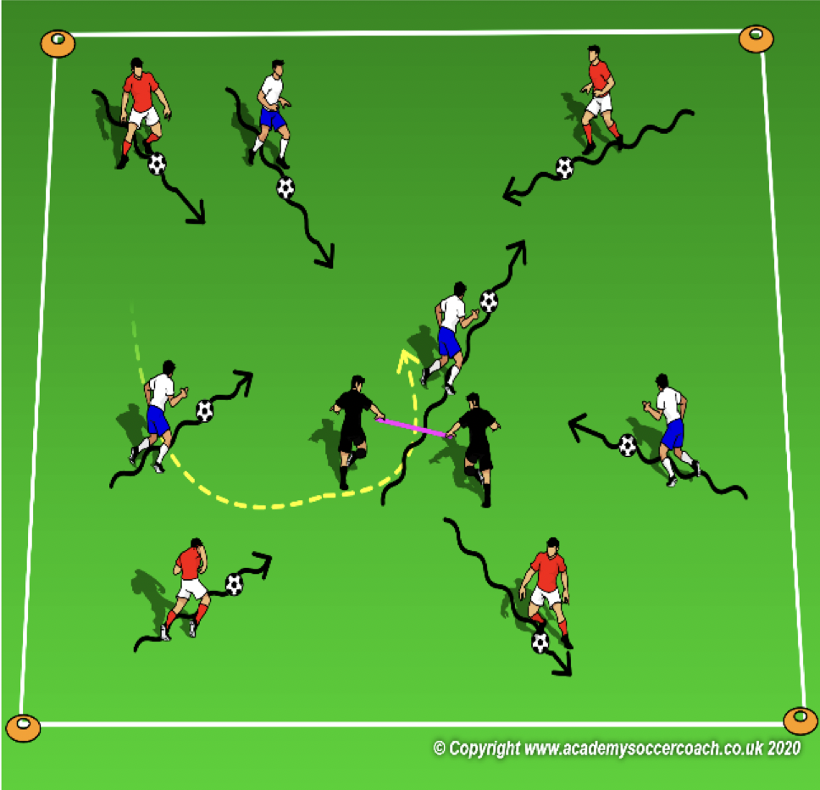
Activity 1 – Pre K – K
OBJECTIVE: Move the ball toward the goal (coach) and score
PLAYER ACTIONS: Dribble forward & shoot
ORGANIZATION: In a 15W x 20L grid, 2 coaches are joined by holding a pinny between them. They walk around the field to create a moving tunnel. Each player dribbles their soccer ball. The dribblers try to dribble or pass/shoot through the tunnel. Count the number of times each player can play their soccer ball through the tunnel in 1 minute. If needed, select 2 players/1 coach & 1 player to make a second tunnel so the players have more chances to score. Remember to change the players so the players are dribblers more often than the tunnel.
RULES: Play begins as soon as the tunnel(s) start moving. Players must stay within the grid. Coaches can award bonus points for players who can dribble or score with different surfaces of the foot.
KEY WORDS: Move toward the tunnel, watch out for traffic around the tunnel
GUIDED QUESTIONS: Who can show me 2 different parts of the foot you can score with? When is the best
time to go through the tunnel?
ANSWERS: Laces, toe, inside of the foot or outside of the foot would be the most common answers. They can say heel also (bottom of the foot would be difficult.) Wait for the tunnel to be open then get through as fast as you can.
Note: if a player simply goes back and forth through the tunnel, praise them. Change the rules if you would like to see the player try something different.

Slide 19
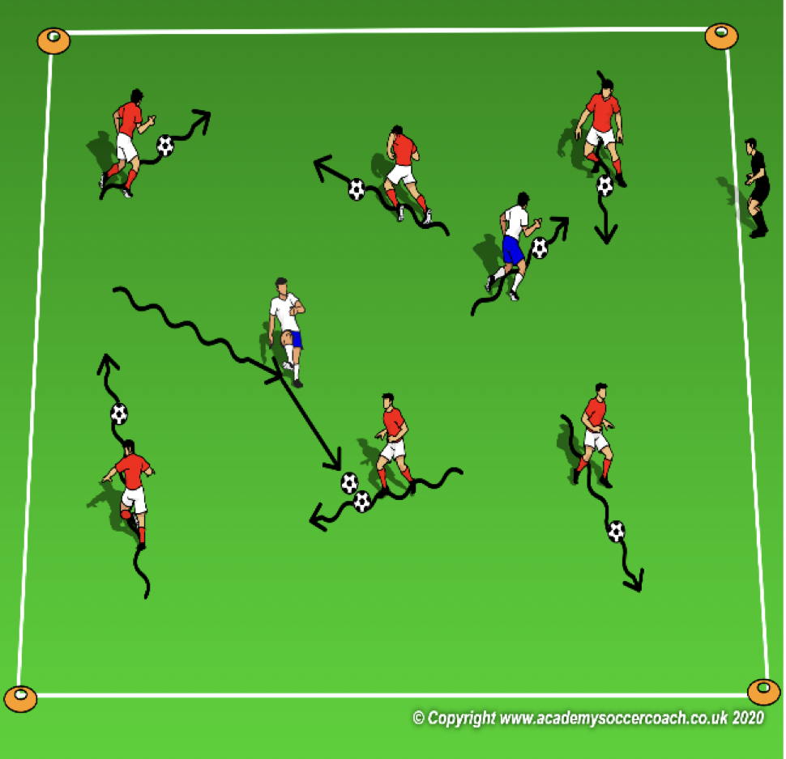
Activity 2 Pre K - K
OBJECTIVE: Move the ball forward & away from opponents. Pass the ball.
PLAYER ACTIONS: Pass or dribble forward
ORGANIZATION: In a 15W x 20L grid, select 2-3 players to start as the Police Patrol; they should wear pinnies. The rest of the players dribble their soccer ball like crazy drivers. The Police Patrol dribble their soccer ball & try to ticket the crazy drivers by hitting the driver’s soccer ball with their own. The Police Patrol counts the number tickets they give away in 1 minute.
RULES: Play begins when coach says “police are on patrol.” Players must stay within the grid. Coaches can start as the police patrol but after the 1st round should step out.
KEY WORDS: Dribble fast away from the police patrol, hide your ball from the police (shielding)
GUIDED QUESTIONS: What should the crazy drivers do if their ball starts to get away from them?
Who can show me how they would hide their soccer ball?
ANSWERS: Use softer touches to keep the ball close. Put your body between the police patrol and the ball so they cannot hit it with their ball.
Note: Police Patrol can tag drivers if hitting the ball is too challenging. When hiding the ball, remember safety. Sitting or lying on the ball is hiding it but is not very safe.

Slide 20
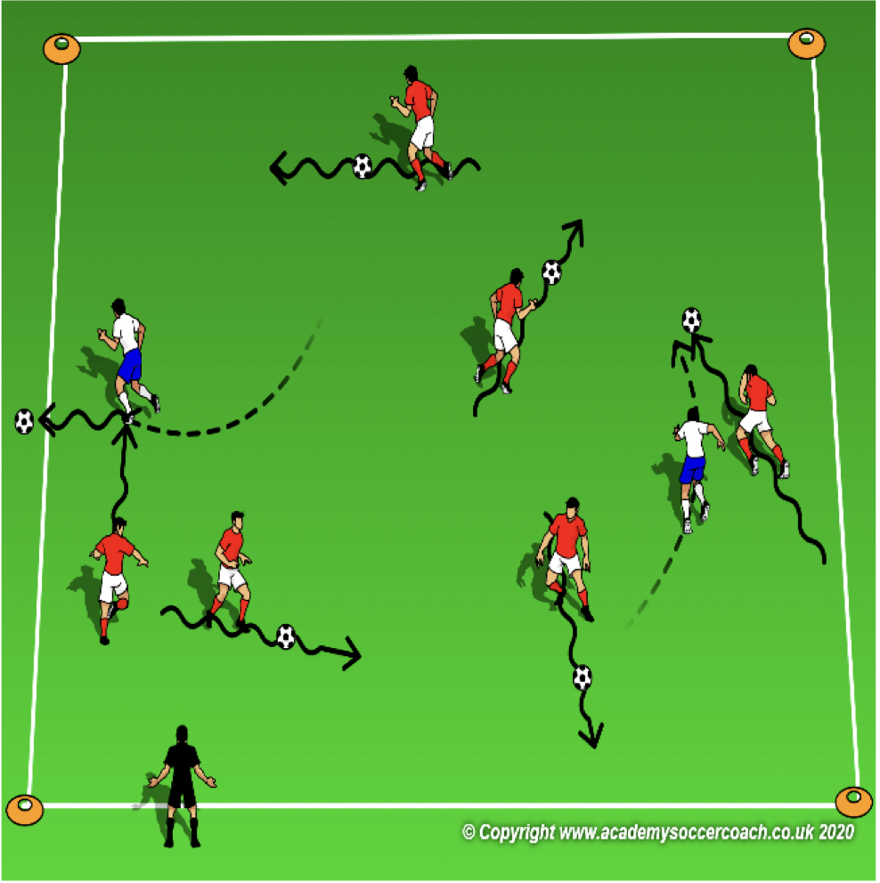
Activity 3 Pre K – K
OBJECTIVE: Move the ball forward toward the opponent’s goal
PLAYER ACTIONS: Dribble forward
ORGANIZATION: In a 15W x 20L grid, select 2-3 players to be Monster Trucks; they do not need a soccer ball. All other players dribble around the grid & avoid the Monster Trucks. The Trucks are trying to smash (kick) the soccer balls out of the grid. If a ball gets smashed out of the grid, the dribbler must go get it & re-enter the game. Coach can ask them to complete a task before re-entering the game such as toe taps on top of the ball. Count the number of smashed trucks at the end of an interval (40 seconds.)
RULES: Play starts when the coach says, “let the crushing begin!” Players must stay with the grid.
KEY WORDS: Turn away from danger, dribble fast to a safe space on the field
GUIDED QUESTIONS: How can you turn the ball away from a Monster Truck? Where are the areas of the field
that are safe from Monster Trucks?
ANSWERS: Use the inside of the foot (big toe) or the outside of the foot (little toe). Wrap the toe to the farthest part of the ball and push the ball in a new direction. An open area with no dribblers or Monster Trucks is the safest.
Note: If the players need an additional challenge, add a goal to each end line. The dribblers can count how many goals they can score without losing the ball to a monster truck. If the coach starts as a monster truck, it is to allow the players more dribbling success. Smashing all the trucks is not the goal. Try to determine which players need more pressure and which need a little less.

Slide 21
PLAY 2 – Pre K - K
ORGANIZATION
Split players into two teams and play
PLAYER ACTIONS
Pass/dribble, Spread out, Pass options
KEY WORDS
Use space, hips open, pass, dribble, get open

Slide 22
Week Four

Slide 23
PLAY 1 – Pre K - K
ORGANIZATION
Mark out two fields. (Field size dependent on age group)
Free play:
Field 1: Teams play 2v2/3v3 or 4v4 (Depending on age group and number of players.
Field 2: Teams play 2v2/3v3 or 4v4 (Depending on age group and number of players.
Allow players to play freely introducing key words
PLAYER ACTIONS
-Pass/dribble -Spread out -Pass options
KEY WORDS
Use space, hips open, pass, dribble

Slide 24
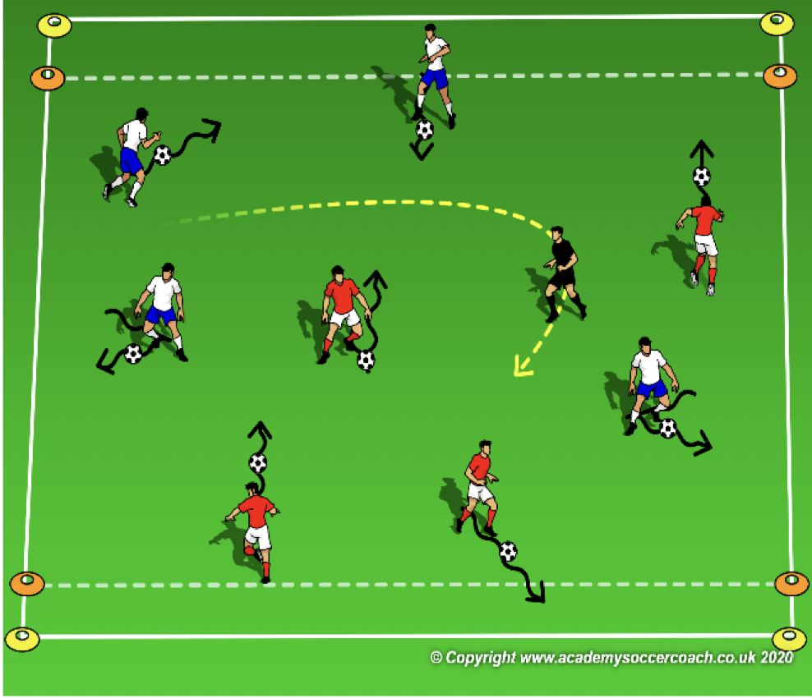
Activity 1 – Pre K – K
OBJECTIVE: Improve the player’s ability to maneuver the ball with different surfaces of the foot
PLAYER ACTIONS: Pass or dribble forward
ORGANIZATION: In a 15W x 20L grid, which includes a 3 yard end zone on each end line and all players with a soccer ball. Ask the players to use the following 4 surfaces in 1 fluid motion & in order: Outside of the foot (pinky toe), inside of the foot (big toe), laces & bottom (sole). Once they have stopped it with the bottom of their foot, try to repeat the pattern with their other foot. While using the 4 surfaces, players try to move from 1 end zone to the other. RULES: Play begins as soon as the coach calls out the first surface. After 2 rounds, see if the players can shout out the surfaces as they use them.
KEY WORDS: Outside, inside, laces & bottom
GUIDED QUESTIONS: Which parts of the foot can help you move side to side? What do you have to do with
your foot if you want your laces to hit the ball?
ANSWERS: The outside & insides of your feet will help you move the ball side to side. Point your toe down toward the ground so your laces are facing the ball. Now, hit the ball with your laces.
Note: Introducing the 4 surfaces works best when 1 surface is introduced at a time then the other surfaces are layered in 1 at a time. This will allow time to become more comfortable with each surface.

Slide 25
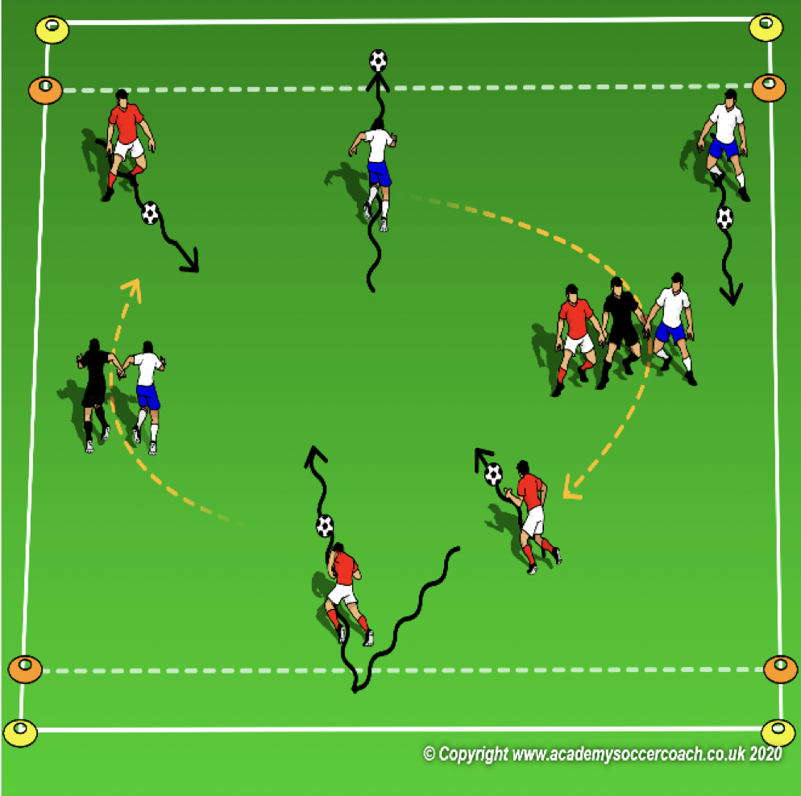
Activity 2 Pre K - K
OBJECTIVE: Improve the player’s ability to dribble the ball away from opponents
PLAYER ACTIONS: Dribble forward
ORGANIZATION: In a 15W x 20L grid, which includes a 3 yard end zone on each end line & each player with a soccer ball. The coaches start as the hungry hippos in the river. Players dribble their ball across the river to the river’s edge (end zone) while avoiding the hippos. When the players cross and get tagged by a hippo or their ball gets tagged, they join hands with the hippo to make the hippo grow. How many times can the dribblers cross the river in 1 minute without getting tagged?
RULES: The game begins with the hippos say, “we dare you to cross the river.” Hippos should not get bigger than 4 players.
KEY WORDS: Watch out for the hippos, dribble fast
GUIDED QUESTIONS: How do you know where the hippos are? Where are the safe areas of the
field?
ANSWERS: Pick your head up and look around to find the hippos. Dribble to the river’s edge to be safe.
Note: First team to get 4 players in their hippo wins the round. Start a new game. This makes the game safer so the end player is not getting whipped around.

Slide 26
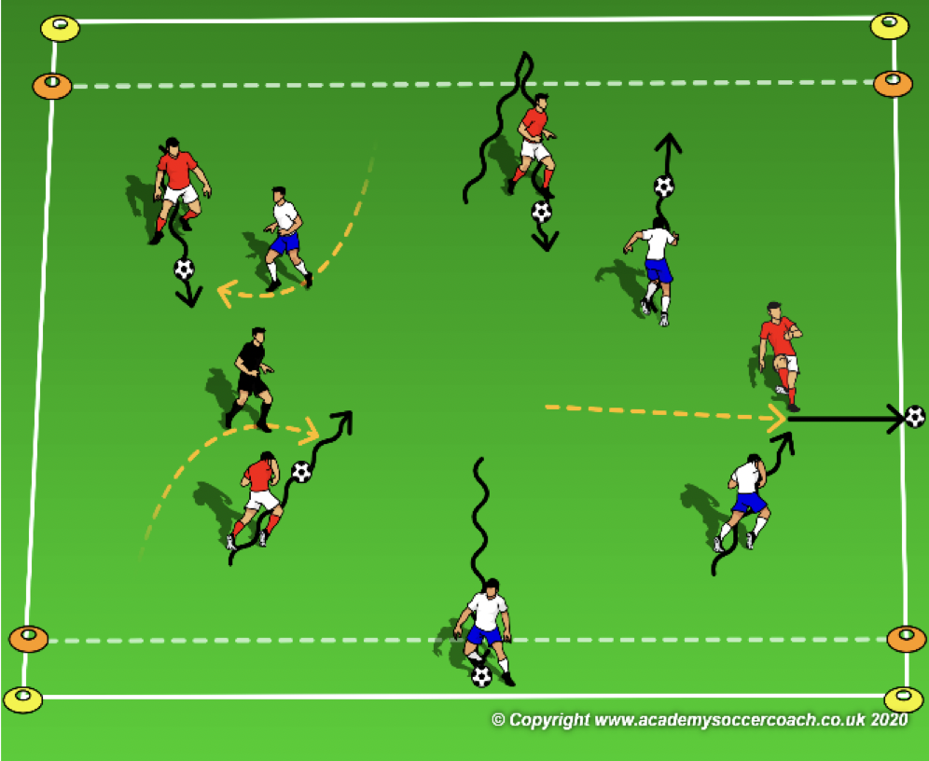
Activity 3 Pre K – K
OBJECTIVE: Move the ball forward to get past the opponent’s
PLAYER ACTIONS: Dribble forward
ORGANIZATION: In a 15W x 20L grid, which includes a 3 yard end zone on each end line & each player starts with a soccer ball. The coaches start as Crocs in the River. The players dribble their soccer ball across the river to the river’s edge (end zone) while avoiding the crocs. When a player crosses and a croc can steal their ball and play it over a side, the dribbler becomes a croc also.
Rules: Play begins when coach says go. If a croc steals a ball, they must dribble it over the side line (not kick). Dribblers can steal their ball back as long as it is on the field. Dribblers can rest for a moment if they reach an end zone but must cross to get points.
KEY WORDS: look for openings across the river, try to fake the crocs
GUIDED QUESTIONS: What is an opening to get across the river? How can you fake out one of the crocs?
ANSWERS: An opening is a gap across the river with no crocs guarding it. Try to dribble in one direction. Then with the inside or outside of the foot, change direction and get across quickly.
Note: Coaches can have the players switch roles if they lose their soccer ball instead of accumulating crocs. Help the players identify the openings that are safe to cross in and why they are safe.

Slide 27
PLAY 2 – Pre K - K
ORGANIZATION
Split players into two teams and play
PLAYER ACTIONS
Pass/dribble, Spread out, Pass options
KEY WORDS
Use space, hips open, pass, dribble, get open

Slide 28
Week Five

Slide 29
PLAY 1 – Pre K - K
ORGANIZATION
Mark out two fields. (Field size dependent on age group)
Free play:
Field 1: Teams play 2v2/3v3 or 4v4 (Depending on age group and number of players.
Field 2: Teams play 2v2/3v3 or 4v4 (Depending on age group and number of players.
Allow players to play freely introducing key words
PLAYER ACTIONS
-Pass/dribble -Spread out -Pass options
KEY WORDS
Use space, hips open, pass, dribble

Slide 30
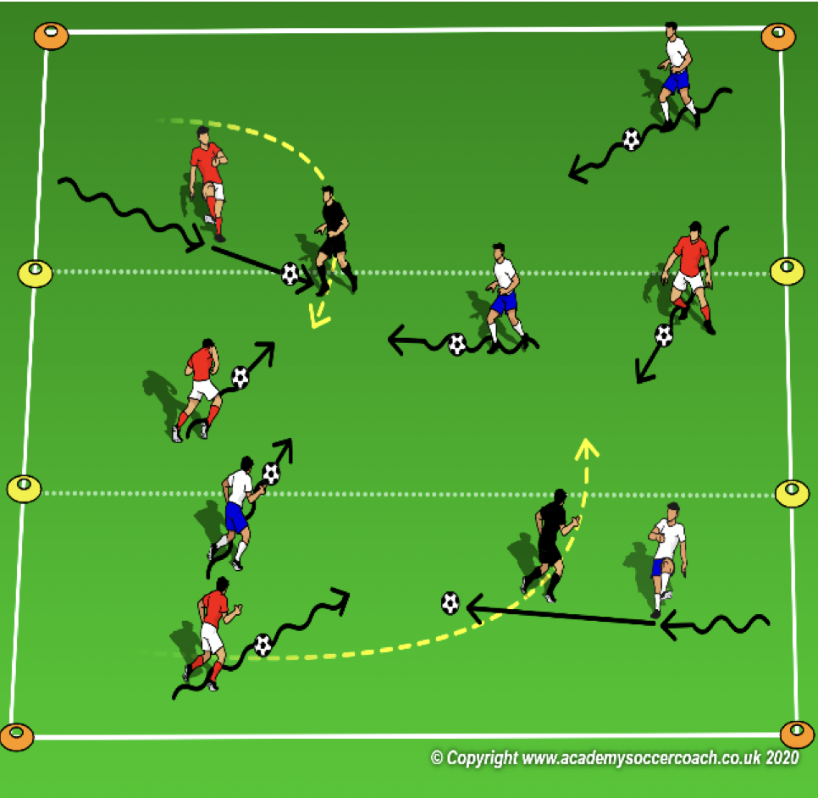
Activity 1 – Pre K – K
OBJECTIVE: Move the ball toward the goal (coach) and score
PLAYER ACTIONS: Dribble forward & shoot
ORGANIZATION: In a 15W x 20L grid which includes a 5 yard zone across the middle of the grid. All the players with a soccer ball. The coaches walk around the grid and the players try to hit the coach below the knee with their ball.
RULES: Play begins as soon as the coaches begin walking. The players count how many times they can hit a coach in 40 seconds. Each time the coach gets hit with a ball, they must say, “OUCH!”
KEY WORDS: Move toward the tunnel, watch out for traffic around the tunnel
GUIDED QUESTIONS: What can you do to hit the coach more often? Which part of the foot should you
use to close shots/long shots?
ANSWERS: Dribble closer to the coach before trying to kick the ball and hit them. Try to use the inside of the foot for closer shots & use the laces for longer shots.
Note: As the coaches move around the field, move closer to players who are struggling to get a point so they can achieve success. Walk further away from the players who have more points to increase the challenge for them. Coach can award different point values in the different thirds of the field if a variation is needed.

Slide 31
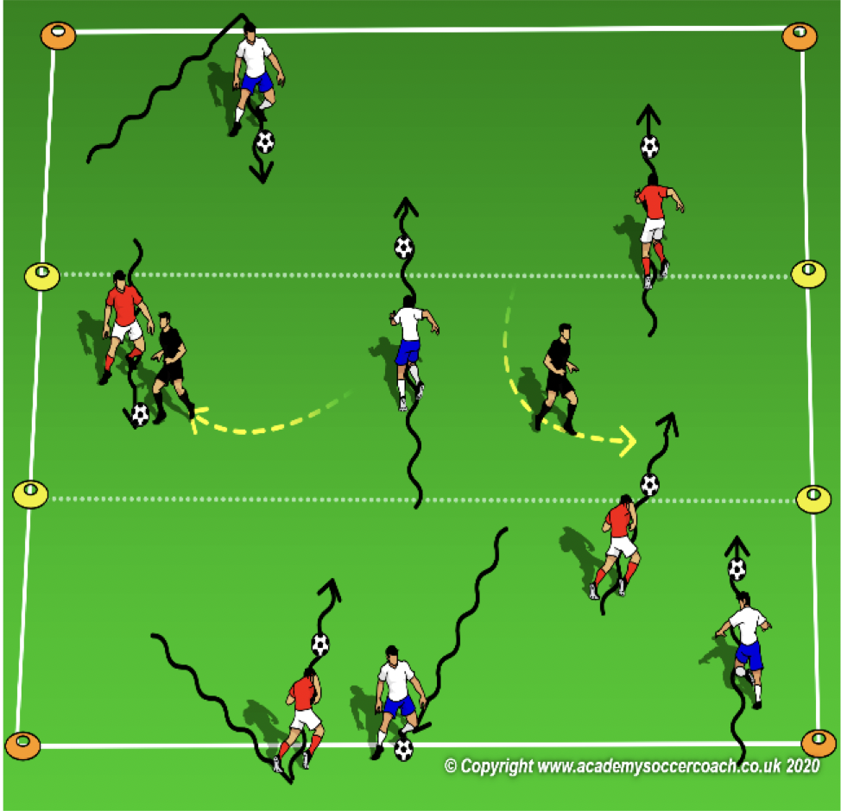
Activity 2 Pre K - K
OBJECTIVE: Improve the players ability to dribble the ball through the opponents
PLAYER ACTIONS: Pass or dribble forward
ORGANIZATION: In a 15W x 20L grid, select which includes a 5 yard zone across the middle (the dog pound), all players start on 1 end line with a soccer ball. The coaches start in the middle as dog catchers, they cannot leave the pound. The players are bulldogs. They try to dribble their ball through the dog pound to the other side without waking the dog catches.
RULES: Play begins when coach says “who let the dogs out.” After 2 rounds, make the game continuous. The players do not stop on the end line. How many times can they get through the pound without getting tagged?
KEY WORDS: soft touches around the dog catcher, big touched to get through the pound
GUIDED QUESTIONS: When is it important to keep the ball close? Why would you kick the ball
harder?
ANSWERS: Keep the ball close if a dog catcher is in front of you. If you see an opening through the pound, kick it hard and run fast after it.
Note: Try not to be in too big of a hurry to start tagging players. Their success will encourage them to try to get through again.

Slide 32
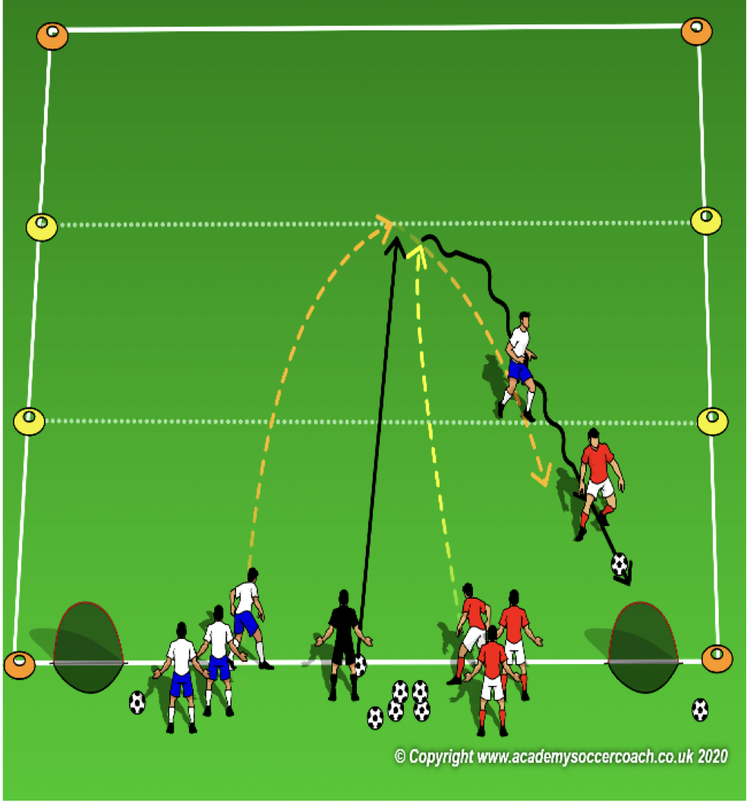
Activity 3 Pre K – K
OBJECTIVE: Turn the ball to goal and shoot
PLAYER ACTIONS: Shoot, Pass or dribble forward
ORGANIZATION: In a 15W x 20L grid, select which includes a 5 yard zone across the middle and 2 pugg goals on the same end line. The coach starts between the goals with all the soccer balls. The players are split into 2 teams; 1 on the coaches right and the other on his left. Each team names their team after a breed of dog (hopefully to give them a sense of team identity.) Once the coach plays a ball onto the field, 1 player from each team goes after it and tries to bring it back to their own goal. Once the ball is scored or is played off the field, both players leave the field and rejoin their team. The coach plays another ball onto the field for the next players to go after.
RULES: Play begins when a coach plays the ball onto the field. Round ends once a goal is scored or the ball leaves the playing area.
KEY WORDS: Turn away from danger, dribble fast to a safe space on the field
GUIDED QUESTIONS: How can you turn the ball away from a Monster Truck? Where are the areas of the field
that are safe from Monster Trucks?
ANSWERS: Use the inside of the foot (big toe) or the outside of the foot (little toe). Wrap the toe to the farthest part of the ball and push the ball in a new direction. An open area with no dribblers or Monster Trucks is the safest.
Note: The middle zone is not necessary but can be used as a visual for players to try to score from further away. The coach can play 1v1, 2v1 or 2v2 by telling the players before they kick a ball onto the field. If a team is not ready, observe how the team who is ready responds to less pressure.
After several rounds, the teams can change and try to score on their opponent’s goal.

Slide 33
PLAY 2 – Pre K - K
ORGANIZATION
Split players into two teams and play
PLAYER ACTIONS
Pass/dribble, Spread out, Pass options
KEY WORDS
Use space, hips open, pass, dribble, get open

Slide 34
Week Six

Slide 35
PLAY 1 – Pre K - K
ORGANIZATION
Mark out two fields. (Field size dependent on age group)
Free play:
Field 1: Teams play 2v2/3v3 or 4v4 (Depending on age group and number of players.
Field 2: Teams play 2v2/3v3 or 4v4 (Depending on age group and number of players.
Allow players to play freely introducing key words
PLAYER ACTIONS
-Pass/dribble -Spread out -Pass options
KEY WORDS
Use space, hips open, pass, dribble

Slide 36
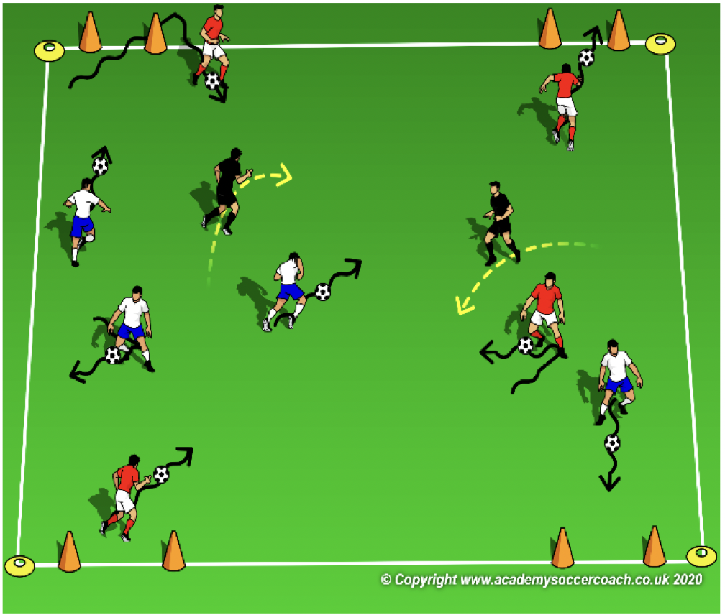
Activity 1 – Pre K – K
OBJECTIVE: To dribble and change direction to goal
PLAYER ACTIONS: Pass or dribble forward
ORGANIZATION: In a 15W x 20L grid with 2 cone goals on each end line & each player with a soccer ball, the players dribble their ball using specific surfaces: outside right (pinky toe)-inside right (big toe)- laces & bottom. Repeat with the left foot. Coaches walk around the field and act as obstacles while the players try to dribble to the safety of any of the 4 goals. RULES: Players begin dribbling as soon as they have their ball. On the coach’s command (or whistle), the players will dribble their ball as fast as they can through any of the 4 goals. After each round, the coach introduces a new surface until all 4 surfaces are completed in a row.
KEY WORDS: Outside, inside, laces & bottom
GUIDED QUESTIONS: How do you know where the coaches are? (Building on the first question) Since the
goals never move, why is it still important to dribble with your head up?
ANSWERS: By looking around, you can see where the coaches are moving to. Since the coaches and the other players could be in your way, it is important to know where everyone is.
Note: Introducing the 4 surfaces works best when 1 surface is introduced at a time then the other surfaces are layered in 1 at a time. This will allow time to become more comfortable with each surface.
.

Slide 37
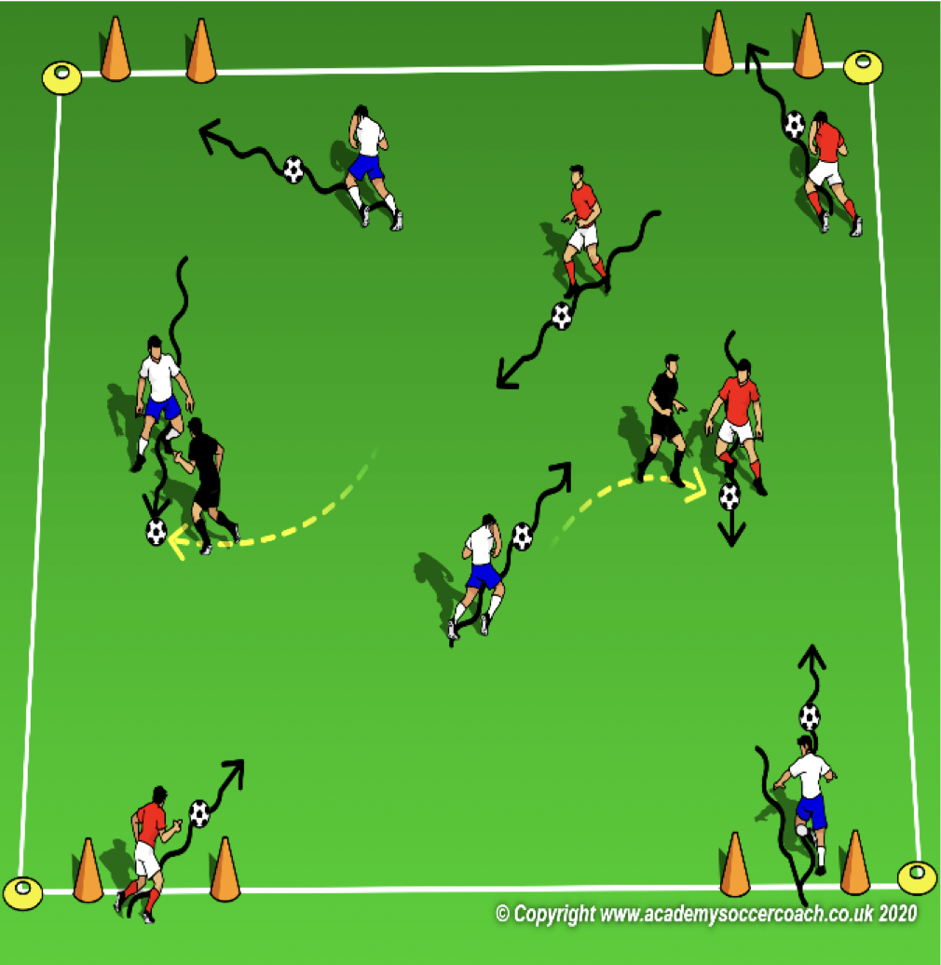
Activity 2 Pre K - K
OBJECTIVE: Improve dribbling to avoid opponents & dribbling to goal
PLAYER ACTIONS: Pass or dribble forward
ORGANIZATION: In a 15W x 20L grid, 2 cone goals on each end line, the players (Crash & Eddy the possums) try to dribble their soccer ball to as many goals as possible while avoiding Sid the Sloths (the coaches who can only walk.) Sid the Sloths try to tag Crash & Eddy.
RULES: Play begins as soon as Crash & Eddy begin dribbling. Crash & Eddy get 1000 points for every goal they can score by dribbling through the cones. If Sid the Sloth tags a dribbler, they lose all their points & have to begin counting over again.
KEY WORDS: Go around Sid, push the ball forward
GUIDED QUESTIONS: When do you want to go around the sloths? What can you do if one goal
is really crowded?
ANSWERS: If Sid is blocking your opening to a goal, you can try to dribble around them (use the outside & inside of the foot to move the ball to the side and laces to push it past Sid.) Use the outside, inside or bottom of the foot to turn the ball toward an open goal.
Note: Coach should focus on the player’s success. Sometimes, instead of tagging them, encourage them to move around the coach and get away. The thought of getting tagged could make them move a little faster.

Slide 38
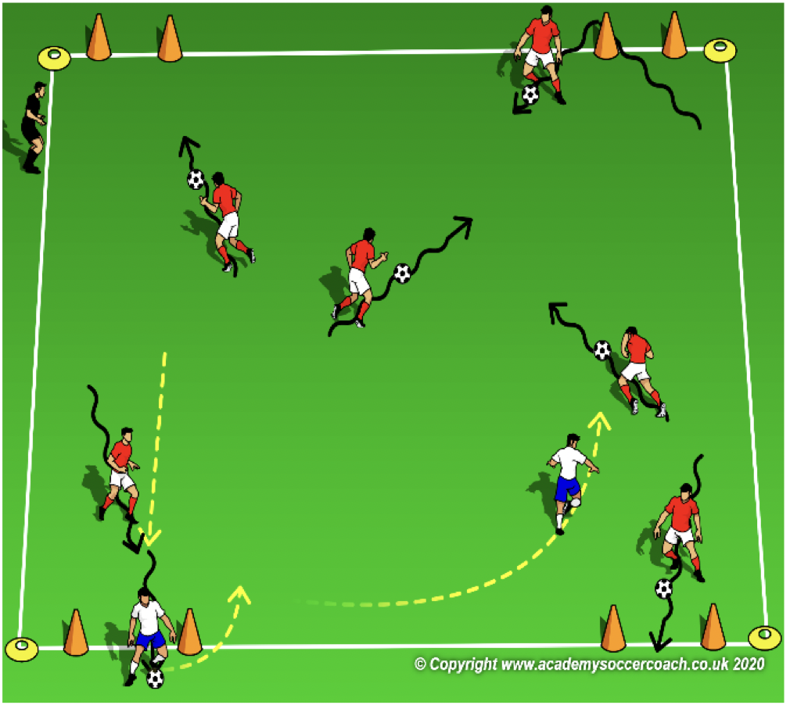
Activity 3 Pre K – K
OBJECTIVE: Move the ball forward to get past the opponent’s in order to score
PLAYER ACTIONS: Shoot, pass or dribble forward
ORGANIZATION: In a 15W x 20L grid, 2 cone goals on each end line, select 2 players to be Scrats (they do not need a soccer ball.) All other players have a soccer ball. The dribblers try to dribble their soccer ball (acorn) into as many goals as possible while avoiding the Scrats. The Scrats try to steal the dribbler’s acorns and hide them in the trees (goals.)
Rules: Play begins as soon as the Scrats enter the field. Dribblers get 1 point for every goal they score. Dribblers can steal their ball back before Scrat gets it to a tree. If a Scrat steals their ball and hides it in a tree, the dribbler loses all their points and have to begin scoring over again.
KEY WORDS: Get close to the goal, try to shoot, don’t let the Scrats hide your ball
GUIDED QUESTIONS: What are some ways you can score more goals? What would happen if you stole the
ball back from Scrat before they could hide your ball?
ANSWERS: Try to shoot it from far away then run after it or dribble closer to the goal before you shoot it. You can keep the Scrat from scoring/hiding your ball and save your points.
Note: In the last few rounds, you can try to accumulate Scrats. If a Scrat steals and hides a ball in a goal, that player becomes a Scrat also. Which player can last the longest? Remember to encourage the dribblers more than the Scrats.

Slide 39
PLAY 2 – Pre K - K
ORGANIZATION
Split players into two teams and play
PLAYER ACTIONS
Pass/dribble, Spread out, Pass options
KEY WORDS
Use space, hips open, pass, dribble, get open

Slide 40
Week Seven

Slide 41
PLAY 1 – Pre K - K
ORGANIZATION
Mark out two fields. (Field size dependent on age group)
Free play:
Field 1: Teams play 2v2/3v3 or 4v4 (Depending on age group and number of players.
Field 2: Teams play 2v2/3v3 or 4v4 (Depending on age group and number of players.
Allow players to play freely introducing key words
PLAYER ACTIONS
-Pass/dribble -Spread out -Pass options
KEY WORDS
Use space, hips open, pass, dribble

Slide 42
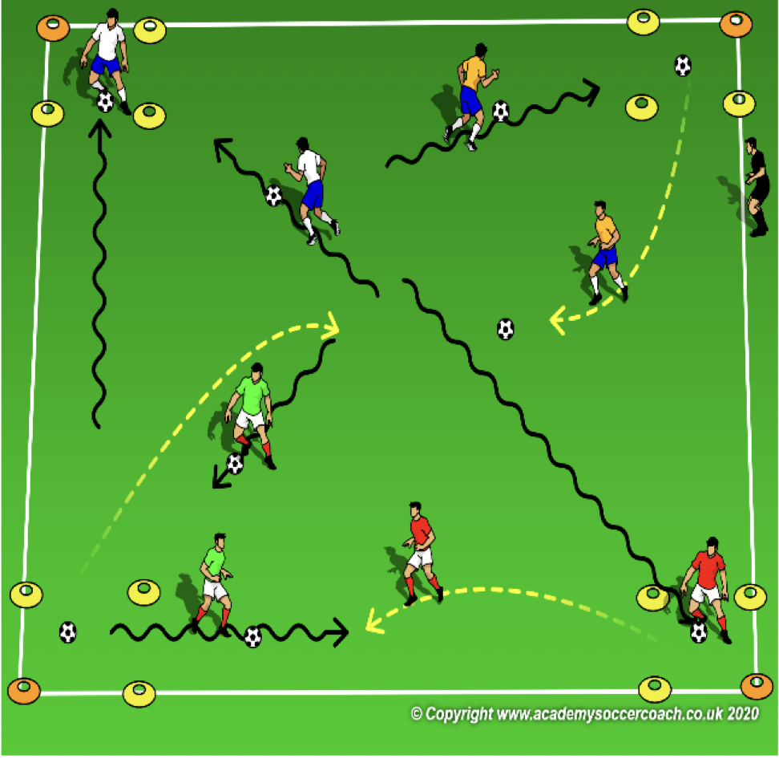
Activity 1 – Pre K – K
OBJECTIVE: Improve the player’s ability to turn and dribble their soccer ball to a target
PLAYER ACTIONS: Dribble forward
ORGANIZATION: In a 15W x 20L grid, place a 4x4 square in each corner & all soccer balls start in the middle of the grid. Divide the players equally between the corners (each team should make up their own team name). On the coach’s command, the players race to the middle to get a ball with their feet and dribble it back to their home square. Once all the balls are gone from the middle, the players can steal soccer balls from other squares.
RULES: Play begins when the coach says, “GAME ON!” Dribblers can only use their feet to get and dribble a soccer ball.
KEY WORDS: Find your home base, look up to find anyone trying to steal your ball
GUIDED QUESTIONS: After you steal a treasure, what now? What can you do if you see a soccer ball on
the field?
ANSWERS: Once you have stolen some treasure, get it back to your home base quickly. Go get it and dribble it back to your home base.
Note: Watch players and make sure they are only using their feet. When guarding the soccer balls, children may try to lay on top of them. For a safer environment, make a rule that doesn’t allow for this. In later rounds, challenge the players to pass it back to their home base.

Slide 43
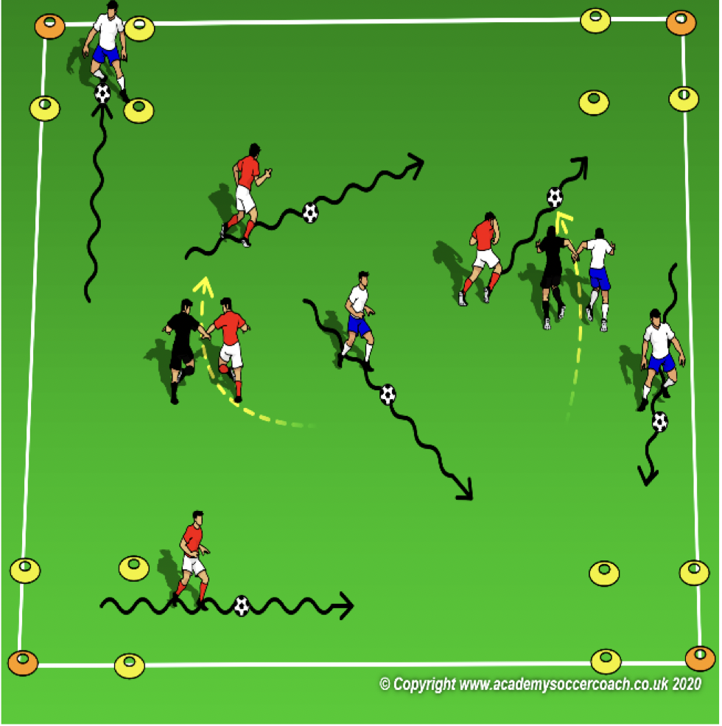
Activity 2 Pre K - K
OBJECTIVE: Improve the players ability to dribble the ball away from opponents
PLAYER ACTIONS: Dribble forward
ORGANIZATION: In a 15W x 20L grid, place a 4x4 square in each corner (caves.) Divide the players equally between the 4 corners & each player has a soccer ball except for 2. Each of these players joins hands with a coach to become a Two-Headed Monster. The players try to dribble their soccer ball into as many caves as possible. The monsters try to tag them.
RULES: Play begins when the coach says, “MONSTERS ON THE LOOSE!” Dribblers get 100 points for every cave they can get into. If tagged by a monster, they lose their points and begin scoring again. The caves are safe for the dribblers & the monsters must stay connected.
KEY WORDS: sneak behind a monster, stop the ball (in a cave), scan the field
GUIDED QUESTIONS: What can you do if the monsters are not facing you? Where can you go if a
monster is guarding a cave?
ANSWERS: Quickly sneak behind them to an open cave. Scan the field to find an open cave. Turn if you have to and get to that cave as quickly as you can.
Note: Early on, coaches may need to encourage some players to move from cave to cave. Help them recognize when it is safe to go. Stop assisting once they identify the moment to go.

Slide 44
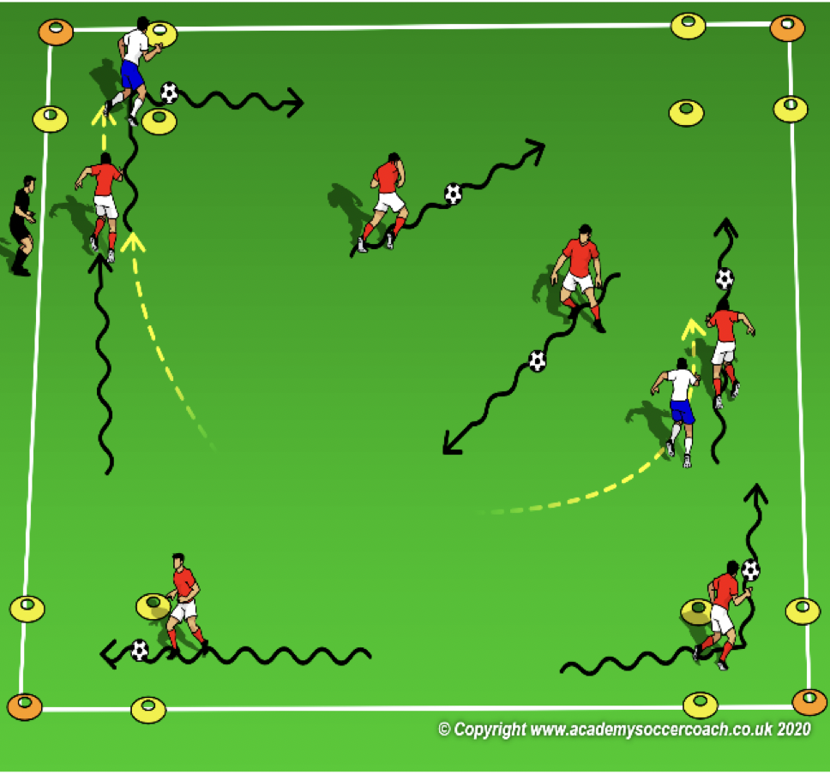
Activity 3 Pre K – K
OBJECTIVE: Turn & dribble your soccer ball away from pressure and find and open goal
PLAYER ACTIONS: Dribble forward
ORGANIZATION: In a 15W x 20L grid, place a 4x4 square in each corner. Select 2 players to start without a soccer ball; all other players with a ball. Players with a ball try to dribble from box to box. Each box they safely get into is worth 1000 points. Players without a ball try to steal any ball they can and start scoring by getting safely to a box.
RULES: Play begins when the coach says, “Game On!” Dribblers get 100 points for every box they can get into. If a player loses their ball, they can either steal their ball back or try to steal another ball so they can start scoring again. A dribbler is safe once they get into a box.
KEY WORDS: Turn away from danger, dribble fast to a safe space on the field
GUIDED QUESTIONS: When is a good time to run to the next box? Why might you want to stop your ball
inside one of the boxes?
ANSWERS: If you see an opening to the next box & can get their safely. By stopping the ball in the box, you have time to rest and scan the field for the next box to get to.
Note: Coaches may have to remind the players to try to keep scoring. Coaches may also have to remind the players without a ball that the boxes are safe places for the dribblers. Remember to focus on the players with the ball and the decisions they may have to make.

Slide 45
PLAY 2 – Pre K - K
ORGANIZATION
Split players into two teams and play
PLAYER ACTIONS
Pass/dribble, Spread out, Pass options
KEY WORDS
Use space, hips open, pass, dribble, get open

Slide 46
Week Eight

Slide 47
PLAY 1 – Pre K - K
ORGANIZATION
Mark out two fields. (Field size dependent on age group)
Free play:
Field 1: Teams play 2v2/3v3 or 4v4 (Depending on age group and number of players.
Field 2: Teams play 2v2/3v3 or 4v4 (Depending on age group and number of players.
Allow players to play freely introducing key words
PLAYER ACTIONS
-Pass/dribble -Spread out -Pass options
KEY WORDS
Use space, hips open, pass, dribble

Slide 48
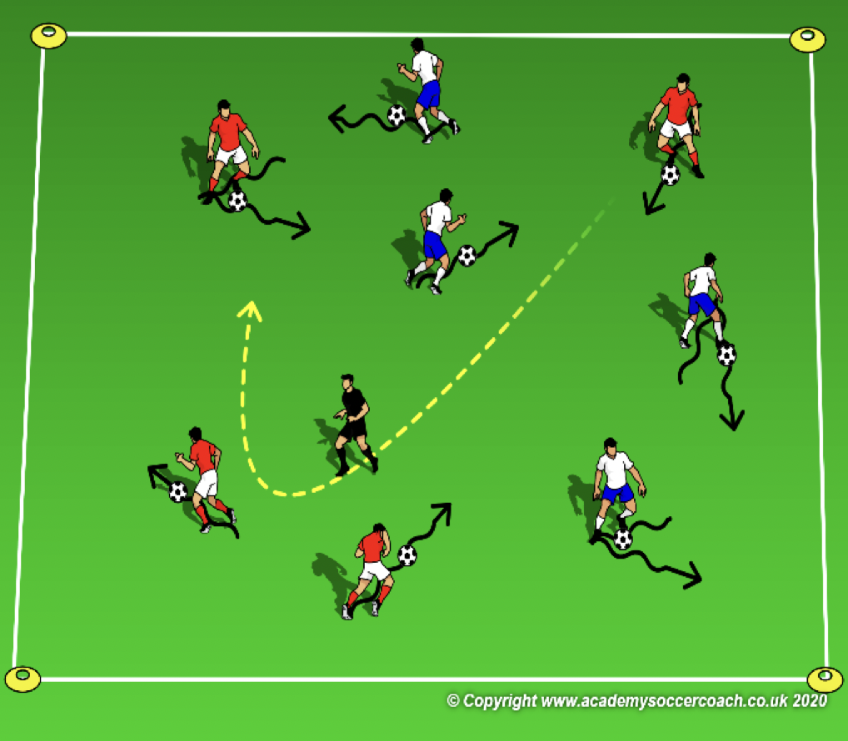
Activity 1 – Pre K – K
OBJECTIVE: To dribble and change direction
PLAYER ACTIONS: Dribble forward
ORGANIZATION: In a 15W x 20L grid & all players with a soccer ball, the players dribble their ball using specific surfaces: outside right (pinky toe)-inside right (big toe)-laces-bottom-toe-heel. Repeat with the left foot. Coaches walk around the field to assist or encourage the players through the pattern.
RULES: Players begin dribbling as soon as they have their ball. On the coach’s command (or whistle), the players will dribble their ball as fast as they can using all six surfaces. After each round, the coach introduces a new surface until all 6 surfaces are completed in a row.
KEY WORDS: Outside, inside, laces, bottom, toe & heel
GUIDED QUESTIONS: What can you do to help you remember the different surfaces? Who can explain to
me what they have to do with their foot in order to use the different surfaces?
ANSWERS: Encourage the players to say the surfaces as they use them. This will help with their memory of the pattern. Question 2 is checking for understanding. See if the players can tell & show the team how they can use the different surfaces.
Note: Since the players have already used 4 surfaces, start with who can show the 4 surfaces in rounds 1 & 2. Now, 1 at a time, introduce the 2 new surfaces.

Slide 49
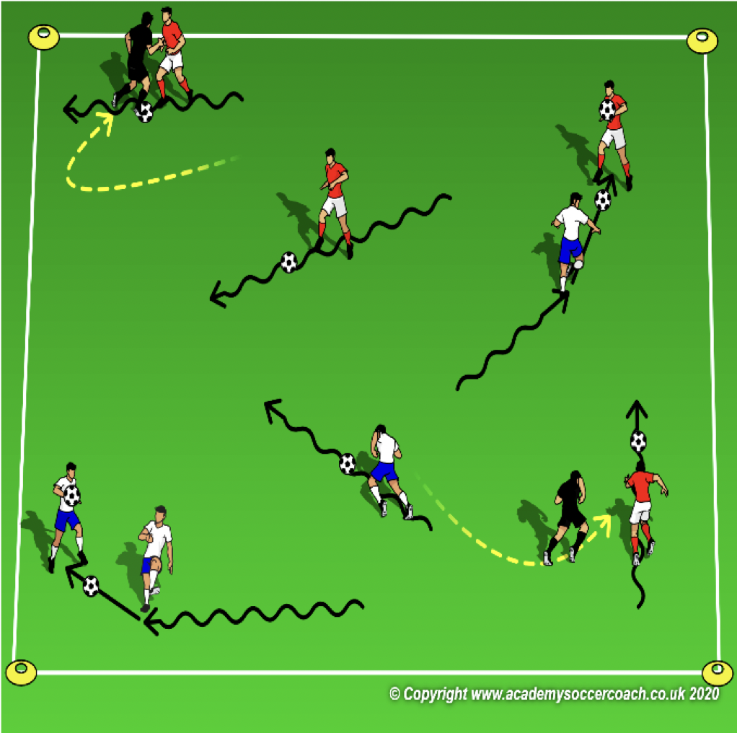
Activity 2 Pre K - K
OBJECTIVE: Improve dribbling to avoid opponents
PLAYER ACTIONS: Pass or dribble forward
ORGANIZATION: In a 15W x 20L grid, the coach will select 2 Freeze Monsters who do not need a soccer ball. The rest of the players dribble their ball around the grid and avoid the Freeze Monsters. If a Freeze Monster tags a dribbler, they are frozen. They must stand & hold their soccer ball over their head so their teammates know they are frozen. To get unfrozen, a dribbling teammate must hit them in their shin guards with their ball.
RULES: Play begins when the coach says, “BEWARE OF THE FREEZE MONSTER!” Dribblers must stay within the grid. If their ball goes out of play, the dribbler must retrieve it as fast as they can and return to the game.
KEY WORDS: Find who is frozen, unfreeze your teammate
GUIDED QUESTIONS: How do you know where the Freeze Monsters are or where the frozen players
are? How do you unfreeze a teammate?
ANSWERS: You have to look up and around you to see the Freeze Monsters and your frozen teammates. When no Freeze Monsters are close, dribble to your teammate and pass your ball into their shin guards.
Note: If they players are able to hit their teammates in the shin guards, you can also try to have them pass through their frozen teammates legs. If they are struggling the free their teammates, a simple tag can unfreeze them too. Coaches can start as freeze monsters if needed.

Slide 50
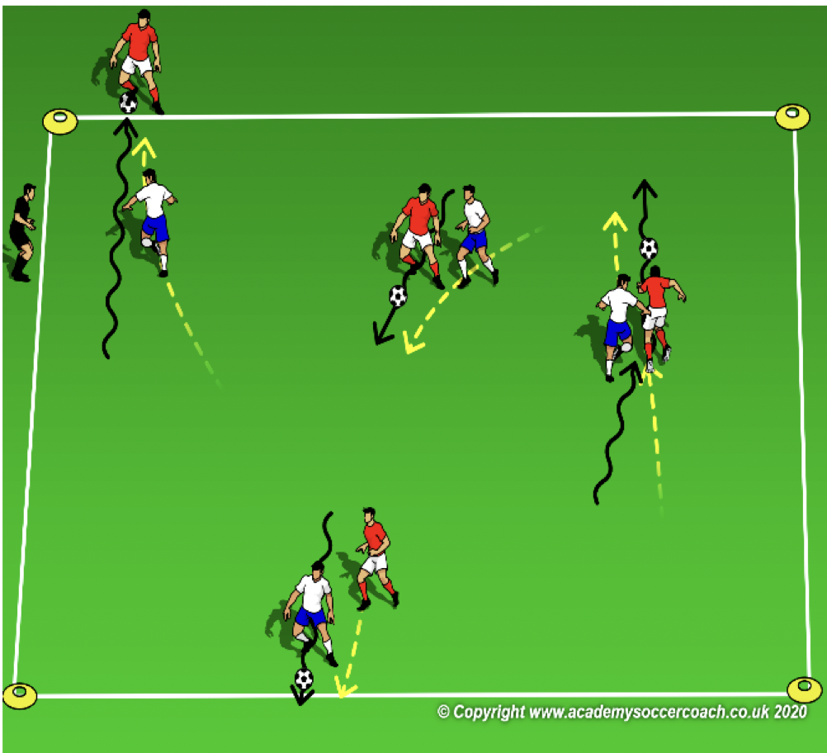
Activity 3 Pre K – K
OBJECTIVE: Move the ball forward to get past the opponent’s in order to score (stop it on the line)
PLAYER ACTIONS: Dribble forward
ORGANIZATION: In a 15W x 20L grid, each player gets a partner and 1 soccer ball to share. Play a short 1v1 game. 1 player attacks an end line & their partner/opponent attacks the opposite end line. All pairs play at the same time.
Rules: Play begins as soon as any player touches the ball. Goals are scored by the attacking player stopping the ball on the opponent’s end line. After a goal is scored, the player who didn’t score starts with the ball. The game is continuous for 30 seconds. Players must stay within the grid.
KEY WORDS: Get the ball to the line, stop it, go around them
GUIDED QUESTIONS: What is the best way to get by your opponent and score? Once you get to the line,
who can show me at least 2 different ways to stop your ball & score?
ANSWERS: Find an opening all the way to the line then push the ball in front of you so you can run after it. Question 2 is a check for understanding. Encourage the players to show you how they can stop the ball on the line (without using their hands.)
Note: The coach can walk around the field if needed to interact with the players. Your positive voice can be encouraging to the players to try and score. The field should be big enough but monitor the players if they begin to get too congested.

Slide 51
PLAY 2 – Pre K - K
ORGANIZATION
Split players into two teams and play
PLAYER ACTIONS
Pass/dribble, Spread out, Pass options
KEY WORDS
Use space, hips open, pass, dribble, get open

Slide 52
Week Nine

Slide 53
PLAY 1 – Pre K - K
ORGANIZATION
Mark out two fields. (Field size dependent on age group)
Free play:
Field 1: Teams play 2v2/3v3 or 4v4 (Depending on age group and number of players.
Field 2: Teams play 2v2/3v3 or 4v4 (Depending on age group and number of players.
Allow players to play freely introducing key words
PLAYER ACTIONS
-Pass/dribble -Spread out -Pass options
KEY WORDS
Use space, hips open, pass, dribble

Slide 54
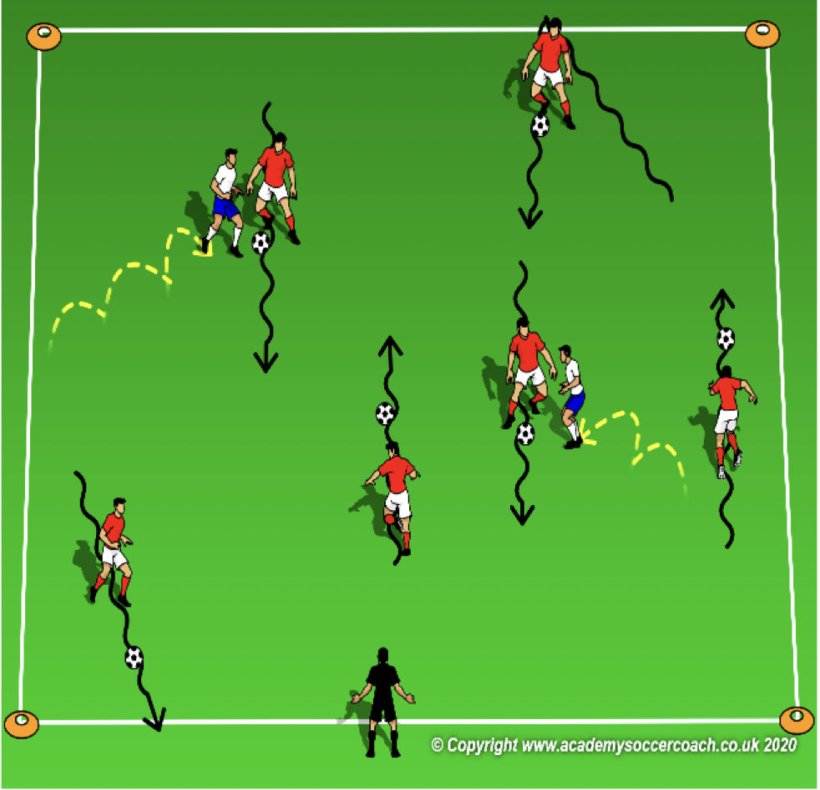
Activity 1 – Pre K – K
OBJECTIVE: To dribble and change direction to avoid Things 1 & 2
PLAYER ACTIONS: Pass or dribble forward
ORGANIZATION: In a 15W x 20L grid, select 2 players to start as Things 1 & 2; they do not need a soccer ball & can only hop to move. The rest of the players start with a soccer ball at 1 end line; they are Cats in Hats. The Cats try to dribble their ball from 1 end line to the other as many times in 30 seconds as they can. If a Cat gets tagged by Thing 1 or 2, they become a thing also.
RULES: Play begins as soon as the coach say, “LETS HAVE SOME FUN.” Count the number of times the cats can safely cross.
KEY WORDS: Faster with longer touches, slower with shorter touches
GUIDED QUESTIONS: Why should you use big touches to dribble? What kind of touches should you
use if you are get close to an end line and want to turn?
ANSWERS: By kicking it further in front, you can build up speed and go faster. Use softer touches when you close to an end line and want to turn.
Note: A variation in the game is to allow the players to switch roles if a Thing can tag a cat. Coaches can also start as Things 1 & 2 in the first round. Remember to encourage dribbling. If the coaches start has Things 1 & 2, sometimes allow the players to achieve success by not rushing to tag a player who is struggling to dribble.

Slide 55
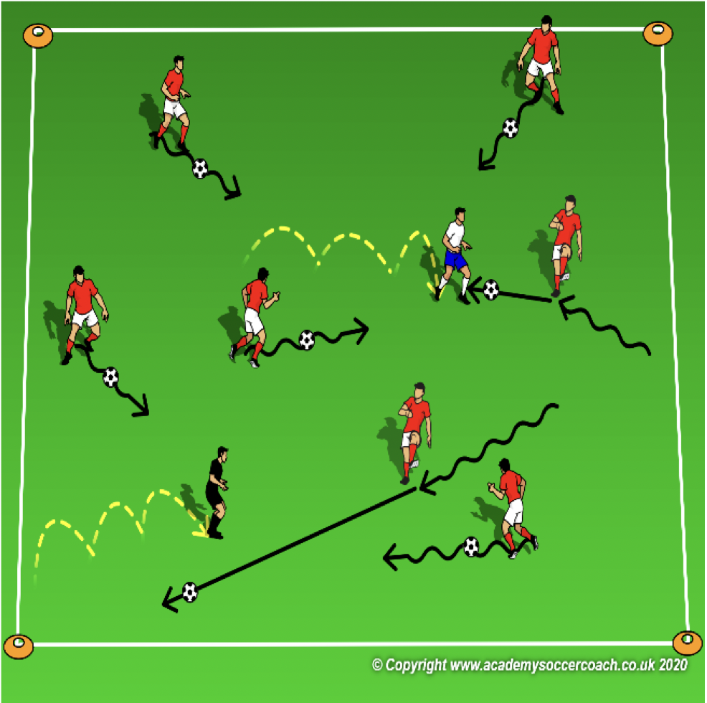
Activity 2 Pre K - K
OBJECTIVE: Improve dribbling toward a target and kicking your ball to a moving target
PLAYER ACTIONS: Pass or dribble forward
ORGANIZATION: In a 15W x 20L grid, select 2 players to start as Tiggers. They start without soccer balls and can only hop or skip to avoid getting hit with a ball. The rest of the players start with a soccer ball and they are Rabbits. They dribble their ball & try to hit the Tiggers in their socks with their ball. Since the Rabbits hate the noise the Tiggers are making, they only way to stop them is with their ball.
RULES: Play begins as soon as 1 Tigger takes a hop. Rabbits get 1 million points for every Tigger they can hit. Each round, switch who are Rabbits and who are the Tiggers.
KEY WORDS: Kick the ball closer to a Tigger, watch the ball as your foot hits the ball
GUIDED QUESTIONS: Why would you get closer to a Tigger before you try to hit them? Where is
the best place to strike a soccer ball if you want to hit a Tigger in the socks?
ANSWERS: It is easier to hit the Tiggers if you are closer to them. If you watch your foot hit the ball right in the middle, the ball will stay low to hit the socks.
Note: Coaches can start as Tiggers. Observe the players and how they are kicking the ball to make for a safer game. Encourage striking through the middle of the ball to help keep it on the ground.

Slide 56
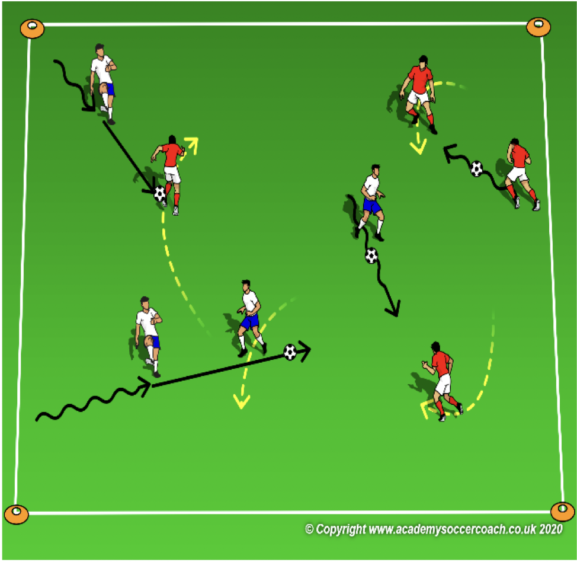
Activity 3 Pre K – K
OBJECTIVE: Improve dribble toward a target and striking the ball to a moving target
PLAYER ACTIONS: Pass or dribble forward
ORGANIZATION: In a 15W x 20L grid, 2 teams-1 team of Good Minions, without soccer balls & 1 team of Evil Minions, with soccer balls. Evil Minions try to dribble their ball & zap the Good Minions by hitting them below the knee with their ball. Good Minions try to run & avoid getting hit.
RULES: Play begins as soon as the first Evil Minion begins to dribble. If an Evil Minion hits a Good Minion, the switch roles; the Good Minion becomes Evil and Evil Minion becomes Good. The new Evil Minion get a ball and begins to hunt the Good Minions.
KEY WORDS: Accuracy (Aim,) Pace (Speed) & Weight (Strength)
GUIDED QUESTIONS: Who can describe what they have to do with the ball in order to hit a Good Minion? So,
when is the best to for the Evil Minions to shoot their ray gun (soccer ball?)
ANSWERS: Take aim by turning your body toward the Good Minion hit the ball with enough pace so the Good Minion can’t get out of the way. After you have dribbled close and took aim, hit through the middle of the ball with the middle of your foot to hit the Good Minion.
Note: Coaches can start as Good Minions. Always be aware of how players are striking the ball and guide the players on ways to keep the ball on the ground. If a coach becomes an Evil Minion, remember to strike the ball gently to make the game safer for the players.

Slide 57
PLAY 2 – Pre K - K
ORGANIZATION
Split players into two teams and play
PLAYER ACTIONS
Pass/dribble, Spread out, Pass options
KEY WORDS
Use space, hips open, pass, dribble, get open

Slide 58
Week Ten

Slide 59
PLAY 1 – Pre K - K
ORGANIZATION
Mark out two fields. (Field size dependent on age group)
Free play:
Field 1: Teams play 2v2/3v3 or 4v4 (Depending on age group and number of players.
Field 2: Teams play 2v2/3v3 or 4v4 (Depending on age group and number of players.
Allow players to play freely introducing key words
PLAYER ACTIONS
-Pass/dribble -Spread out -Pass options
KEY WORDS
Use space, hips open, pass, dribble

Slide 60
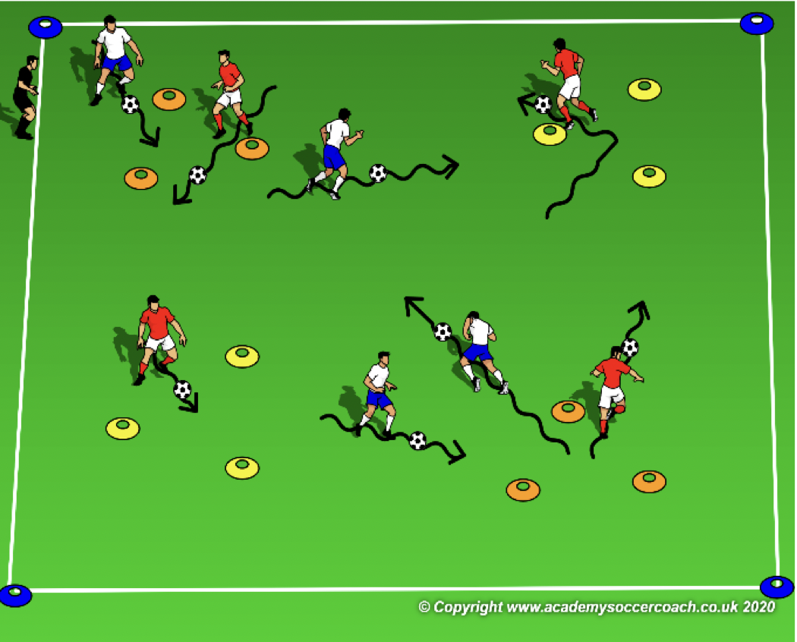
Activity 1 – Pre K – K
OBJECTIVE: Improve the player’s ability to dribble & change direction
PLAYER ACTIONS: Dribble forward
ORGANIZATION: In a 15W x 20L grid with several 3 yard triangular goals randomly placed in the grid & all players with a soccer ball, the players dribble their ball into or through as many goals as possible. How many goals can the players get to in 1 minute?
RULES: Players begin dribbling when coach says, “GO!” Intervals 2 & 3, players try to beat their score. Intervals 4-6, still beat their score but also must stop the ball in each space for a point.
KEY WORDS: look up, look around, stop your ball
GUIDED QUESTIONS: Why is it important to pick your head up and look over your shoulder? How do you
know which triangle goal to go to next?
ANSWERS: Pick your head up and look around to see which triangle to attack next. Keep looking so you don’t bump into anyone. The triangle goal with the fewest players close to it is usually best.
Note: Coach should observe the players to determine their level of understanding. You may have to start slow by asking the players to get to any goal as fast as they can. Then, who can get to all goals the fastest? Finally, make the game a challenge

Slide 61
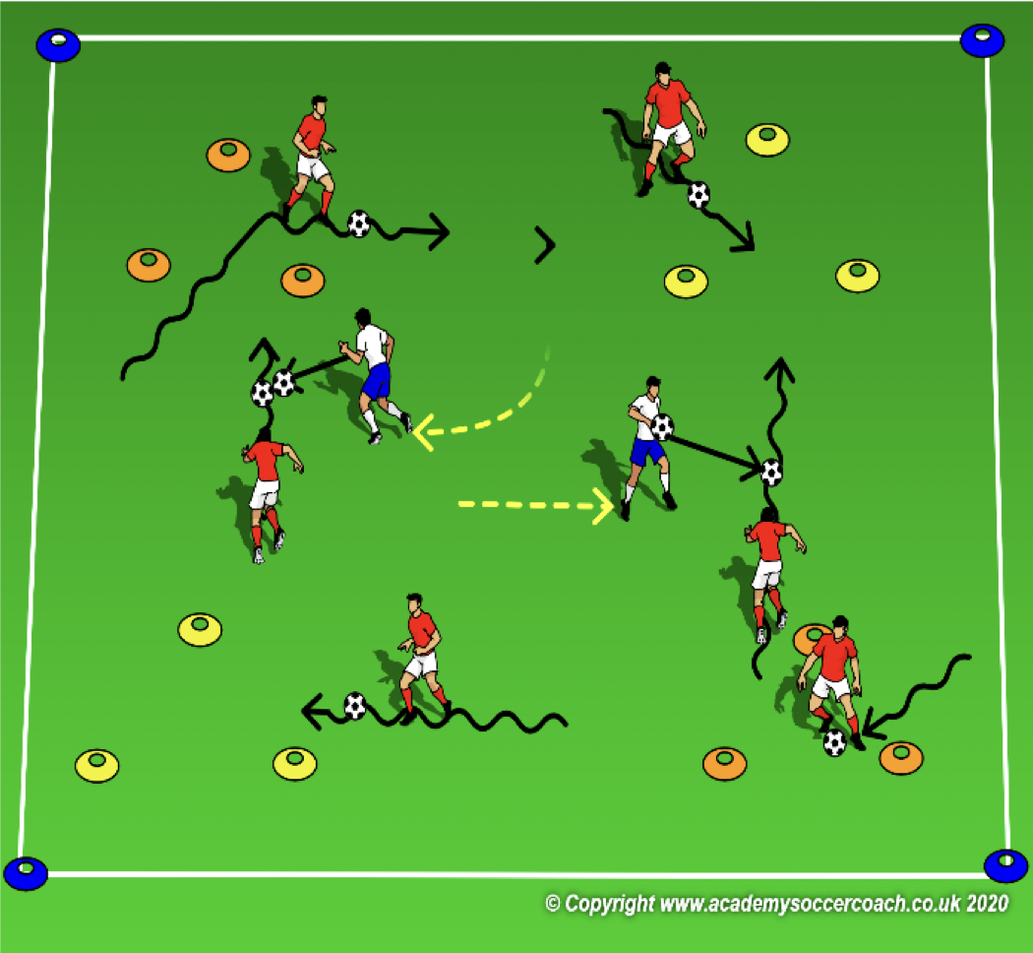
Activity 2 Pre K - K
OBJECTIVE: Improve the player’s ability to dribble away from opponent’s and stop their soccer ball
PLAYER ACTIONS: Dribble forward
ORGANIZATION: In a 15W x 20L grid with several 3 yard triangular goals (bases) randomly placed in the grid, all players with a soccer ball, the coach will select 2 players to be it. The 2 players who are it, have their ball in their hands & they guard the bases. The rest of the players try to dribble their ball and get 100 points for every base they can stop their ball in. If a guard can hit the dribblers ball with their own, the dribbler loses all their points.
RULES: Players begin dribbling when coach says, “GO!” Guards can only toss their ball with 2 hands and underhand to hit the dribbler’s ball. Dribblers are safe if they can stop their ball (with their feet) in any triangular goal.
KEY WORDS: Stop your ball, look before you go to the next base
GUIDED QUESTIONS: Who can show me how to stop their ball inside of a triangle? When is the best
time to move to the next goal?
ANSWERS: First question is eliciting a player who can demonstrate how to stop the ball. Generally it can be with the bottom of the foot but any surface which stops the ball from rolling is ok. With no guards are looking at you or are close to you, get to the next goal.
Note: 2 hands and underhand will keep the game safe. Overhand throws tend to be a little more reckless. Guide (instead of tell) the players to recognizing the moment to go.

Slide 62
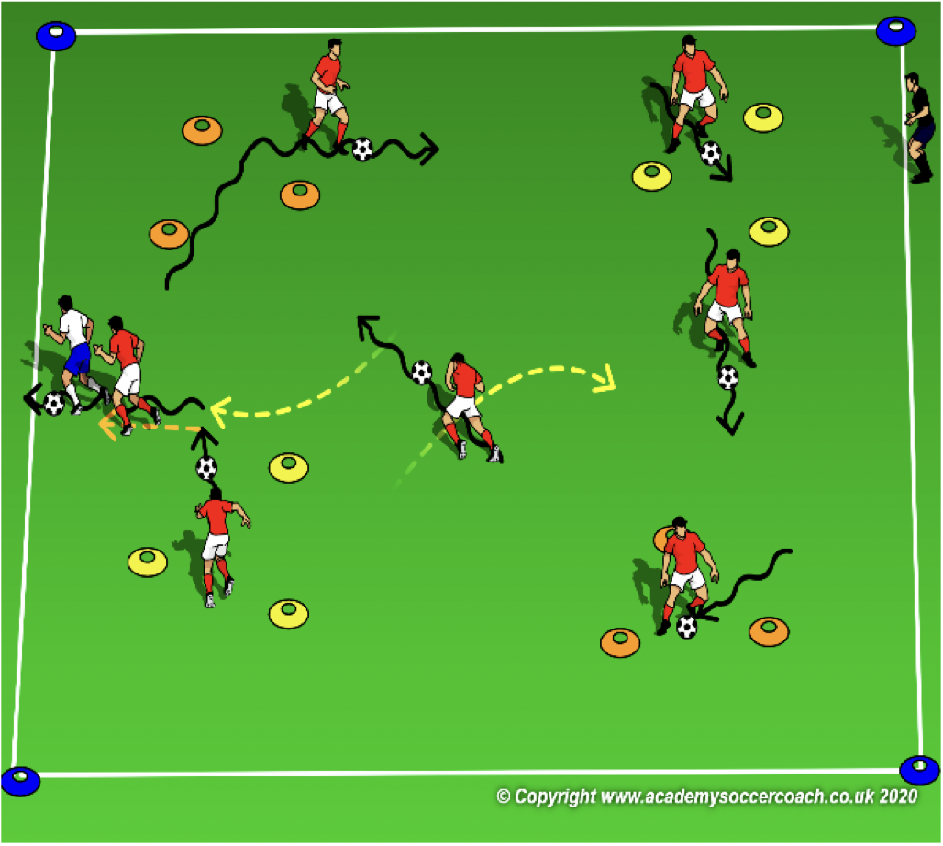
Activity 3 Pre K – K
OBJECTIVE: Move the ball forward to get past the opponent’s in order to score (stop it on the line)
PLAYER ACTIONS: Dribble forward
ORGANIZATION: In a 15W x 20L grid with several 3 yard triangular goals (bases) randomly placed in the grid, all players with a soccer ball, the coach will select 2 players to be it (they are Boo.) The 2 players who are it, do not have a soccer ball. The rest of the players (Mike & Sully) do have a ball & try to dribble their ball & hide from Boo in a closet (the goals). They get 1000 points for every base they can stop their ball in. If Boo tries to steal their ball and dribble it out of the grid.
RULES: Play begins when coach says, “look out for Boo!” Dribblers try to get from closet to closet. Dribblers are safe in a closet. If Boo steals their ball and dribbles it out of the grid, they lose all points and start again.
KEY WORDS: Step close to the ball to stop it, look out for Boo
GUIDED QUESTIONS: Where should your body be when you are trying to stop the ball? Besides in the
closet, when is another time you would want to stop your ball?
ANSWERS: Try to run slightly ahead of the rolling ball before putting your foot on top of the ball to stop it. If the ball starts to get too far in front of you or is about to go out of play, stop it and start dribbling again.
Note: After 2 rounds, change the rules so now, only 1 player in a closet at a time. If a new player enters, the player in the longest has to leave. Boo & the monsters can also switch roles if the ball is lost; coaches choice.

Slide 63
PLAY 2 – Pre K - K
ORGANIZATION
Split players into two teams and play
PLAYER ACTIONS
Pass/dribble, Spread out, Pass options
KEY WORDS
Use space, hips open, pass, dribble, get open

Slide 64
Thank you for taking your time to help better our MYS Soccer Family

