Slide 1

Mansfield Youth Soccer 3-6th Grade Spring Session Plans

Slide 2

It is important to note what we are trying to achieve within a season so we can re-evaluate at the end to see if we have accomplished our goals. The pathway to success depends on how well we execute the follow philosophy in every session we take:
• To help each Pre K grade player to reach their full potential in the sport of soccer.
• To develop players that are comfortable with the ball at their feet
• To Improve each players knowledge and understanding of the game.
• To create a positive and fun atmosphere where players can learn and develop at their own pace.

Slide 3

•Heel / Toe Roll : - Roll ball up and down sole of foot from heel to toe keeping contact with the ball at all times
•Inside Outside Roll : - Same but now but moving ball from inside to outside of sole of foot
•Circle Roll : - Moving ball with same foot in a circular motion
•Front foot Dribble :- Small touches using the front of the foot only (laces)
•Big Toe / Little Toe : - Move ball with Inside of big toe, followed by outside of little toe in a zig zag fashion
•Big Toe, Big Toe / Little Toe Little Toe :- Same but now 2 touches with big toe followed by two touches of little toe
•Side Sprints:- Ball in between feet moving ball from side to side in a pendulum fashion
•Side Sprints forwards / backwards :- Same but now moving ball forwards and backwards
•Side Sprints Side to Side :- Now move body to left whilst performing 3-4 side sprints and then back to the right in a zig zag
•Pull Push :- Pull ball back from heel to toe and push forward with the laces
•Pull Push Inside / Outside :- Pull ball across body using the pull and out of body using the push, repeat both sides
•Pull Push Behind :- Pull ball to side & behind standing foot and using inside of big toe push across to control with other foot
•Side sprints w / pull push combo :- As described above
•Sole Taps :- Little touches on ball using front of the sole of the foot
•Sole Taps forwards / backwards :- Same, moving ball backwards and forwards
•Sole Taps w / pull push behind combo :- Same but now add a pull push behind
•Sideways Rolls :- Body square to the ball, roll whole foot over the ball inside of foot first and quickly repeat
•Sideways Rolls change over left to right :- Same but change ball from left to right with a roll across body
•Sideways Rolls w/ roll over step over :- Same but now roll across body while performing a step over
•Figure 8 dribbling :- Dribbling ball in a figure 8 between two cones

Slide 4
8 Week Seasonal Plan
Build up in the defensive half
2. Build up in the opponent’s half
3. Running with the ball
4. Changing direction with Turns
5. Improve Scoring Goals
6. Passing
7. 1 vs 1’s and 2 vs 1’s: To targets/goals
8. Shooting Games

Slide 5

Each session will follow the same format. The format is designed to get the player into game situations right from the start of training. There are 3 phases that the session will go through, progressively getting more challenging and competitive:
Related Warm-Up
2. Activity 1
3. Activity 2
4. Small sided games
Each session will last 60 minutes.

Slide 6
Session One:
Build up in the defensive half

Slide 7
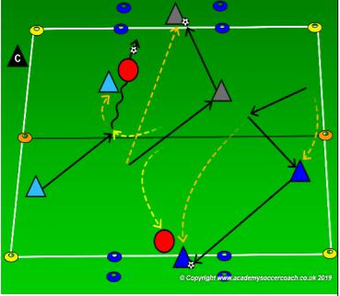
Warm Up Activity: TRAFFIC LIGHTS
Area: 30 x 30 yards area. All players with a ball.
Description: All players in pairs. Select 1 pair to be the bandits. Each pair needs 1 ball to share except for the bandits. The pairs with a ball will try to dribble & pass to either goal & pass to their teammate within the goal. After scoring in one end, play to the other. How many goals can you score in 2 minutes? The mission of the bandits is to steal the ball from the passing pairs & bring it to one of the two hideouts (goals). The passing pairs can take the ball back from the bandits before they get it all the way to the hideout. If the bandits get the ball into the hideout, the pair lose all their points and have to start counting over again. Rotate bandits after each interval.
Progression: Variation-if bandits steal a ball and get it to a hideout, they can now begin scoring goals. The team that lost the ball must now steal another ball in order to start scoring again.

Slide 8
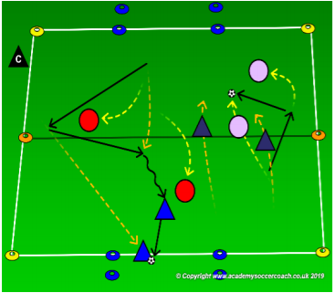
Activity 1: FOLLOW THE LEADER
Description: coach will create teams of 2 players. Two teams will play against one another and, on the same field and at the same time, two other teams will also play against one another. Each team will defend 1 goal and score in the other. A goal is scored by either dribbling the ball into the opponent's box or passing the ball to your teammate in the box. After a goal is scored, the scoring team backs up to allow the ball back into play and the game continues. If you have more than 4 teams of 2, either rotate teams onto the field or create a second field.
Progression:: Coach can add passing or scoring incentives as needed to further challenge the players

Slide 9
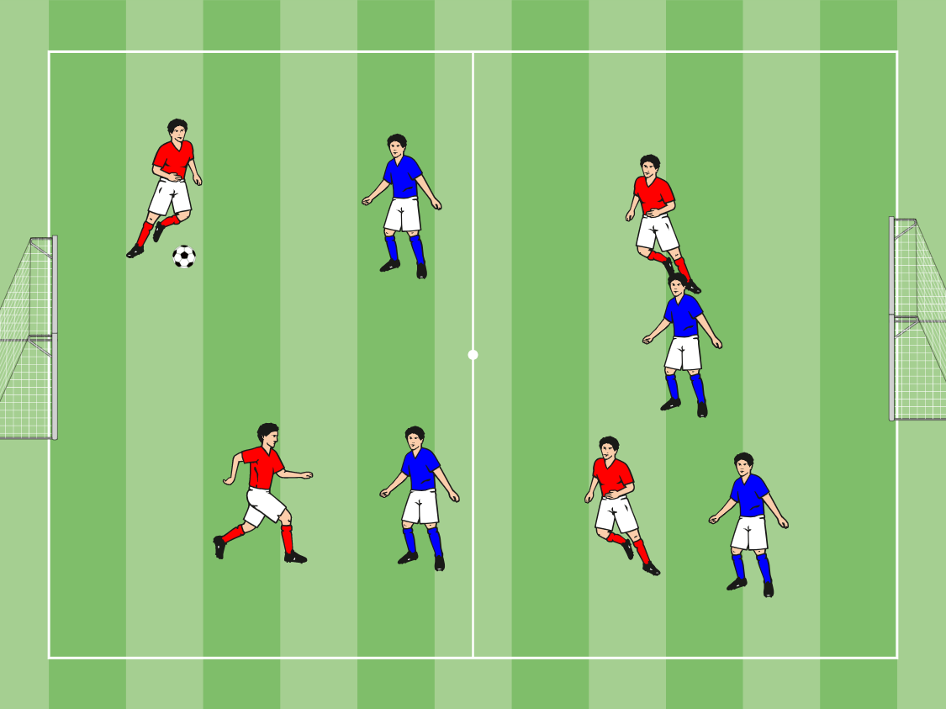
Small Sided Games: 4 V 4
Organization: 20 x 30 grid,
Two teams of 4 vs 4
Let the game flow and give pointers when necessary, try not to keep starting and stopping it.

Slide 10
Session Two:
Build up in the opponent’s half

Slide 11
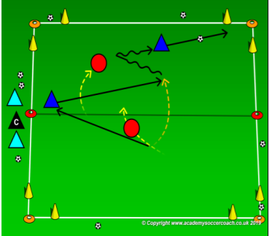
Warm Up
Description: place a cone goal in each corner of the field. Play a 2v2 game on each field. Each field will also have a team on the side line who switches in after 1 minute. Both teams will defend the 2 goals on one end line and attack the 2 goals on the other end line. Place several soccer balls around the field for quicker restarts. Rules: coach keeps track of time. After 1 minute, a team leaves the field. After the first minute, each team remains on the field for 2 games and they have 1 game off. The game does not stop to switch teams. The team who stays on the field can score if the new team doesn’t enter quickly.
Progression: . After 1 minute, a team leaves the field. After the first minute, each team remains on the field for 2 games and they have 1 game off. The game does not stop to switch teams. The team who stays on the field can score if the new team doesn’t enter quickly.

Slide 12
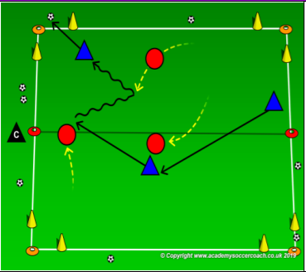
Activity 1
Description: Place a cone goal in each corner of the field. Play a 3v3 game on each field. Both teams will defend the 2 goals on one end line and attack the 2 goals on the other end line. Place several soccer balls around the field for quicker restarts.

Slide 13
Small Sided Games: 4 V 4
Organization: 20 x 30 grid,
Two teams of 4 vs 4
Let the game flow and give pointers when necessary, try not to keep starting and stopping it.

Slide 14
Session Three:
Running with the ball

Slide 15
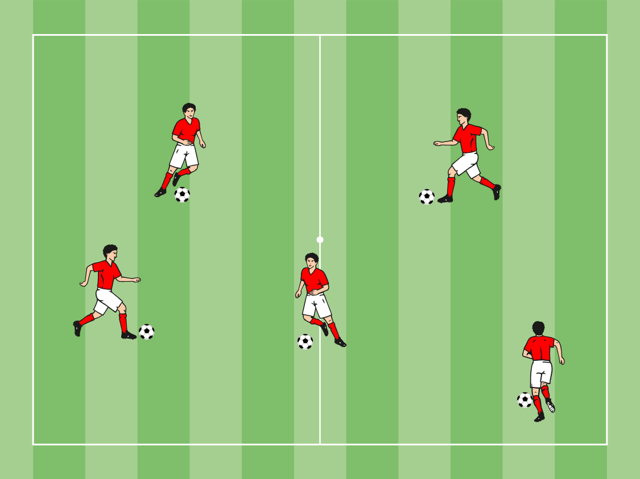
Warm Up Activity: PAINT THE FIELD
Description: Each player has a ball which will act as a paint brush. The players must dribble the ball all around the area ‘ Painting’ the field. Encourage the players to use there imagination, change colors and paint shapes.
Progression: 1. Use other foot
2. Use different parts of the foot
3. On the shout ‘ change’ players can change paint brushes (balls) with someone else.
Coaching Points: Players concentrate on small, close touches with a touch on the ball every time they take a step.
Can we move In open spaces.

Slide 16
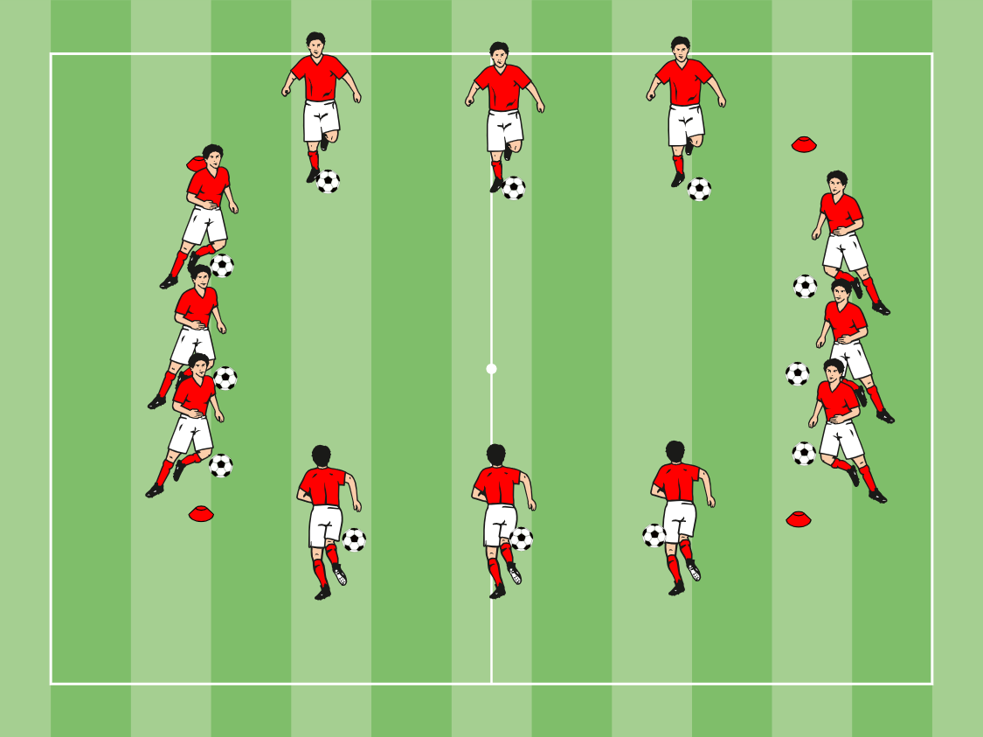
Activity 1: AROUND THE WORLD
Area: 30 x 30 yards area. 4 cones, 1 ball each.
Description: Players surround the outside of the grid. When the coach shouts a command the players will dribble across the box avoiding the players around them. Have the players decide the side names (different country's etc)
Commands:
Fly- Players go quickly but carefully.
Sail – players go slowly but not walking
Coaching Points: Keep the ball close, what do you see. Heads up so we don’t crash.

Slide 17
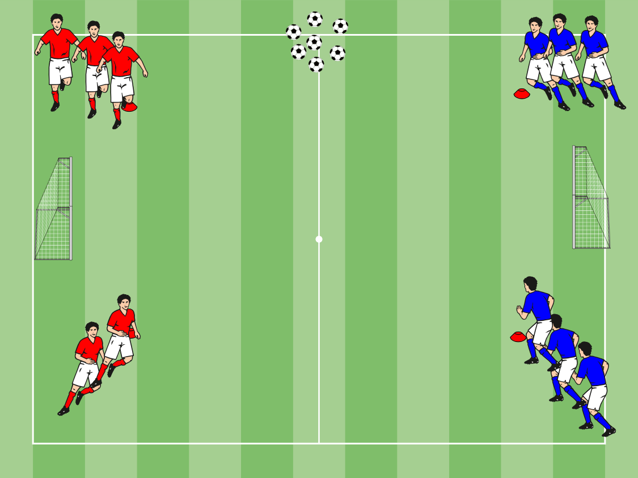
Activity 2: NUMBERED SHOOTING
Area: 30 x 30 yards area.
Description: Separate the players into 2 teams. Each player is giving a number between 1 – 6. The coach will shout out a number, that player will run into the field and shoot in the opponent’s goal.
Progression:
Use other foot
Make it a race
Call multiple numbers
Coaching Points:
What can you see, move the ball away from pressure.
What part of my foot do I want to use when shooting. Inside for accuracy, Laces for power.

Slide 18
Small Sided Games: 4 V 4
Organization: 20 x 30 grid,
Two teams of 4 vs 4
Let the game flow and give pointers when necessary, try not to keep starting and stopping it.

Slide 19
Session Four:
Changing directions with Turns

Slide 20
Warm Up Activity: 10 STEPS TO SOCCER
Area: 16x16 yard grid
Equipment: 4 red cones, 1 ball each.
Description: Players must react to the coach’s commands while dribbling around the grid. The coach will call out a number from 1 through 10. Players will perform the skill and continue dribbling. Progression: 1 = Run - with the ball
2 = Shoe - tap ball with sole of foot
3 = Knee - tap ball with knee
4 = Score - shoot at the goal
5 = Dive - dive like a goalie
6 = Tricks - perform a soccer trick
7 = Heaven - throw ball above head and control it on ground
8 = Mate - change balls with a friend 9 = Mine - protect your ball but kick everyone else's away
10 = Do it all again! - at home Coaching Points:
Keep the ball close and respond quickly!

Slide 21
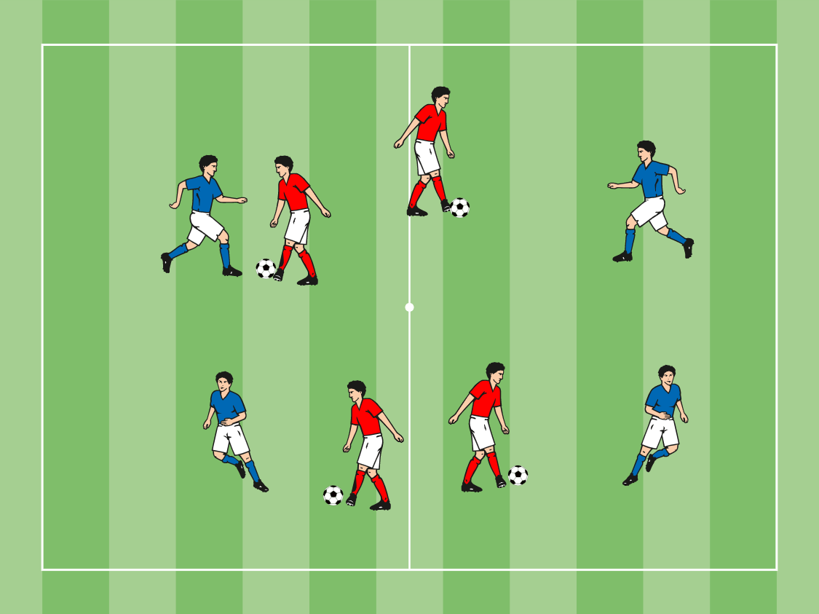
Activity 1: SOCCER DODGE BALL
Area: 16x16 yard grid
Equipment: 4 red cones, 5 balls, 2 groups
Description: Create 2 teams, one with a ball each the other without. The group with the ball will try and tag the opposition by passing the ball on the ground and hitting the opposition below the knee. The ball must stay on the ground at all times. Players struck by the ball must stand with their legs open and wait for a teammate to crawl through and free them. Continue for 90 seconds and switch roles.
Progression:
1- All players must have balls and both teams can shoot. If a player is hit they must remain frozen.
Coaches Phrases:
1- Keep the ball close – take care of it.
2- What can you see? – Judge the pace of the ball.

Slide 22
Activity 2: 2 V 2 TO GOAL
Area: 22x20 yard grid
Equipment: 4 blue cones, 4 balls, 2 sets of pinnies.
Description: Create 2 teams of 4. on the sideline, the teams line up face to face as shown. The coach plays the ball into the middles and the first 2 players from each team play creating a 2v2 and try to score and the next 2 go. Players can score in either goal.
Progression:
1- Coach can play a lofted ball out
2- Players must perform a turn before scoring
3 – Players must score in their opponents goal only.
Coaches Phrases:
1- Be quick and positive.
2- Be creative

Slide 23
Small Sided Games: 4 V 4
Organization: 20 x 30 grid,
Two teams of 4 vs 4
Let the game flow and give pointers when necessary, try not to keep starting and stopping it.

Slide 24
Session Five:
Improve Scoring Goals

Slide 25
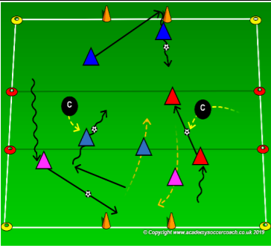
Warm Up Activity
Description: A 5 yard zone in the middle (the dog pound) & a cone goal on each end line. Coaches start in the pound as the dog catchers (dog catchers do not use a soccer ball & must stay in the pound). Each player has a partner and one soccer ball to share. Players start on one end line. Players (bulldogs) try to sneak through the dog pound without waking the catchers. If they can get through the dog pound without losing their ball and score in the goal, their team gets 100 points. Once they have scored, they can go back through the dog pound to score in the other goal.
Rules: When the coach yells, “Who let the dogs out?” the players start across the grid. If a dog catcher steals your soccer ball you and your partner lose your points and have to start scoring again.

Slide 26
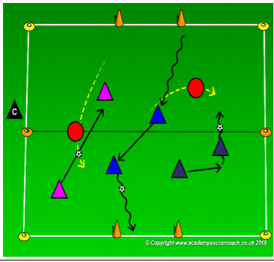
Activity 1
Description: With a cone goal on each end line. Coaches or 2 players start as dog catchers (dog catchers do not use a soccer ball.) The rest of the players have a partner and a soccer ball to share. Players start on one end line. Players (bulldogs) try to play past the dog catchers without getting caught. If they can get past the dog catchers without losing their ball and score in the goal, their team gets 100 points. Once they have scored, they can go back past the dog catchers to score in the other goal.
Rules: When the coach yells, “Who let the dogs out?” the players start across the grid. If a dog catcher steals your soccer ball you and your partner lose your points and have to start scoring again

Slide 27
Small Sided Games: 4 V 4
Organization: 20 x 30 grid,
Two teams of 4 vs 4
Let the game flow and give pointers when necessary, try not to keep starting and stopping it.

Slide 28
Session Six:
Passing

Slide 29
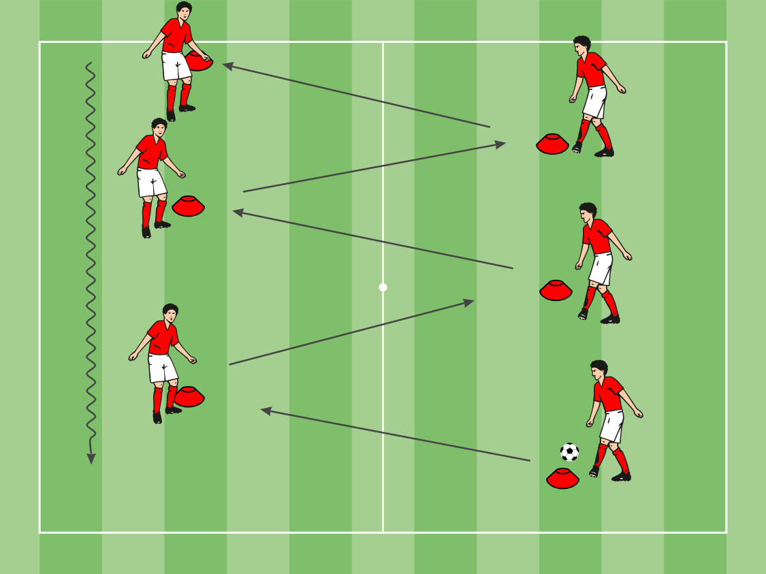
Warm Up Activity: PASSING WARM UP
Area: Poles or cones marked out 12 yards apart in a zig zag pattern.
Description: Players at the start with a ball. The first player to receive checks away and pass # 1 is played into his feet, the players should receive inside of the pole and pass with his 2nd touch, following pass through.
Progression:
# 1 – Receive around the Pole, checking to ball and then back peddaling to receive around pole
# 2 – Pass, Pass & Set, in front of pole, tight 3 pass sequence
# 3- Wall pass around the pole
Coaching Points:
# 1 – Timing of movement off the pole
# 2 – Game speed movements and passes
# 3- First touch attacks the space

Slide 30
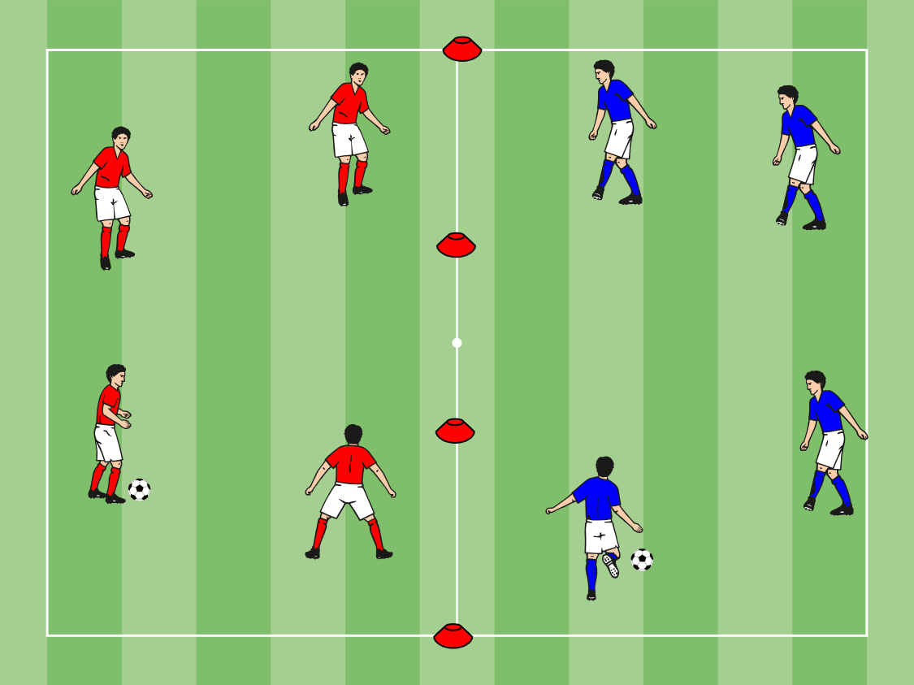
Activity 1: SQUASH THE BUG
Set-up: 25 x 50 yard area (2 x 25 yard areas next to each other). Players in two separate groups of 4-5 players in each of the areas. 1 ball per team. Players number themselves within their group (1-5).
Activity: Players numbered 1-5 within the area. Players pass and move within the area to start. Coach on the outside calling out numbers. If coach shouts out # 1, then # 1 from each team goes into the opposing area and tries to Squash the bug (Ball) (4 vs 1). First defender to Squash the ball gets a point for their team. If players pass the ball for more than 5 passes the coach calls out a second #.
Coaching Point(s): Try to move to open space (outside of the area). Paces to be hit with pace. Use your hands to let the player with the ball know where you want the pass played. Take first touch away from the pass (pressure) on the back foot. Try to split the defender(s).
.

Slide 31
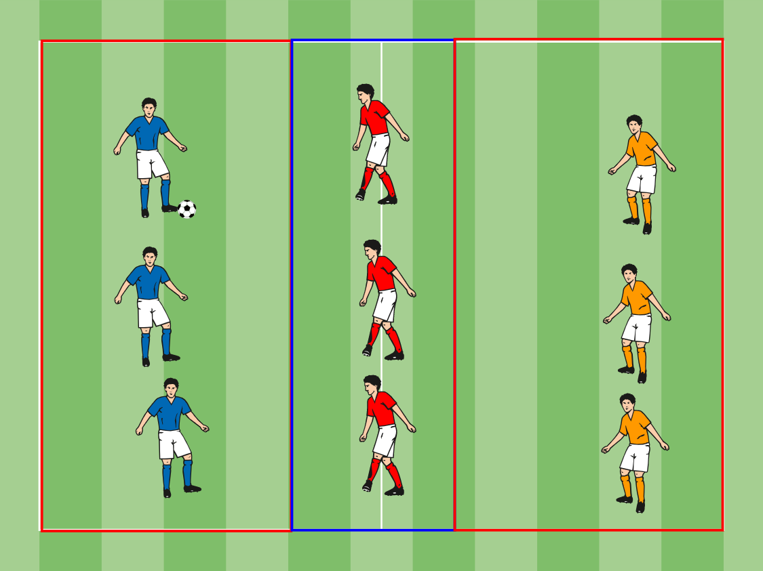
Activity 2: 3 Zone Passing
Area: 16x16 yard grid
Equipment: 4 red cones, 4 blue cones, 4 yellow cones. 1 ball.
Description: The teams on the end try to pass the ball through the center area to the opposite end without the team in the middle winning the ball.
If the team in the middle wins the ball, it changes places with the end team that played the last pass.
Teams score a point each time they pass a ball through the central area.
Progression: Play 5v4 using the whole playing area.
The central zone is now a “no tackling” area. Encourage the defending team to drop back behind the ball and regroup as soon as its opponents enter the central zone.
Coaches Points: Good weight of pass, can we find open space. Can we move to block off passes.

Slide 32
Small Sided Games: 4 V 4
Organization: 20 x 30 grid,
Two teams of 4 vs 4
Let the game flow and give pointers when necessary, try not to keep starting and stopping it.

Slide 33
Session Seven:
1 vs 1’s and 2 vs 1’s: To targets/goals

Slide 34
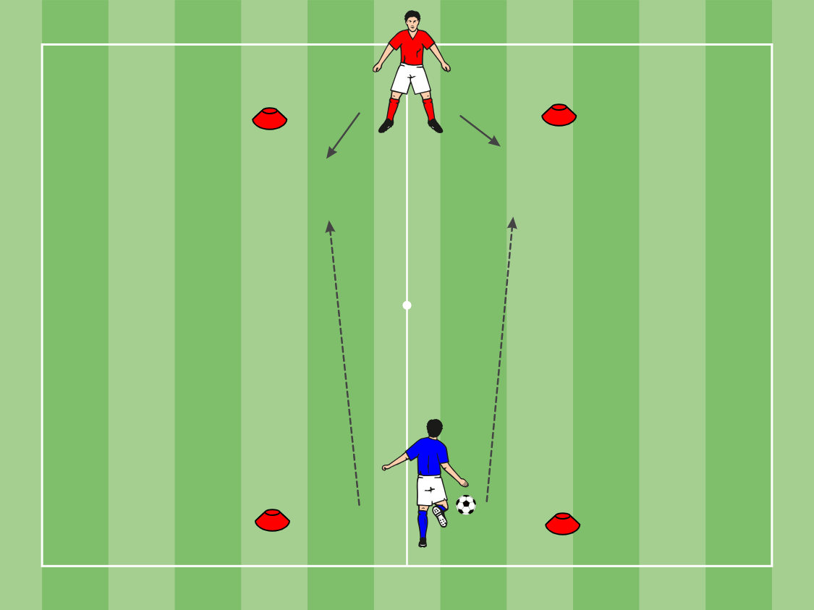
Warm Up Activity: 1 V 1 Game
Set-up: Gates (3-5 yards apart) set up 15-20 yards away from each other. Players in pairs with 1 ball, on opposite side of the area, each between a gate.
Description: Players attempt to pass the ball across the area between their partners gate. Points are given if your partner does not control the ball in between their cones or if they come in front of their cones. Points also given if the pass does not go in between the gates. Vary the touch and passing conditions. Play for 2 minute games. Ball has to travel at below knee height.
Coaching Points: Passes have to be hit with enough speed (weight of pass) to get the ball across the area. Concentrate on striking the ball correctly, with the knee and upper body over the ball. Follow through to increase accuracy. First touch to the sides if possible. Strike the ball in front of the body. Try to move your partner around instead of passing directly to them.

Slide 35
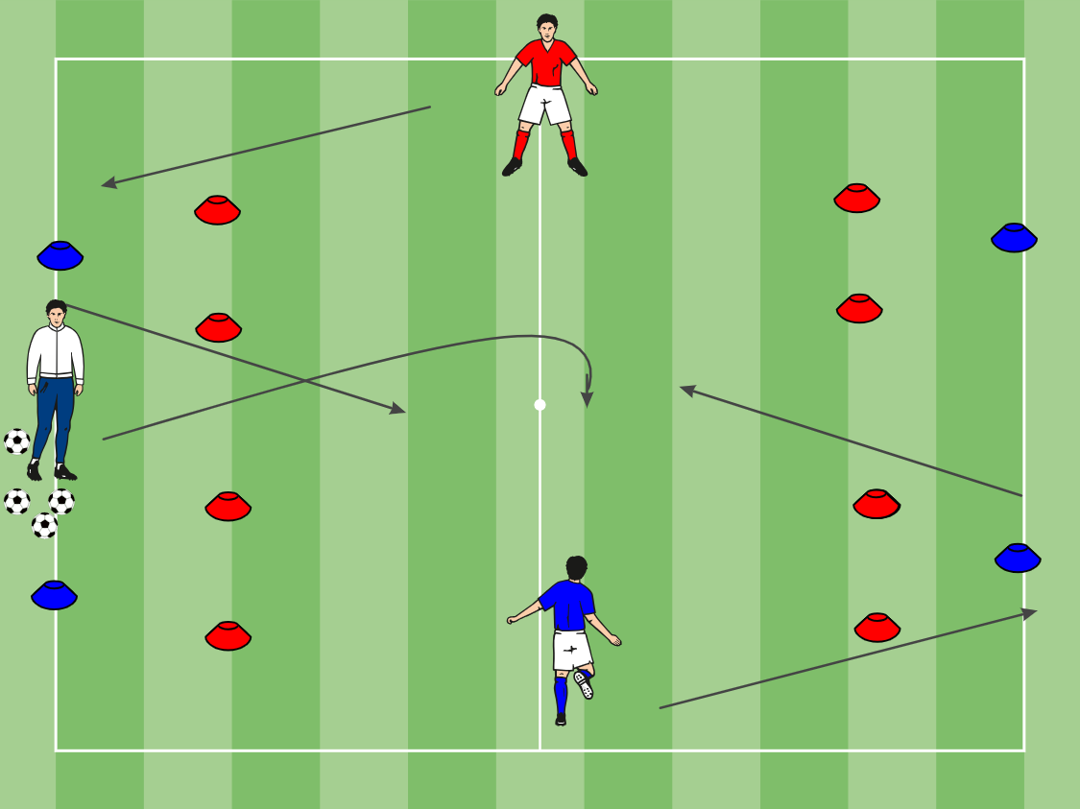
Activity 1: 1 V 1 CHANGE OF DIRECTION
Area: Start cones are 15 yards apart, wide cones are 15 yards apart and 5 yards from start cones, gates are 2 yards wide, and 3 yards from wide cones.
Description: Separate the group into 2 teams, the first player from each line play 1v1. Players must react to the ball being played in, then run around the wide blue cone before challenging for the ball. To score the players must dribble through one of the gates.
Coaching Points:
Always protect the ball
Correct Foot
Scan
Quick acceleration after move

Slide 36
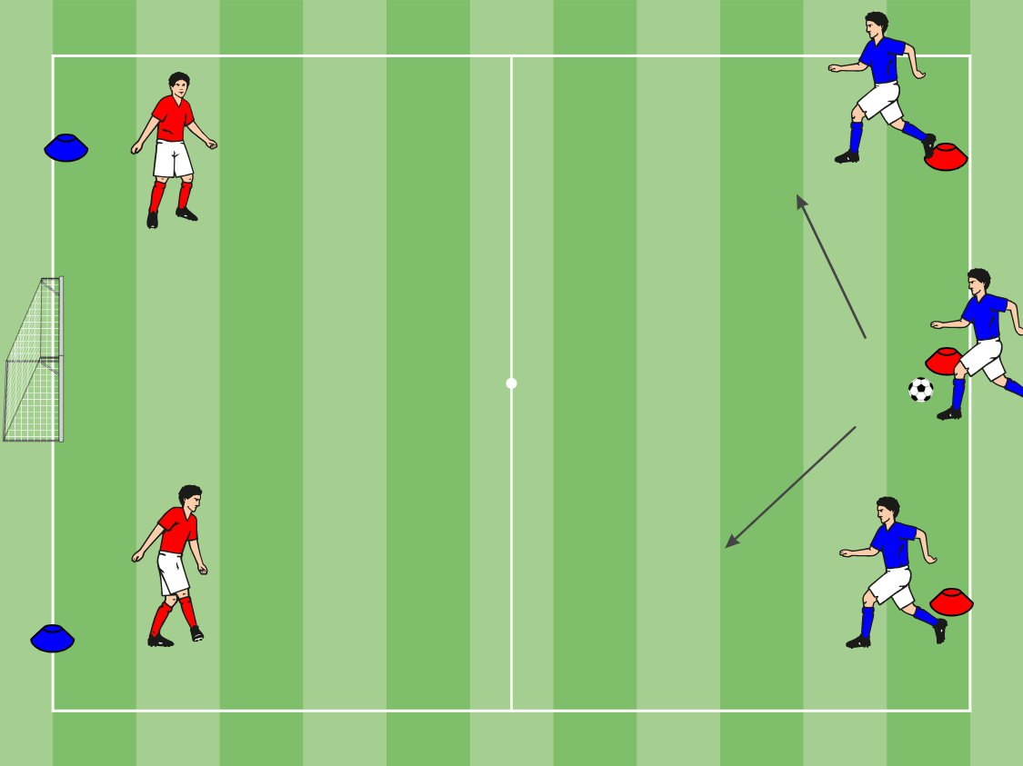
Activity 2: 3 V 2 TO GOAL
Set-up: 40 x 60 yard field. Target goal(s) on end line. Separate players into 2 teams. 1 team of attackers, 1 team of defenders. Defenders line up on opposite sides of the end line. ½ Defenders in the area. Attackers line up at the top of the area at 3 different cones 5-10 yards apart. 1 Attacker to start in the middle of the area between the 2 Defenders Supply of balls with the attackers at the center cone. Add a GK to progress.
Description: Center attacker passes the ball into the attacker in the center of the area. The ball is played back and players then attack the goal 4 vs 2. Change the passing combinations and runs. Switch attackers and defenders around every 5-10 minutes.
Coaching Points: Passes to be hit with pace. Movement off the ball is as important as the passes. Communicate which run you are making. Attempt to play in 1 or 2 touches. Finish with a shot at the goal.

Slide 37
Small Sided Games: 4 V 4
Organization: 20 x 30 grid,
Two teams of 4 vs 4
Let the game flow and give pointers when necessary, try not to keep starting and stopping it.

Slide 38
Session Eight:
Shooting Games

Slide 39
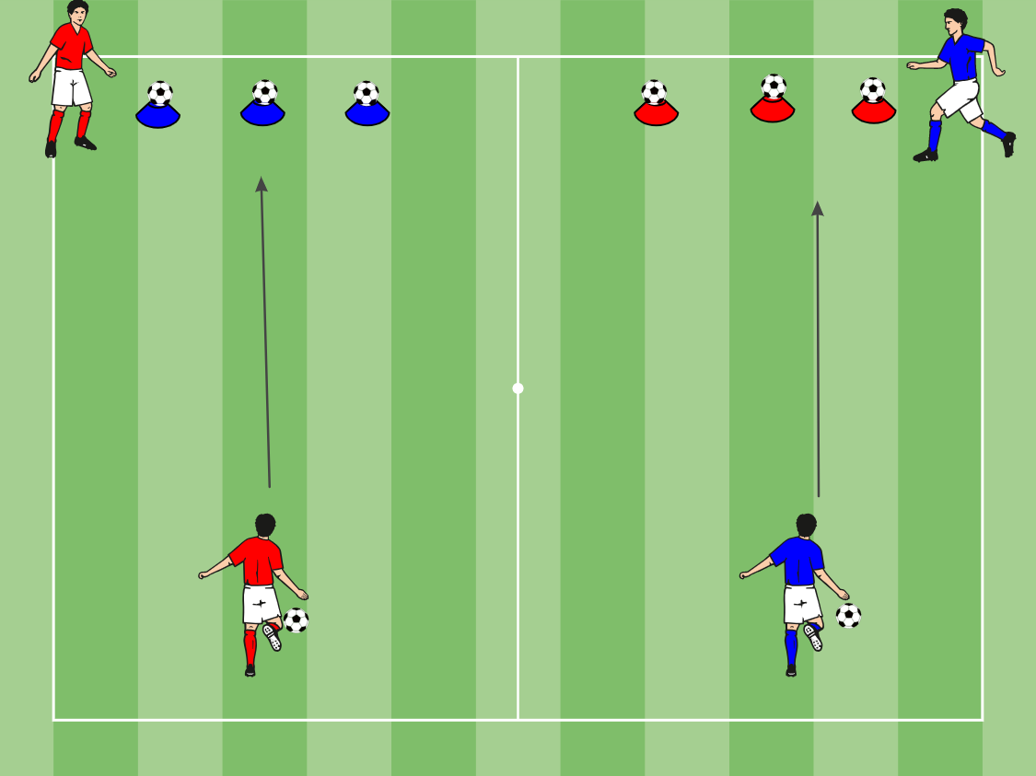
Warm Up Activity: TARGET PRACTICE
Set-up: Set up Cones with Balls on top (3-5 y set up 15-20 yards away from players at bottom. Players in teams with 1 ball, on opposite side of the area.
Description: Players attempt to shoot the ball across the area to knock off the balls from the cones. The Player at the top dribbles the ball back to the start for the next player to shoot at the targets.
First team to knock all the balls off wins.
Coaching Points: Shoots have to be hit with enough speed to get the ball across the area. Concentrate on striking the ball correctly, with the knee and upper body over the ball. Follow through to increase accuracy. First touch to the sides if possible. Strike the ball in front of the body.

Slide 40
Activity 1: NUMBERED SHOOTING
Area: 30 x 30 yards area.
Description: Separate the players into 2 teams. Each player is giving a number between 1 – 6. The coach will shout out a number, that player will run into the field and shoot in the opponent’s goal.
Progression:
Use other foot
Make it a race
Call multiple numbers
Coaching Points:
What can you see, move the ball away from pressure.
What part of my foot do I want to use when shooting. Inside for accuracy, Laces for power.

Slide 41
Activity 2: CLEAR THE GARBAGE
Set-up: 25 x 50 yard area (2 x 25 yard areas next to each other). Players in two separate groups of 4-5 players in each of the areas. 1 ball each per player.
Activity: Players must dribble within the area. Players shoot the ball across to the other side. Coaches can add and take away balls to make it more challenging. The team after 30 – 45secs with the least amount of balls in there area wins.
Coaching Point(s): Try to kick the ball to open space . Shots to be hit with pace. Try to split the defender(s).
.

Slide 42
Small Sided Games: 4 V 4
Organization: 20 x 30 grid,
Two teams of 4 vs 4
Let the game flow and give pointers when necessary, try not to keep starting and stopping it.

