Slide 1
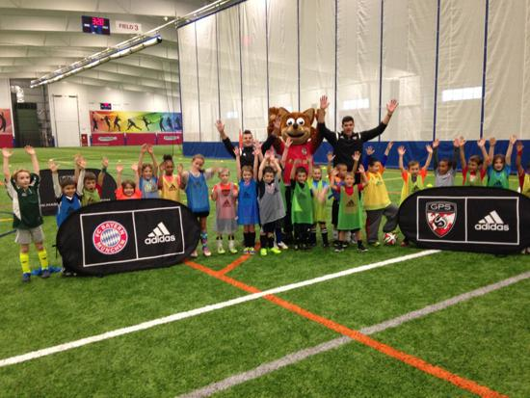

Global Premier Soccer
Town Partner Curriculum
1st & 2nd Grade

Slide 2
Week 1

Slide 3

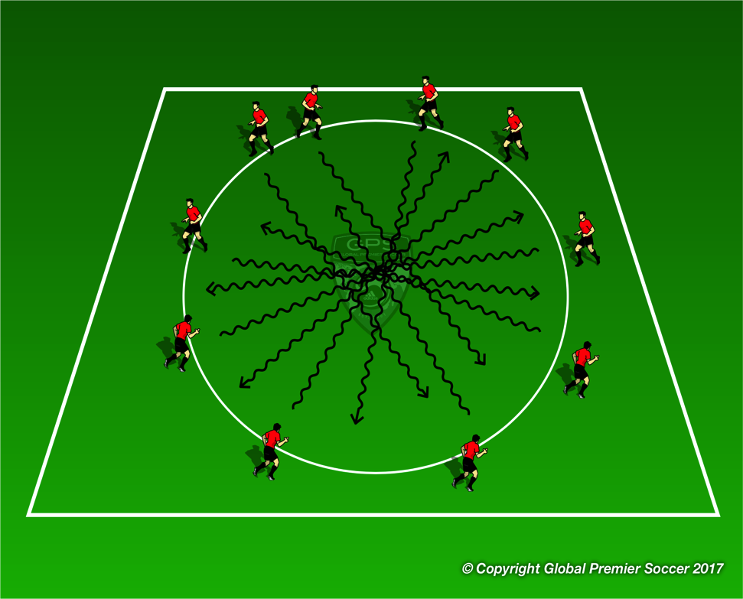

Week 1: Dribbling
Organisation
Players stand on the outside of the circle and walk around to the left. Coach calls go and layers must run through the middle to the other side avoiding collisions.
Progressions
Now add player inside the circle who is the tagger. Any player tagged replaces the tagger in the middle. Add 2 taggers.
Coaching Points
Head up to see other players Change of speed into space or slow down to avoid collision
Organisation
Now each player has a ball. Players must dribble their car around the circle with little touches. When coach calls go players dribble through the middle to the other side using foot skills to avoid collisions
Progressions
Now add player inside the circle who is the tagger. Tagger tries to hit other players ball by throwing their own ball. Any player tagged replaces the tagger in the middle. Add 2 taggers.
Coaching Points
Little touches to keep ball close Head up to see space Change direction to avoid collisions | Toe taps around the outside Foundations around the outside Inside/outside Roll overs

Slide 4
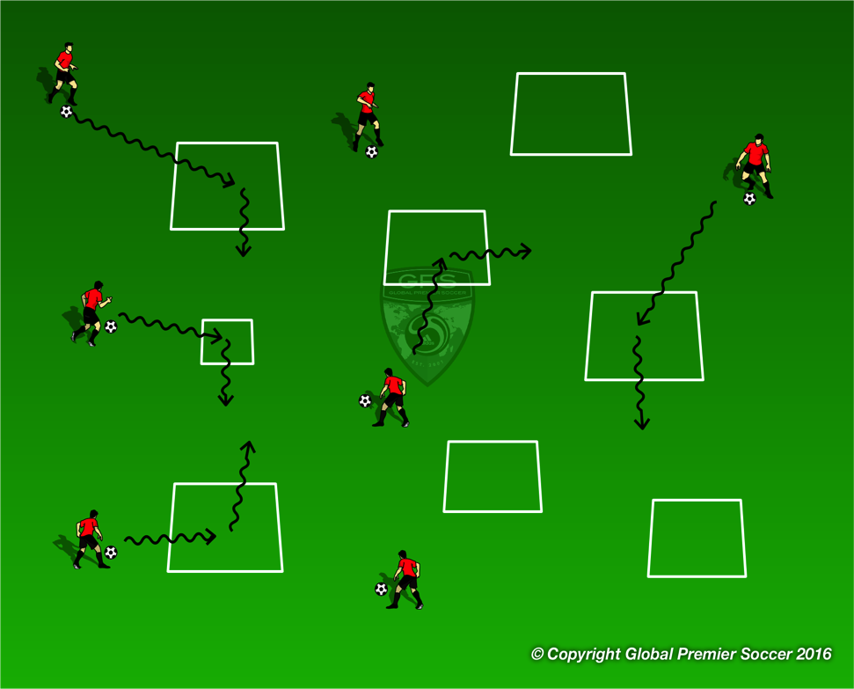
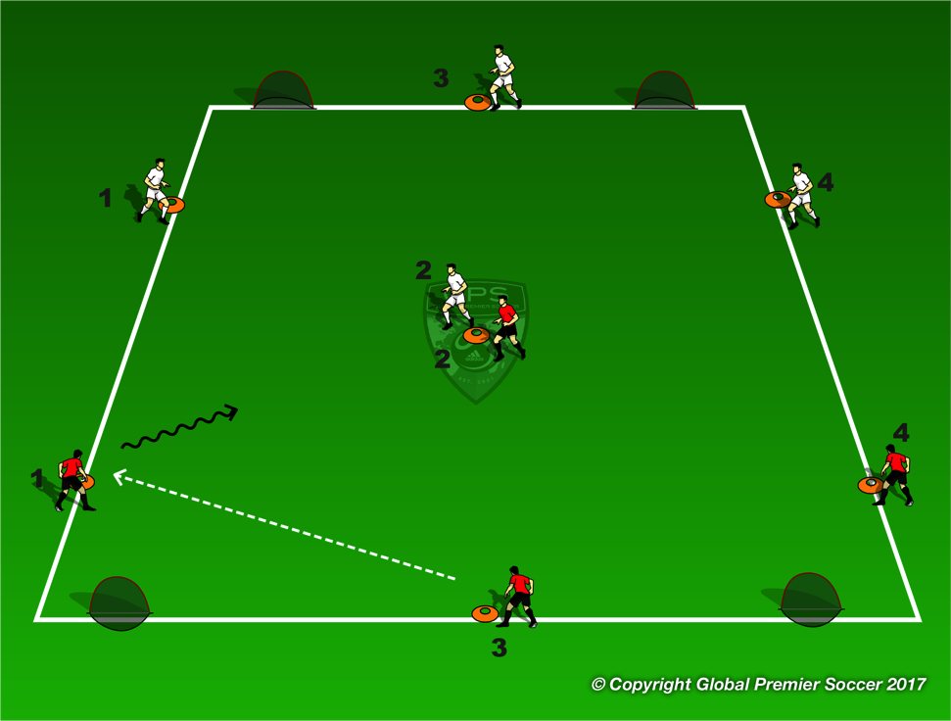
Week 1: Dribbling
Organisation
Set out a number of 2x2 yard boxes. Each box represents a store, restaurant, gas station etc. Each player has a car (ball) and drives their car (dribbles their ball) to as many stores as possible.
Progressions
Make one box blue (police station) and have one player be the policeman. Players dribble slowly until coach holds green light. Players then dribble fast. Policeman tries to catch fast drivers by tagging them. If tagged player must go to the police station until freed by a team mate.
Coaching Points
Little touches to keep ball close Head up to see space Change direction to avoid collisions
Organisation
Set out 24x20 yard field. Player start cones are 6 yards from end line. Play 3 minute game then have players rotate to next cone in number order. Player 4 must run around the back of their own goal to cone 1. It’s a race between both player 4s to get to cone 1 for extra point.
Progressions
1 coach per field if more than one coach. Any players not playing can work with coach on side line in 1-1 setting to work o the theme of the session.
Coaching Points
Little touches to keep ball close Head up to see space Change direction to avoid collisions

Slide 5
Week 2

Slide 6
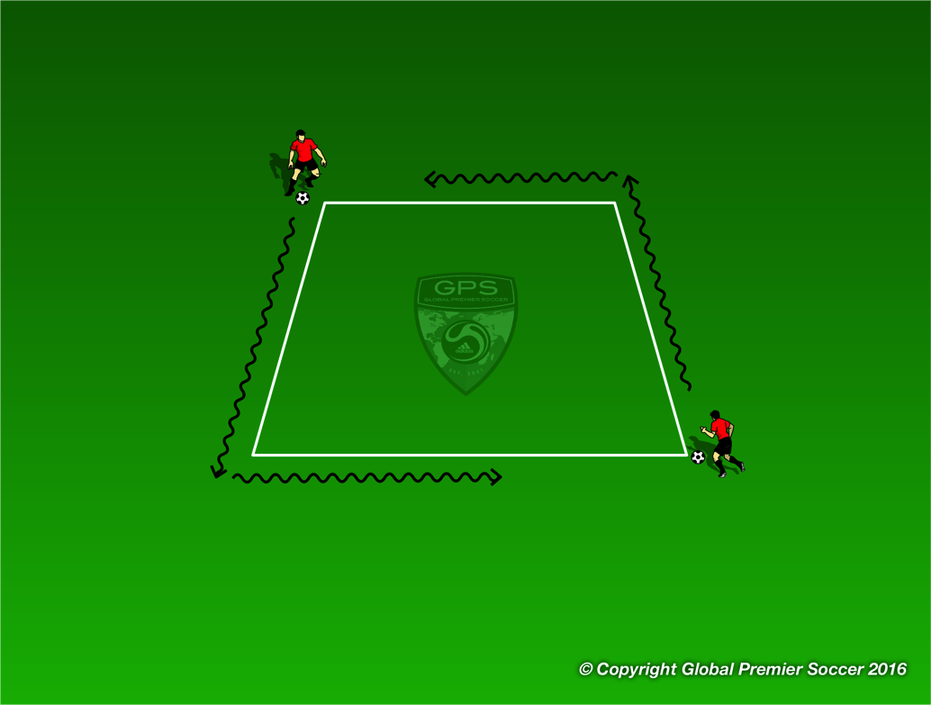

Week 2: Dribbling
Organisation
Players work in pairs. Each pair has one 3x3 yard box. Players leave the ball inside the box and stand on opposite corners. 1 player is the tagger and one player is the runner. Players can not go into the box and. Tagger tries to catch the runner by tagging them on the back. Tagger has 30 seconds to catch them
Progressions
Play same game but this time players must dribble the ball
Coaching Points
Little touches on the ball to keep it close Use different parts of the foot to change direction. Head up to see other player
Organisation
Players now have a ball each and dribble around the area and through as many of the boxes from the previous game as possible.
Coaching Points
Keep ball close Head up to see space Dribble at speed into space
Progressions
Players dribble into the box and turn left Players dribble into the box and turn right Players dribble into the box and turn and dribble out | Players perform 5 toe taps in each box Players perform 5 foundations in each box

Slide 7
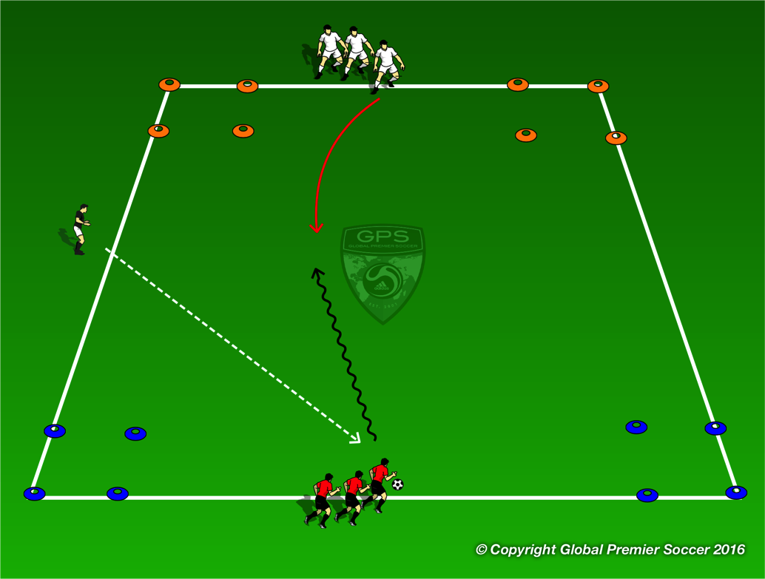
Week 2: Dribbling
Organisation
Set out a 15x20 yard area with a box in each corner. 2 colors at one end 2 at the other. Split players into two teams, each starting between a set of boxes. Coach passes ball into area and players go 1v1 to try and stop the ball in wither box opposite their start point.
Progressions
Play 2 1v1 games at the same time.
Coaching Points
Use body to protect ball Move ball using various part of feet Move ball quickly to try and unbalance defender Exploit space at speed
Organisation
Set out 24x20 yard field. Player start cones are 6 yards from end line. Play 3 minute game then have players rotate to next cone in number order. Player 4 must run around the back of their own goal to cone 1. It’s a race between both player 4s to get to cone 1 for extra point.
Progressions
1 coach per field if more than one coach. Any players not playing can work with coach on side line in 1-1 setting to work o the theme of the session.
Coaching Points
Little touches to keep ball close Head up to see space Change direction to avoid collisions

Slide 8
Week 3

Slide 9
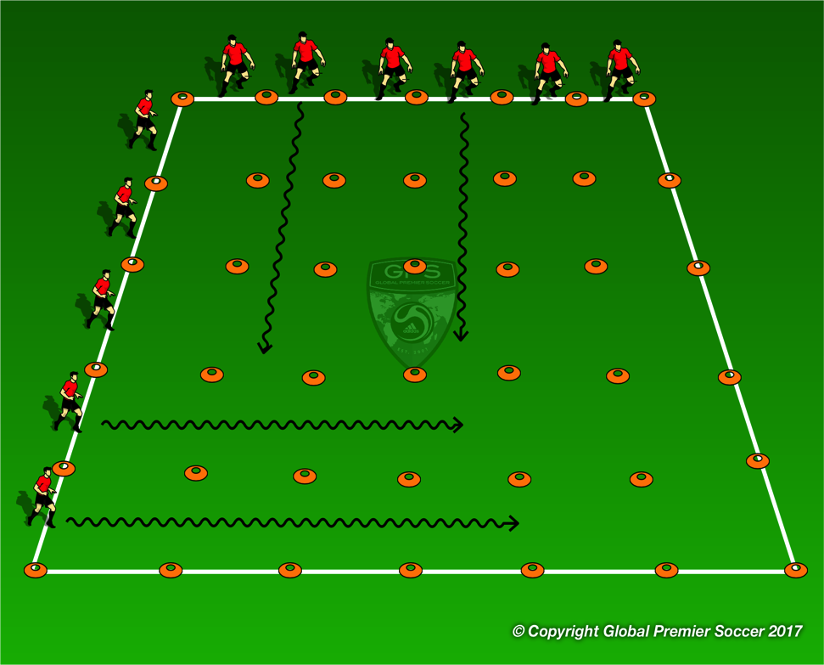
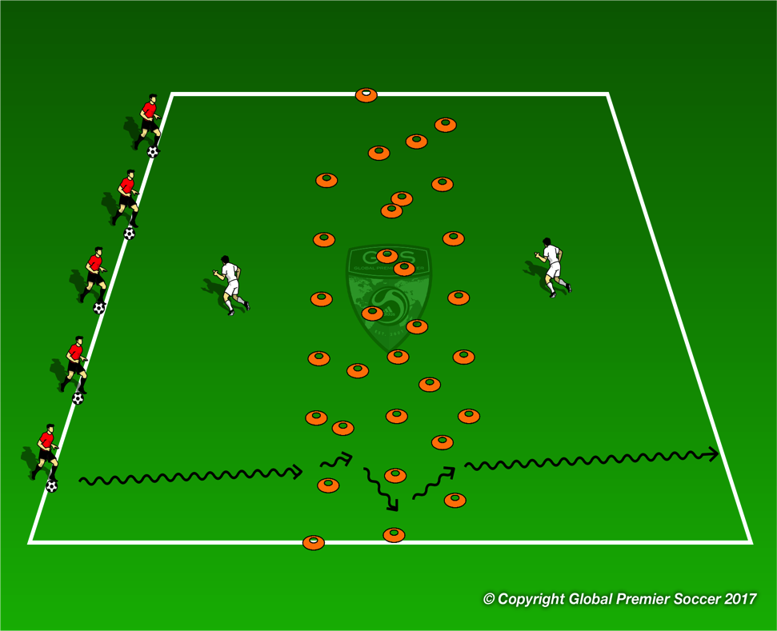
Week 3: Dribbling
Organisation
Set out a grid as shown Each cones 2 yards apart. Each player has a ball and works in their own channel. Have 2 players at each grid if large numbers. Players dribble to the end of there channel and back before next player goes.
Coaching Points
Small touches to keep ball close Speed control to avoid collisions.
Progressions
Toe Taps Foundations Roll overs Inside/outside Zig Zag side to side around cones on outside of your channel | Backwards down channel Dribble into 3 other channels before getting to the end.
Organisation
Now move the cones from the grid into a mess in the middle of the area. Players line up on one side with a defender in each space between cones and end lines. Players must dribble to the opposite side past the defenders and through the cones without being tagged. If you are tagged you become new defender and defender becomes an attacker.
Progressions
2 defenders in each space
Coaching Points
Head up to see defenders Speed through open space Close control between cones

Slide 10
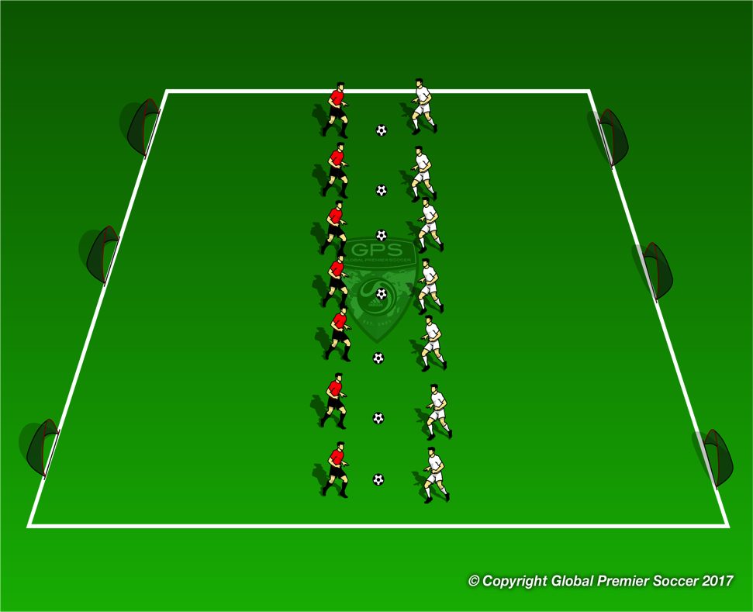
Week 3: Dribbling
Organisation
Set out an area with 6 goals, 3 goals at each end. Players work in pairs with one ball. Players start in the middle, reds one side whites the other. Coach calls go and players play 1v1 against their partner trying to score in any goal. If a goal is scored the bring the ball back to the middle and play again.
Progressions
First player to 3 goals wins.
Coaching Points
Little touches on the ball to keep it close Use different parts of the foot to change direction. Head up to see open goal Speed to get away from opponent
Organisation
Set out 24x20 yard field. Player start cones are 6 yards from end line. Play 3 minute game then have players rotate to next cone in number order. Player 4 must run around the back of their own goal to cone 1. It’s a race between both player 4s to get to cone 1 for extra point.
Progressions
1 coach per field if more than one coach. Any players not playing can work with coach on side line in 1-1 setting to work o the theme of the session.
Coaching Points
Little touches to keep ball close Head up to see space Change direction to avoid collisions

Slide 11
Week 4

Slide 12
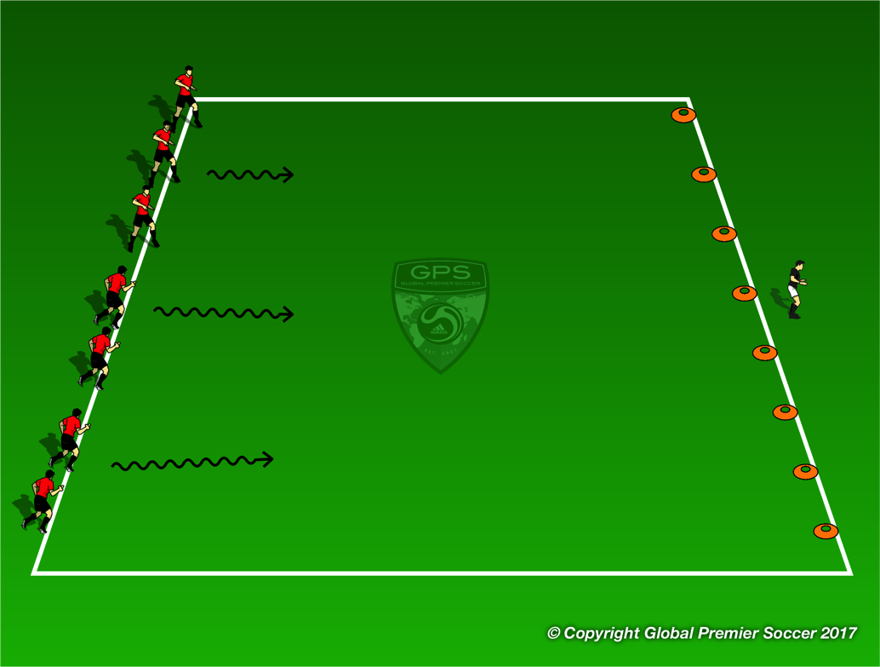
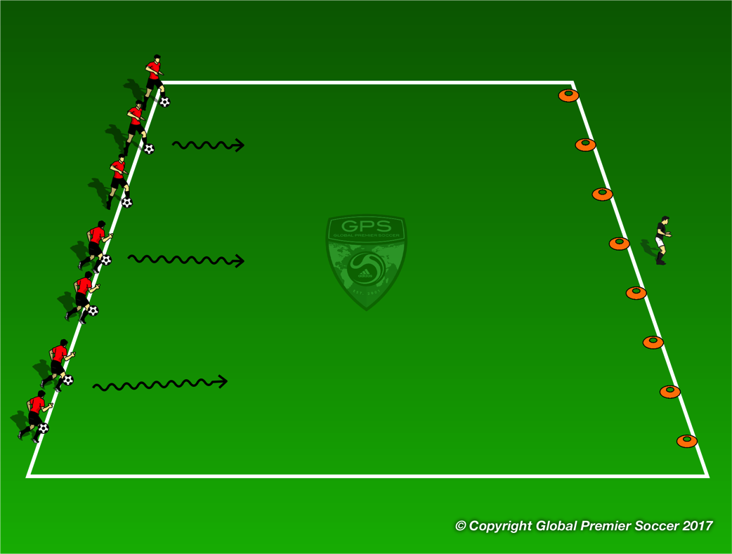
Week 4: Dribbling
Organisation
Set out a line of cones at the opposite end of an area to the players. Coach stand behind the cones. When coach faces the players, the players must be frozen on the spot. When coach turns away players try and sneak towards the cones and try and pick on up, freezing when the coach turns around.
Progressions
Coaching Points
Slow movements Be balanced so not to wobble or fall when coach turns around.
Organisation
Play same game but each player must have a ball and stop the ball with the bottom of their foot.
Progressions
Coaching Points
Small touches of the ball Keep ball close to stop quickly Use different parts of the foot

Slide 13
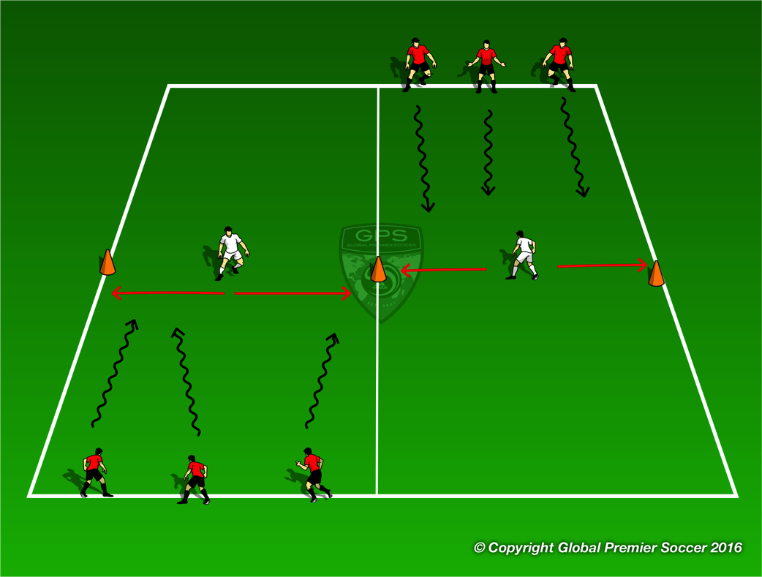
Week 4: Dribbling
Organisation
Set out area as shown with one defender in each area. Each area is 10x20 yards. Players dribble down the channels in 3s and try and get past the defender. Defender tries to kick away any soccer ball. Defenders can only move side to side between cones.
Progressions
Add another defender in each zone.
Coaching Points
Small touches keeping ball close Speed up when you see space Quick change of direction to beat defender
Organisation
Set out 24x20 yard field. Player start cones are 6 yards from end line. Play 3 minute game then have players rotate to next cone in number order. Player 4 must run around the back of their own goal to cone 1. It’s a race between both player 4s to get to cone 1 for extra point.
Progressions
1 coach per field if more than one coach. Any players not playing can work with coach on side line in 1-1 setting to work o the theme of the session.
Coaching Points
Little touches to keep ball close Head up to see space Change direction to avoid collisions

Slide 14
Week 5

Slide 15
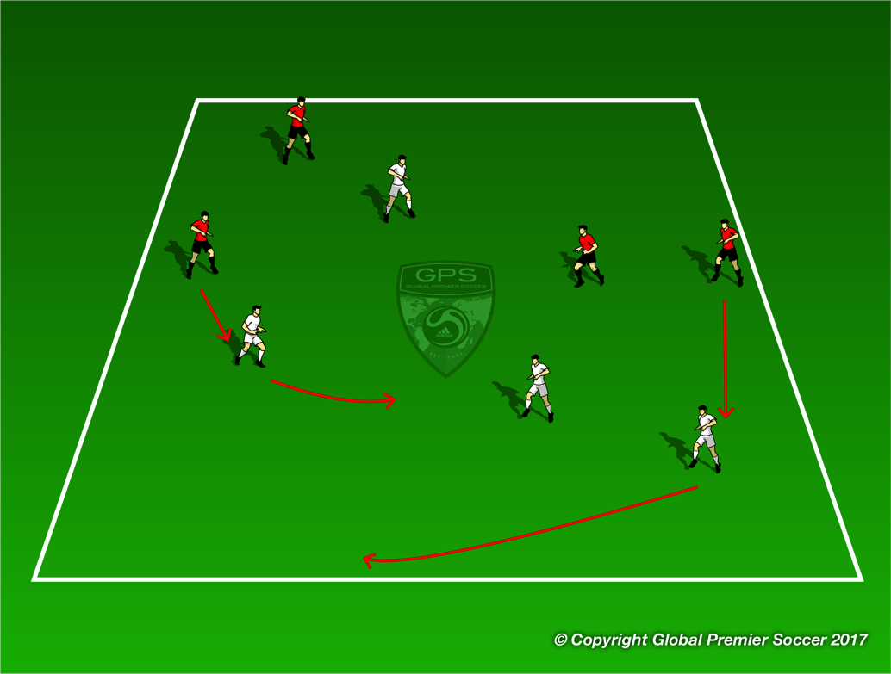
Week 5: Dribbling
Organisation
Players are in pairs (1 red/1 white in diagram). Players play tag with just their partner. Once tag they switch roles. Player who is tagger after 1 minute performs5 star jumps.
Progressions
Add a ball for each player
Coaching Points
Vary speed and direction to lose tagger. Accelerate into space Close control with ball so you can change direction at any moment. Awareness of other players.
Organisation
Players are in pairs (1 red/1 white in diagram). Players play tag with just their partner. Player who is tag after 1 minute performs5 star jumps.
Progressions
Add a ball for each player
Coaching Points
Vary speed and direction to lose tagger. Accelerate into space Close control with ball so you can change direction at any moment. Awareness of other players.

Slide 16
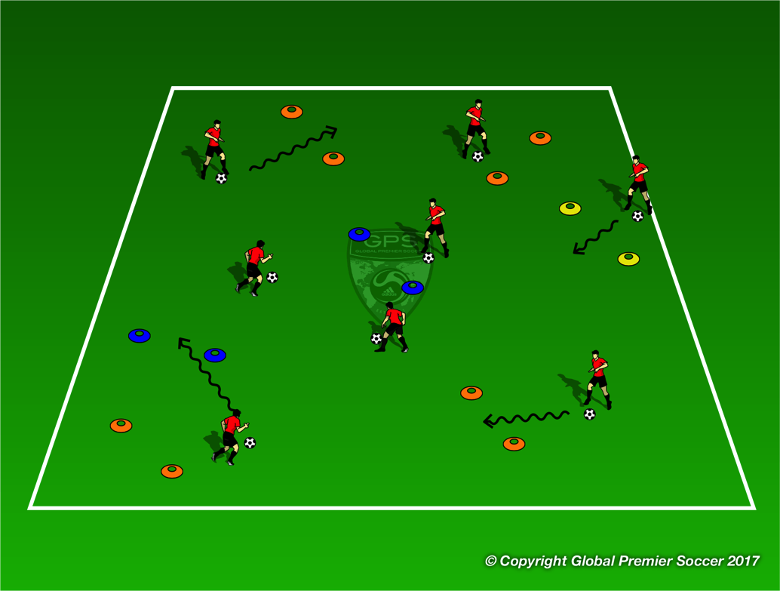
Week 5: Dribbling
Organisation
Set up multiple ‘gates’ out of 2 cones around the area. Have varied color gates. Each player with a ball. Players must dribble through as many as they can in a set time.
Progressions
Use sole only Players can’t go through same color gate twice in a row. Eliminate 1 color. Coach acts as a defender that players must avoid.
Coaching Points
Keep ball close so you can change direction easily. Head up looking for open gates. Avoid crowded ones. Plan your ‘route’ as you move around the gates.
Organisation
Set out 24x20 yard field. Player start cones are 6 yards from end line. Play 3 minute game then have players rotate to next cone in number order. Player 4 must run around the back of their own goal to cone 1. It’s a race between both player 4s to get to cone 1 for extra point.
Progressions
1 coach per field if more than one coach. Any players not playing can work with coach on side line in 1-1 setting to work o the theme of the session.
Coaching Points
Little touches to keep ball close Head up to see space Change direction to avoid collisions

Slide 17
Week 6

Slide 18
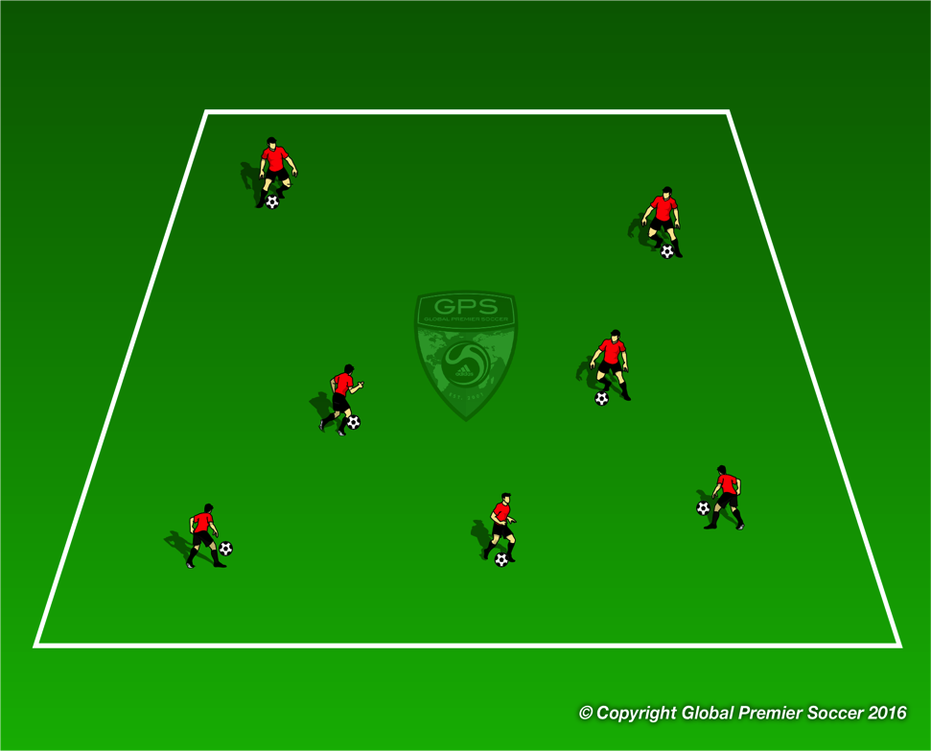
Week 6: Attacking 1v1
Organisation
Each player has a ball and dribbles inside the area. Coach asks players to perform a series of foot skill moves/
Progressions
Toe taps, foundations, toe taps on the move, foundations on the move, pull back turn, roll over,
Coaching Points
Little touches on the ball to keep it close Use different parts of the foot to change direction. Change direction to beat defender Head up to see other players.
Organisation
Set out an area with 6 goals, 3 goals at each end. Players work in pairs with one ball. Players start in the middle, reds one side whites the other. Coach calls go and players play 1v1 against their partner trying to score in any goal. If a goal is scored the bring the ball back to the middle and play again.
Progressions
First player to 3 goals wins.
Coaching Points
Little touches on the ball to keep it close Use different parts of the foot to change direction. Head up to see open goal Speed to get away from opponent

Slide 19
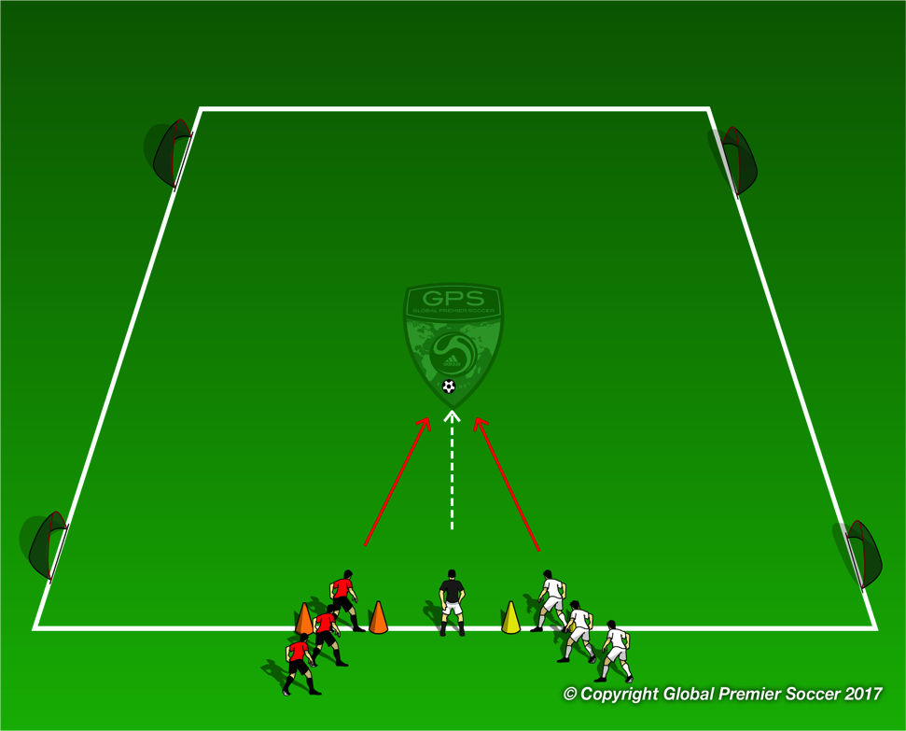
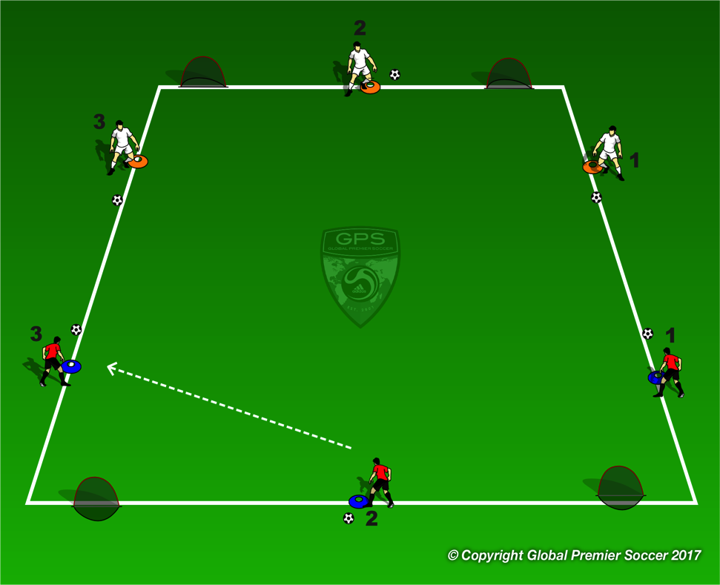
Week 6: Attacking 1v1
Organisation
Have 2 teams lined up alongside the coach on the side line. Coach throws a ball in for the first two players to play 1v1 trying to score in any goal. Have 3 games in play at any one time.
Progressions
Play 2v2
Coaching Points
Little touches on the ball to keep it close Use different parts of the foot to change direction. Head up to see open goal Speed to get away from opponent
Organisation
Set out 24x20 yard field. Player start cones are 6 yards from end line. Play 3 minute game then have players rotate to next cone in number order. Player 3 must run around the back of their own goal to cone 1. It’s a race between both player 3s to get to cone 1 for extra point.
Progressions
1 coach per field if more than one coach. Any players not playing can work with coach on side line in 1-1 setting to work o the theme of the session.
Coaching Points
Little touches to keep ball close Head up to see space Change direction to avoid collisions

Slide 20
Week 7

Slide 21
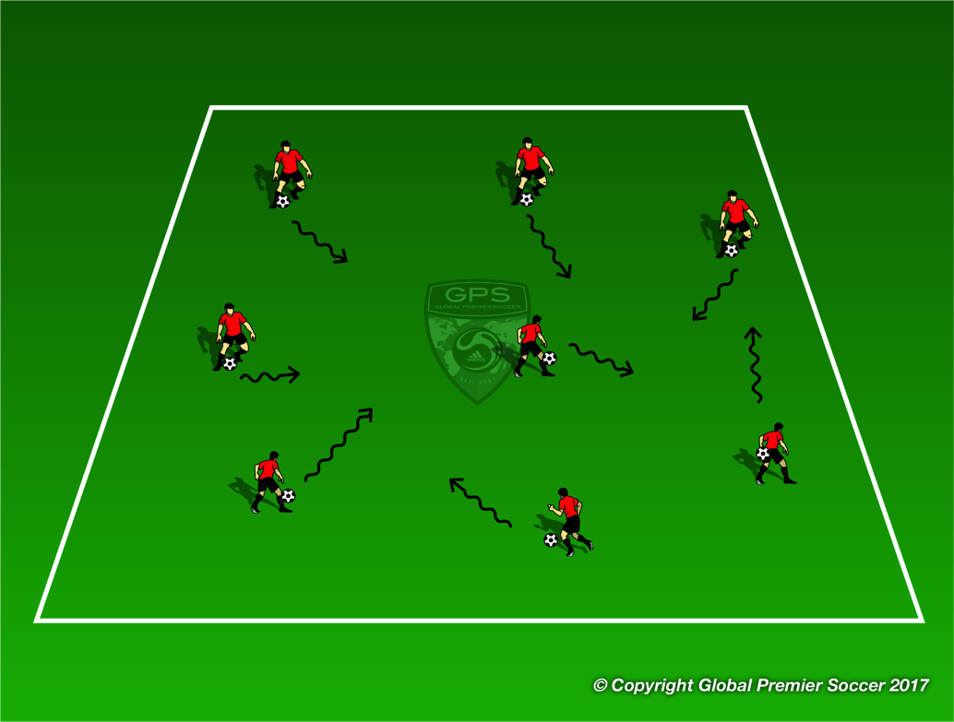
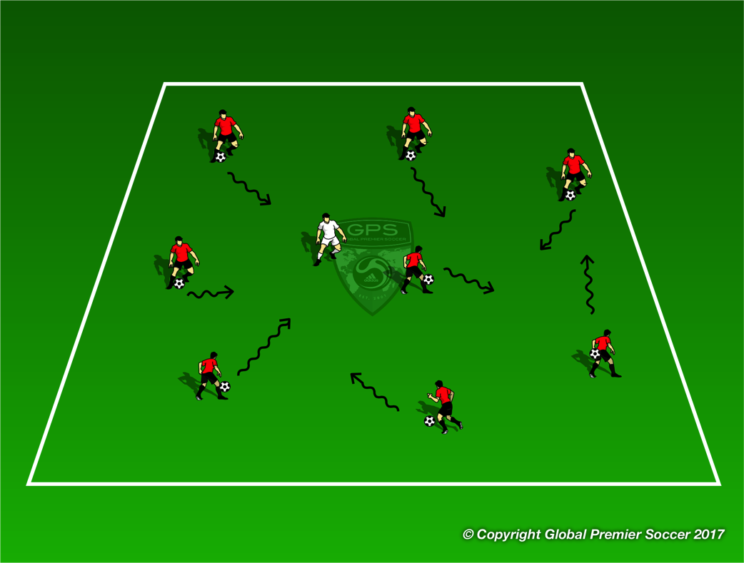
Week 7: Attacking 1v1
Organisation
Set out a 20x20 yard area. Each player has a ball and dribbles freely in the space/ Ask players to perform any 1v1 moves they know from previous soccer sessions
Progressions
Show players a new move and allow them to try and execute it. Scissors, double scissors, roll over, double touch, fake & take.
Coaching Points
Small touches to keep ball close Accelerate after move
Organisation
Now add one player in the area without a ball. This player tries to steal any ball from another player. Once the defender gets two touches on a new ball the player losing the ball becomes new defender
Progressions
Add 2 defenders
Coaching Points
Small touches to keep ball close Use move to unbalance and beat defender Accelerate after move

Slide 22
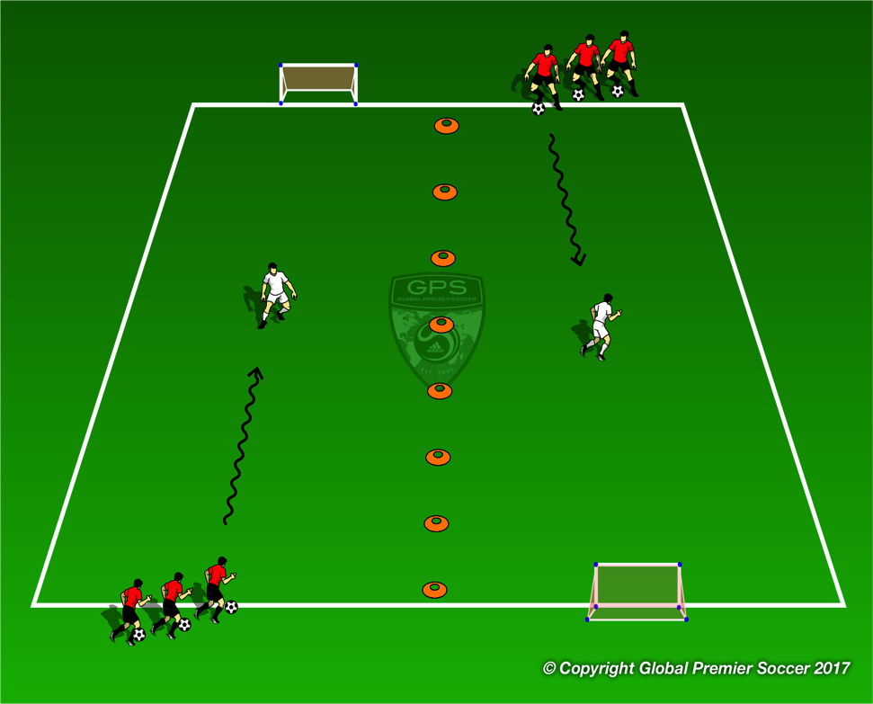
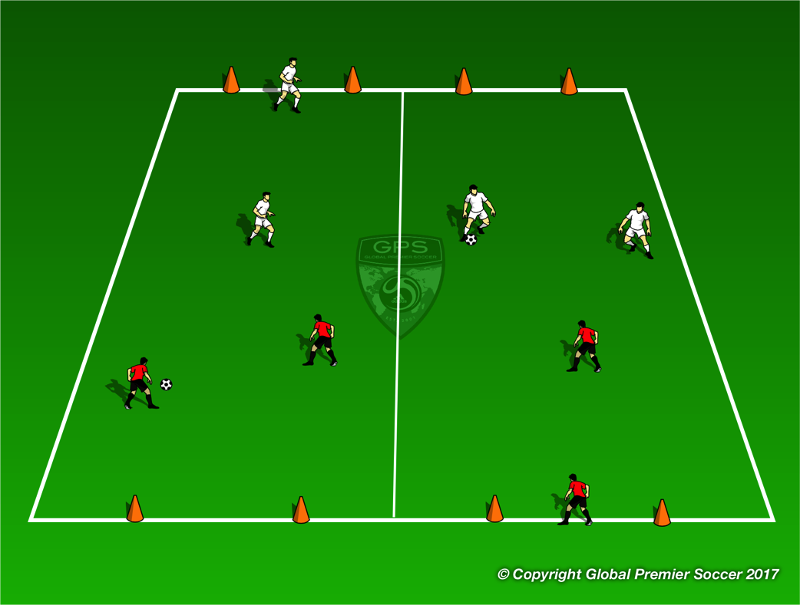
Week 7: Attacking 1v1
Organisation
Create 2 channels with one defender in each. Each player has a ball and dribbles down the channel and tries to beat the defender and score. If defender steals the ball they can score. Player who scores moves onto the next channel. If no goal is scored attacking player stays as attacker.
Progressions
Coaching Points
Keep ball close to be able to move ball quickly Head up to see defender Change of speed or direction to beat defender
Organisation
2v2 games. Team without the ball must have one player drop back and become GK leaving 2v1 on the field
Progressions
Coaching Points
Creativity on the ball Play without fear. Try moves Quick sprint back to box when point is gained

Slide 23
Week 8

Slide 24

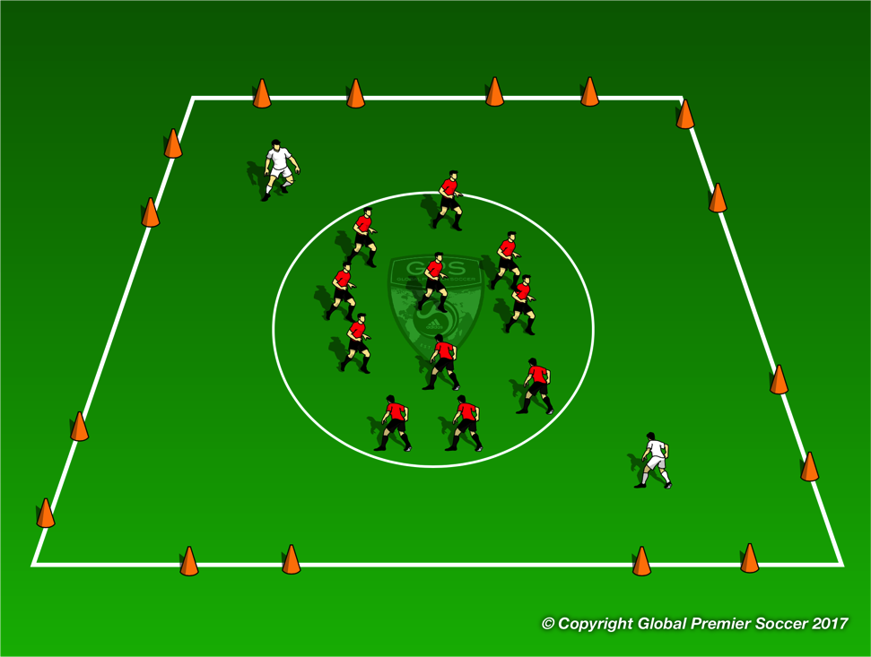
Week 8: Attacking Play
Organisation
Set out two areas with 1 defender in each. Players must try and get past defender without being tagged. Once to the other end players turn and run down the other side trying to get past the second defender.
Progressions
Each player now has a ball and dribbles through the zones. Add another defender in each zone
Coaching Points
Little touches on the ball to keep it close Use different parts of the foot to change direction. Head up to see open goal Speed to get away from opponent
Organisation
Players inside the circle move around until coach calls go. At this point they leave the middle circle and try and run out through two cones. The white players try and tag any player leaving the circle. Once escaped players can try and get back into the circle.
Progressions
Each player now has a ball and must dribble out to escape.
Coaching Points
Little touches on the ball to keep it close Use different parts of the foot to change direction. Head up to see open goal Speed to get away from opponent

Slide 25
Week 8: Attacking Play
Organisation
Have 2 teams lined up alongside the coach on the side line. Coach throws a ball in for the first two players to play 1v1 trying to score in any goal. Have 3 games in play at any one time.
Progressions
Coaching Points
Little touches on the ball to keep it close Use different parts of the foot to change direction. Head up to see open goal Speed to get away from opponent
Organisation
Set out 24x20 yard field. Player start cones are 6 yards from end line. Play 3 minute game then have players rotate to next cone in number order. Player 4 must run around the back of their own goal to cone 1. It’s a race between both player 4s to get to cone 1 for extra point.
Progressions
1 coach per field if more than one coach. Any players not playing can work with coach on side line in 1-1 setting to work o the theme of the session.
Coaching Points
Little touches to keep ball close Head up to see space Change direction to avoid collisions

Slide 26
Week 9

Slide 27
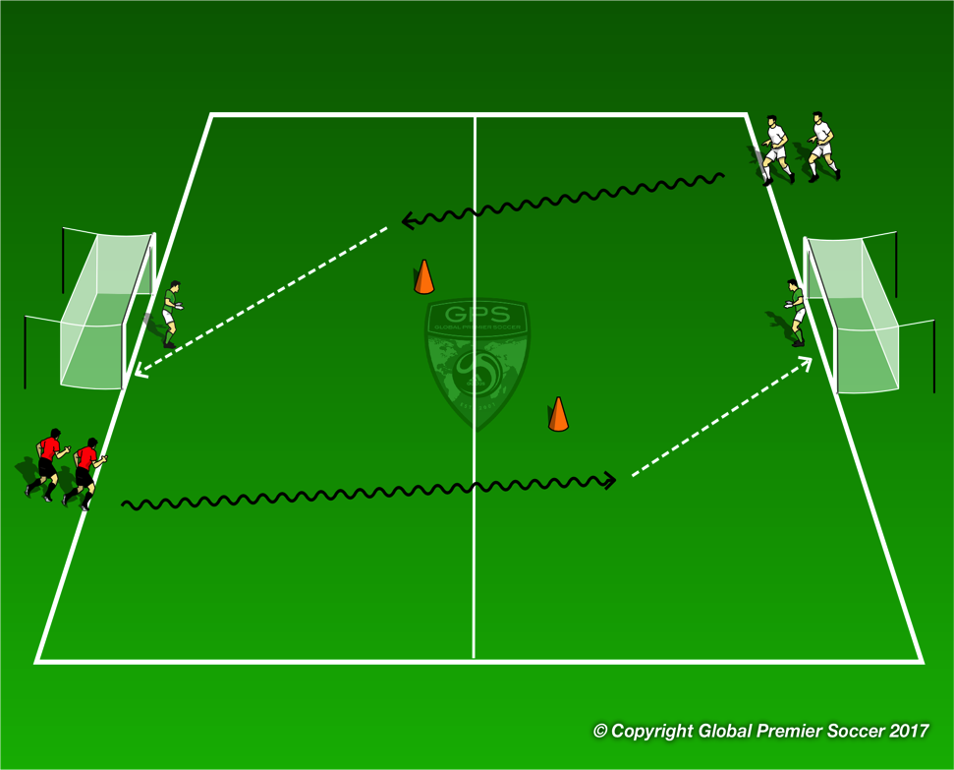
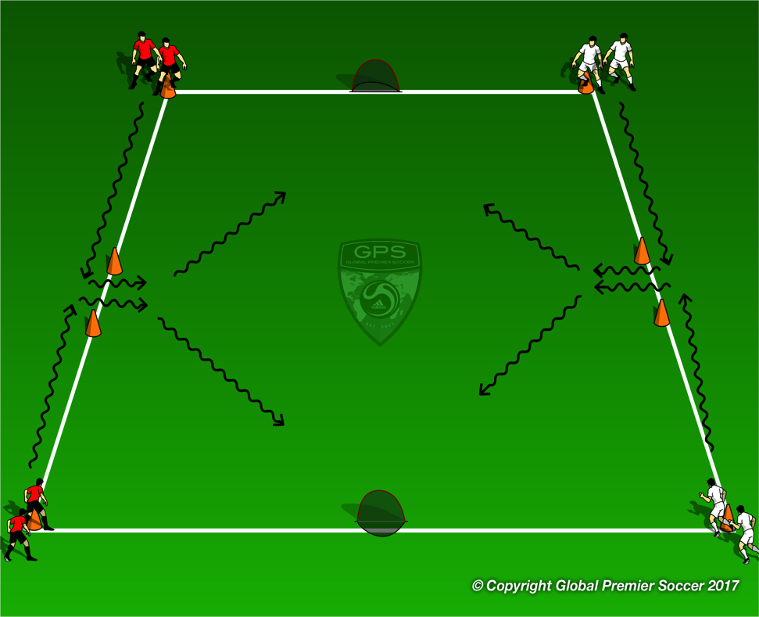
Week 9: Shooting
Organisation
Split players into two teams. When coach calls go the first player from each line dribbles to the goal opposite and shoots. First player to score gets the point for their team
Progressions
Add GKs
Coaching Points
Keep ball close with little touches Shoot with laces of foot
Organisation
Split players into 4 teams. First player in each line dribbles out around the cone and shoots at the goal next to where they start. First player to score gets the point for their team
Progressions
Coaching Points
Keep ball close with little touches Shoot with laces of foot

Slide 28
Week 9: Shooting
Organisation
Set out an area with 6 goals, 3 goals at each end. Players work in pairs with one ball. Players start in the middle, reds one side whites the other. Coach calls go and players play 1v1 against their partner trying to score in any goal. If a goal is scored the bring the ball back to the middle and play again.
Progressions
First player to 3 goals wins.
Coaching Points
Little touches on the ball to keep it close Use different parts of the foot to change direction. Head up to see open goal Keep ball close with little touches Shoot with laces of foot
Organisation
Set out 24x20 yard field. Player start cones are 6 yards from end line. Play 3 minute game then have players rotate to next cone in number order. Player 4 must run around the back of their own goal to cone 1. It’s a race between both player 4s to get to cone 1 for extra point.
Progressions
1 coach per field if more than one coach. Any players not playing can work with coach on side line in 1-1 setting to work o the theme of the session.
Coaching Points
Little touches to keep ball close Head up to see space Change direction to avoid collisions

Slide 29
Week 10

Slide 30
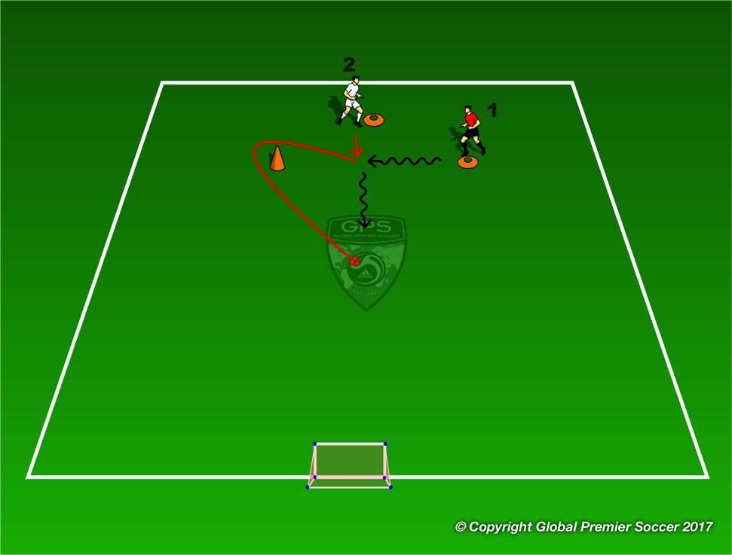
Week 10: Shooting
Organisation
Split players into two teams. When coach calls go the first player from each line dribbles to the goal opposite and shoots. First player to score gets the point for their team
Progressions
Add GKs
Coaching Points
Keep ball close with little touches Shoot with laces or inside of feet
Organisation
Split players into 4 teams. First player in each line dribbles out around the cone and shoots at the goal next to where they start. First player to score gets the point for their team
Progressions
Add GK
Coaching Points
Keep ball close with little touches Stop ball with bottom of foot Big touch and dribble at speed to goal Shoot with laces or inside of foot

Slide 31
Week 10: Shooting
Organisation
Set out an area with 6 goals, 3 goals at each end. Players work in pairs with one ball. Players start in the middle, reds one side whites the other. Coach calls go and players play 1v1 against their partner trying to score in any goal. If a goal is scored the bring the ball back to the middle and play again.
Progressions
First player to 3 goals wins.
Coaching Points
Little touches on the ball to keep it close Use different parts of the foot to change direction. Head up to see open goal Keep ball close with little touches Shoot with laces of foot
Organisation
Set out 24x20 yard field. Player start cones are 6 yards from end line. Play 3 minute game then have players rotate to next cone in number order. Player 4 must run around the back of their own goal to cone 1. It’s a race between both player 4s to get to cone 1 for extra point.
Progressions
1 coach per field if more than one coach. Any players not playing can work with coach on side line in 1-1 setting to work o the theme of the session.
Coaching Points
Little touches to keep ball close Head up to see space Change direction to avoid collisions

