Slide 1

U.S. SOCCER GRASSROOTS PLAYER DEVELOPMENT PHILOSOPHY
At the grassroots level, children learn and develop to their full potential through game-like experiences in an enjoyable environment which supports individual growth
PHASE 1: DELIBERATE PLAY
Players
Small Sided Games (2v2, 3v3, 4v4)
Frequent touches on the ball
Get kids started as soon as they arrive
Game like activities support decision making
Coaches
Use of freezes to fine tune the activity
Key Words to stimulate player actions
Use water breaks for guided questions – let the kids come up with the solutions if possible
PHASE 2: PRACTICE SESSION
Coaches
Choose the session based on reflection of previous game / practice
Session is specific to Phase of the Game and Area of the Field. Stick to coaching that phase of the game, rotate players so everyone gets coached
Session should be game like and reinforce the themes from deliberate play
Alter difficulty level based on what you see
Phase rotation practice to practice (offense vs defense)
PHASE 3: SECOND PLAY
- Coaches observe . . . Are the skills learned in practice being applied to the game
→ Session Goals, Player Actions, Key Qualities, Key Words, Guided Questions and Answers are all outlined on each MA Youth Soccer Session Plan.

Slide 2
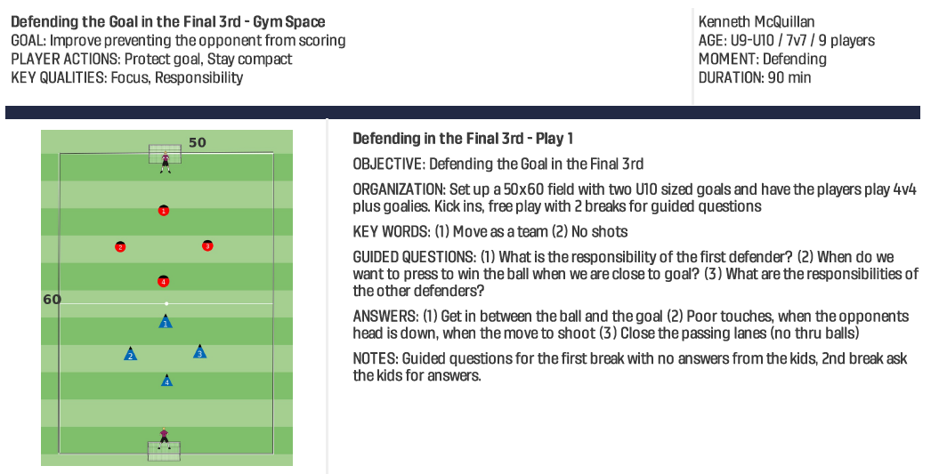

Slide 3
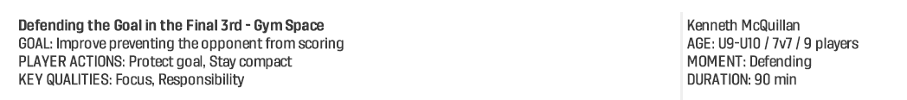
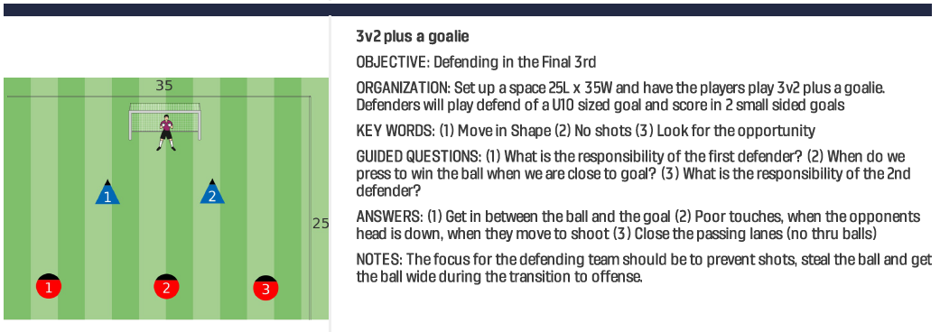

Slide 4
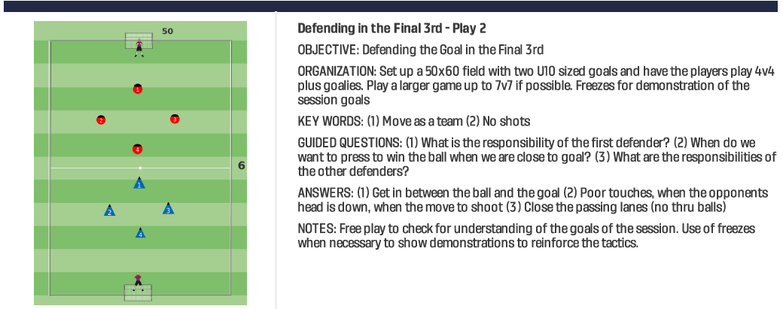

Slide 5
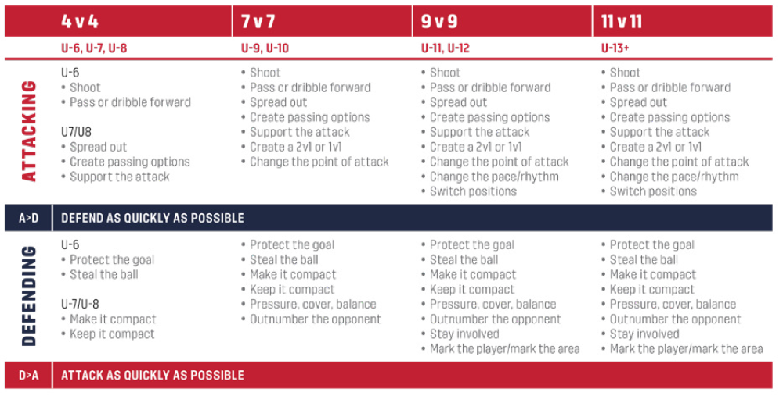
Notes:
Outline of actions players are typically capable of by age group
- Important to remember not to ask too much of the kids too early

