Slide 1
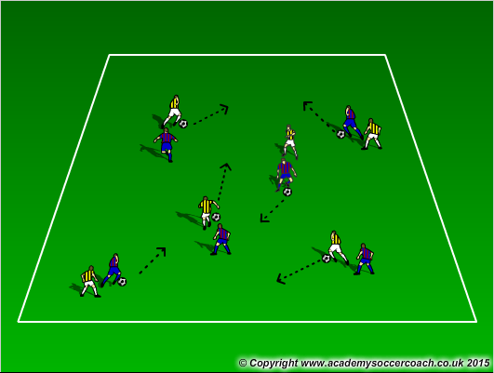
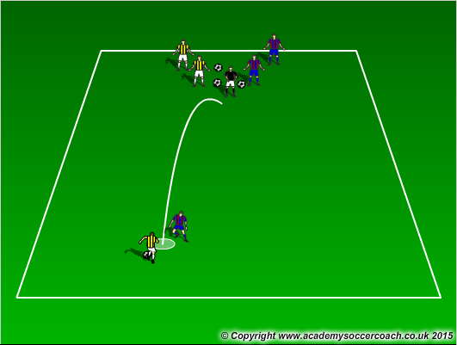
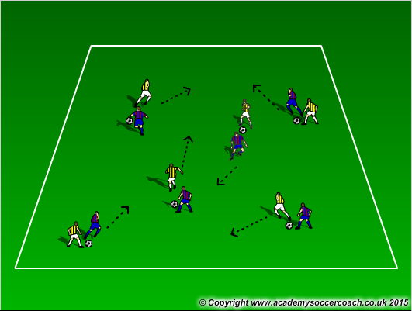
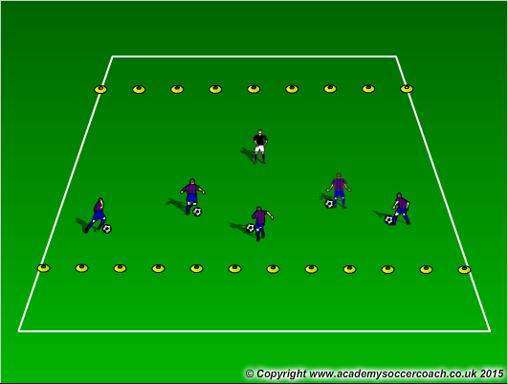
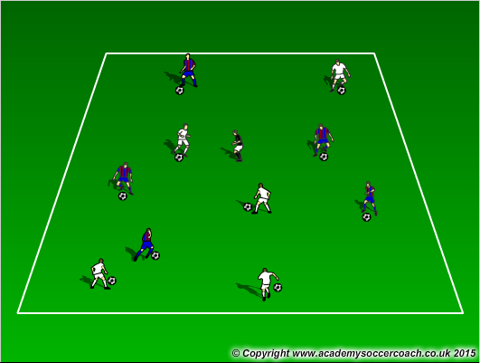
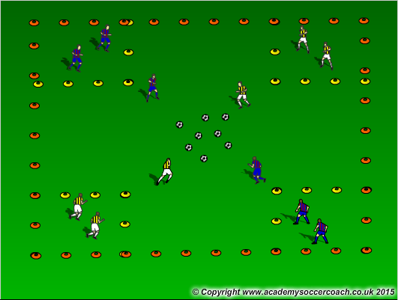
Lead
Combat
Sharks &
Minnows
Follow
Freeze Tag
4 Corners

Slide 2
Week 1
Try to get through at least 3-4 games before
scrimmage (last 30 minutes)
Lead – player 1 with ball leads player 2 without follows
Follow – player 1 without ball leads player 2 with ball follows
Freeze Tag – 1 Player is “it”, when other players are tagged by “it” they are frozen with legs spread and ball above head. To unfreeze, player must pass ball between legs
Combat – 2 teams, coach tosses ball out players must get ball back to coach
Sharks & Minnows – Players must get from one end of the grid to the other and not get tagged. If tagged they become “Seaweed” and stand still and can tag players, which they become seaweed if tagged
4 Corners – In a 15x15 grid, make 3x3 boxes at the corners. Place balls in the middle (6-8 balls). One player in each box is allowed to leave their box and bring a ball back to their box. They can take a ball from the middle or a ball from someone else’s box. Players in box can not block players from getting a ball

