Slide 1
Week 3
U10 United Soccer of Auburn
Topic:
Passing & Receiving

Slide 2
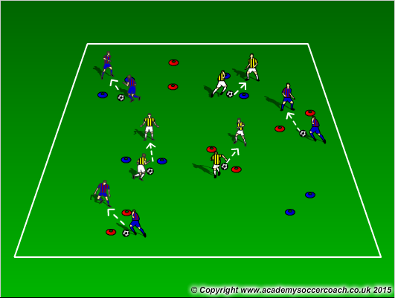
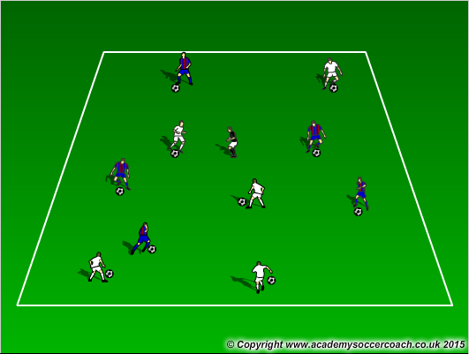
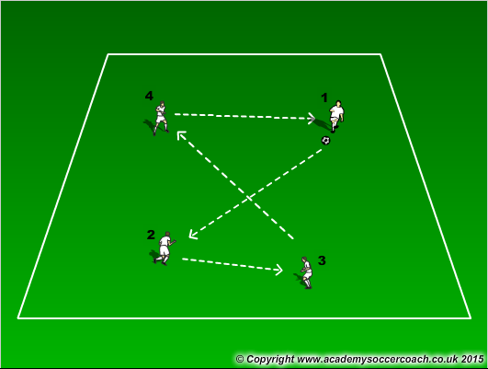
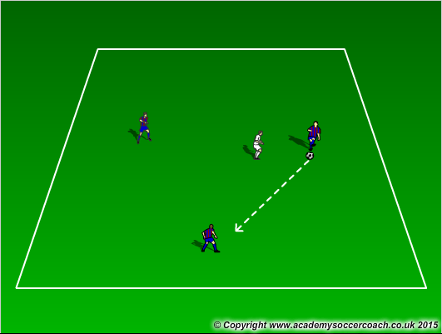
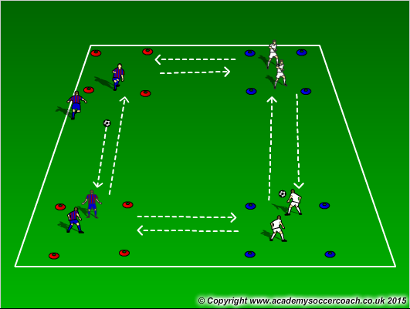
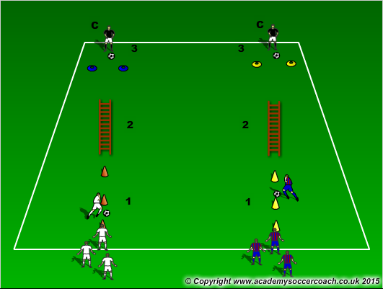
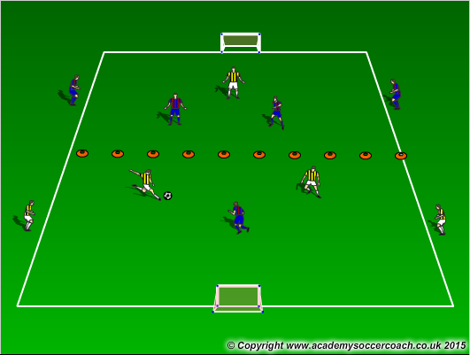
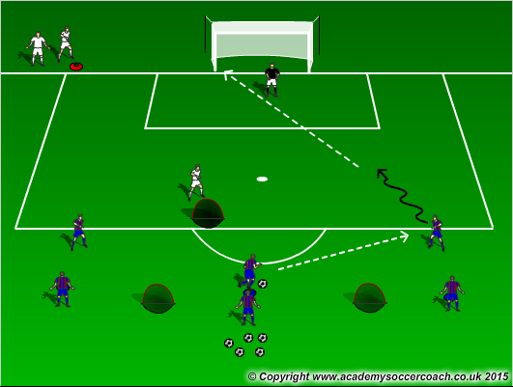
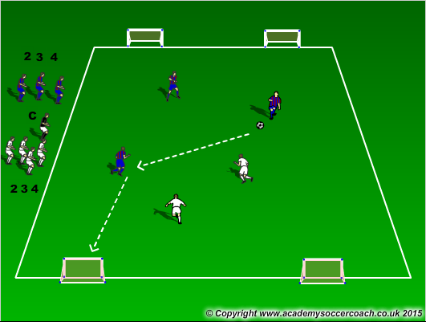
Warm Up
8 mins
Activity 1
10 mins
Activity 2
12 mins
Scrimmage 4v4
25-30 mins

Slide 3
Warm Up
  Gates Passing – In pairs, players go around the field completing passes with their teammate through the gates. Each gate is worth 1 point. Do this in a set amount of time. Have them do multiple rounds with variations (colored cones, must pass it twice through the same cones for it to count).
  Freeze Tag – All players have a ball except “The Freezer”. Player do not want to get frozen by the Freezer. If tagged by the Freezer, you are frozen with ball over head and legs spread. Players get unfrozen when another players passes the ball between their legs. Play till all have been frozen. If players do a move the coach ahs showed them, then they freeze the freezer for 3 seconds.
  Numbers Passing – Divide the team into 2 teams and assign them numbers. Players must try to pass to their own team in ascending order, then descending. Try to be creative with it (odds , evens, or challenge: pass to the even numbers on your team and odd numbers on the opposite team).
Activity 1
  3v1 keep away – Have players play keep away in a 10x10yd grid. Have the player start off able to move but he can slow walk, then he can advance but he must keep his knees from bending, finally he can play for real. Get players use to passing and receiving. Have the player in the middle do this for 30 seconds then advance.
  Box (Island) Passing – Players pass to the opposite box of their own color (blue->blue, red->red). Start of two touch of receive with one foot and pass with the same foot, then receive the ball and the touch goes across the body to pass with the opposite foot). Players will pass and follow to the other box or island. For a challenge, have all grids going in a clockwise direction with 1 ball, then go counter-clockwise.
  Relay race – Players start at the bottom cone and (1) start of zig zaggin through the cones with the ball. When they complete the zig zags, leave the ball before the ladder. (2) Players will go through the ladder with one foot in each space. (3) When out of the ladder they will receive a pass from their coach and they must control the ball and pass it back to the coach between the cones. After the player will go through the ladder again, get the ball at the end of the ladder, and finally zig-zag through the cones before slapping hands with the next player to go. Make it fun and challenging for the players.
Activity 2
  2v1 in attacking half – In a 20x20 grid, cut the field in half. Players will play 2v1 in the attacking half to 1 goal. If defender wins the ball he will look to play to his teammates on the other side
  3v1 to goal – players will play 3v1 to goal. If the defender gets the ball, they will look to score in 2 smaller goals.
  Odd Number game to 2 goals – Players will play to 2 goals. Coach will shout out 2 numbers (1 for each team). Look to play in odd number situations (2v1, 3v1, 3v2…)
Scrimmage
  4v4

Slide 4
Visual Cues
Make sure to instruct and tell players to use the proper technique in passing (inside the foot, heal down, toe up, ankle locked, strike thru the ball)
Plant foot should be pointing to the target and players should try to open the hips a bit
When receiving, look for players to use inside the foot with the heel down and toe up. Look for players to get the ball out from their body about a yard. Try not to let them have it get stuck under them. If they do, it is ok

