Slide 1
Week 5
U12 United Soccer of Auburn
Topic:
Shooting & Finishing

Slide 2
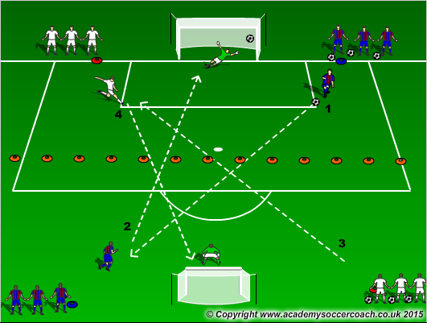
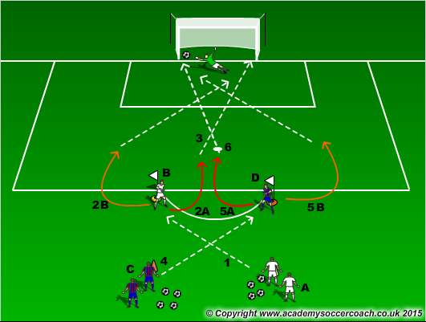
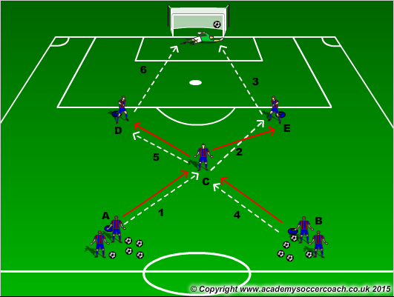
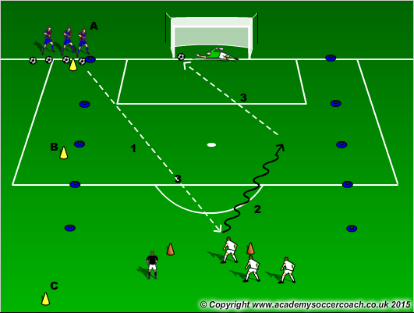
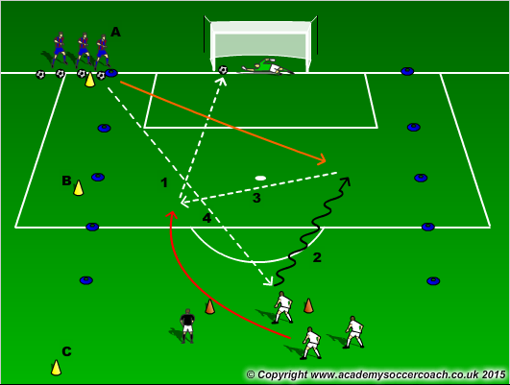
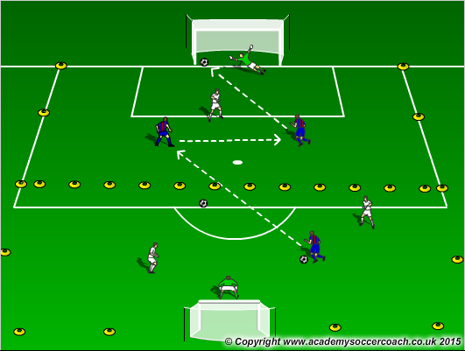
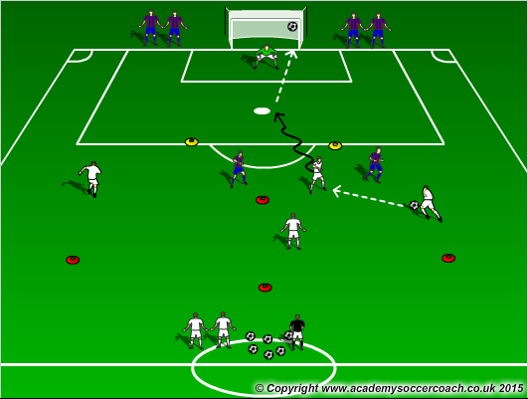
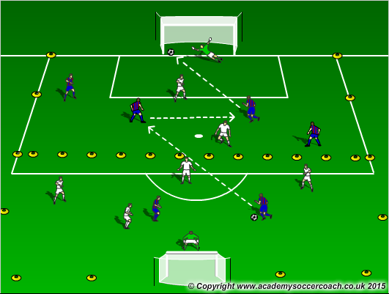
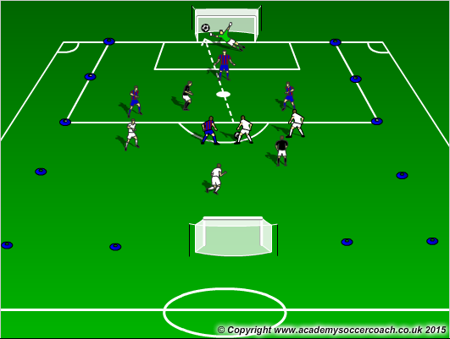
Warm Up
8 mins
Activity 1
10 mins
Activity 2
12 mins
Scrimmage 7v7
25-30 mins

Slide 3
Warm Up
  X box shooting: With teams lined up at 4 corners, the balls will be at a team that is high and straight across from them on the same side (Right side of diagram). 1 passes to 2. 2 has a touch and shoots. 1 will quickly go to 2’s line and 2 will go to 1’s line. Then 3 will pass to 4 and do the same thing. The pattern will continue. For the first couple, have the players working on technique of striking the ball and not hitting it hard. Let the muscles and tendons/ligaments in the body warm up. Also this will help the GK’s warm up as well. After a bit of this, you can have a competition to see which team can get to 10 goals.
  Turn, shot pattern: Shooting players start at the top of the 18. The passers will be 8-10 yds back. Passers play into the shooters, shooters will need to turn and have a shot. The shooters should look to turn using the inside part of their foot (chop), or the outside part of the foot (hook). Players should only take 1 or 2 touches then shot. They should not be shooting any closer than 12 yards away. The coach can start the activity off by shooters turning to the inside for a couple rounds, then turn to the outside. Make sure players change lines so they get use to receiving the ball and having shots from different angles.
  X Passing and shooting pattern: A passes to C, C passes to E, E dribbles and has a shot. After each pass, the player will follow the pass to that spot so A is now at C, C is now at E, and E goes to B. After that, B passes to E, E turns and passes to D, D dribbles and has a shot and again players will follow their pass.
Activity 1
  1v1 to goal in the 18: Defender will pass the ball out to the attacker and play 1v1 to goal. Attackers will look to beat defender and have a shot and finish.
  2v1 to goal in the 18: Defender will pass the ball out to the attacker and play 1v1 to goal. After a certain amount of seconds, a second attacker will be trailing getting involved in the play. 1st attacker can decide to dribble or pass. In the end, the attackers will look to score.
  In a 24x16 yard grid cut in half, players will play 2v1 in their attacking half looking to score on goal. If defender wins the ball they will look to pass it into their attackers.
Activity 2
  4v2 time trial: Attacking players will need to start at their cone and once all are at their cone the coach will play a ball in to the attackers. Attackers will look to play quick and combine to score. If the ball is scored or dead players will need to get back to their cones. If defenders win the ball they will look to play coach and the play isn’t done until the ball gets to the coach. The attacking side will go for a certain time limit (1 minute) to see how many goals they can create and score.
  In a 32x24 yard grid cut in half, players will play 4v2 in their attacking half looking to score on goal. If defender wins the ball they will look to pass it into their attackers.
  3v3+2: In a 32x24 grid players will play 3v3+2(Neutrals) to goal. Coach will look for a lot of shots in this activity
Scrimmage
  7v7

Slide 4
Coaching Points
Technique on shooting the ball. Ankle locked, Striking through the ball using the laces or the inside part of the foot.
Knowing when to shoot the ball and where the GK is to keep it away from the GK
Getting the body through the ball and NOT swinging the leg up and high but forward.
Make contact THROUGH the ball

