Slide 1

WALTHAM YOUTH SOCCER
FALL 2020 Coaches Meeting - 9/17/2020

Slide 2
WALTHAM YOUTH SOCCER
FALL 2020 Coaches Meeting
BOARD OF DIRECTORS:
PRESIDENT - Mike Guzzi
VICE PRESIDENT TRAVEL - Kevin Felton
VICE PRESIDENT INTOWN - Paul Bucelwicz
SECRETARY - Ben Kuchler
TREASURER - Duncan Remage-Healey
REGISTRAR - Mike Guzzi
DIRECTOR OF COACHING - Sean Cook
REFEREE COORDINATOR - Ray Halleran
UNIFORM / EQUIPMENT MANAGER - Michelle Pisuk
FAMILY LIAISON - open
MIDDLESEX LEAGUE TOWN COORDINATOR - Matt Staub
COVID SAFETY OFFICER - Duncan Remage-Healey

Slide 3
WALTHAM YOUTH SOCCER
FALL 2020 Coaches Meeting
OUR PURPOSE:
The purpose of this organization is to foster, promote, and teach the game of soccer to the boys and girls of Waltham through the development of individual skills, fitness, teamwork, and fair play.
WHY NO GAMES? Why don’t we have games against other towns this season?
WYS is a member of the Middlesex Youth Soccer League (MYSL) and will abide by their rules and bylaws. WYS is affiliated with the Massachusetts Youth Soccer Association, Inc. (MYSA) and the United States Youth Soccer Association, Inc. (USYSA). 11 out of 17 MYSL Teams have withdrawn from the Fall Season.
WHO MADE THESE RULES? I don’t want to wear a mask - do we have to follow these COVID Guidelines?
August 15, 2020 - In accordance with COVID-19 order no 43 issued by the Commonwealth of Massachusetts on July 6, 2020, with amendments to supporting documentation issued on August 13, 2020 by the Executive Office of Energy and Environmental Affairs (EEA), Mass Youth Soccer has determined the need to require specific modifications in order for Soccer to be continued to be played as a Moderate Risk Sport under the expansion of Phase III, Levels 1, 2, and 3.
EEA - COVID-19 Order No. 43
Mass Youth Soccer - Return to Soccer Guidelines

Slide 4
WALTHAM YOUTH SOCCER
GENERAL GUIDELINES
TRAINING:
Will begin the week of September 21st and will end Saturday Oct 31st.
Each team has two practices per week (there are no games this season)
All practice sessions will be held at Veteran's Field - 385 Forest St, Waltham
AT THE FIELD:
Masks are required by ALL Players, Coaches, Spectators
Maintain 6' social distance at ALL times
One spectator per player allowed in the Veteran's Complex
No spectators will be allowed on the turf

Slide 5
WALTHAM YOUTH SOCCER
GENERAL GUIDELINES
PARENTS:
Read and understand the COVID Guidelines document.
Take the temperature of your child before bringing them to soccer. DO NOT ALLOW your child to attend soccer if they are sick or any family member is demonstrating any symptoms of being sick.
Email Duncan Remage-Healey (our COVID Safety Officer) immediately if anyone in your family has tested positive for COVID-19. duncan.f.rh@gmail.com
WHAT TO PACK: Each player will need to bring the following.
Face Mask w/ ear loops (no exceptions)
Water Bottle
Soccer ball
2 T-shirts (or sweatshirts when it gets colder) – 1 light colored/1 dark colored (this is because we cannot use pinnies to create opposing sides)
Shin guards
Soccer cleats (grass or turf)
Hand sanitizer

Slide 6
WALTHAM YOUTH SOCCER
GENERAL GUIDELINES
PLAYERS:
Take temperature before coming to soccer (see information outlined in the parent’s section).
Practice and encourage proper hygiene (washing hands frequently with soap and water, for at least 20sec)
Have your own hand sanitizer with you
Cover coughs and sneezes with tissues or sleeves, do not use your hands. Do not touch your face (eyes, nose, mouth) with unwashed hands.
Wear a face mask at ALL times. Only a face covering that loops around a player’s ears will be considered acceptable.
Practice physical distancing on the sidelines. When sitting on the sidelines you should be 6’ from the next player and wear a mask as much as possible. Your belongings should remain in your space when not in use.
Bring your own equipment. (Ball, shin guards, extra t-shirt, etc.) Do not touch anyone else’s equipment.
Bring your own water bottle. Do not touch anyone else’s belongings as sharing will not be permitted.
Wash and sanitize your equipment before and after each training.
No group celebrations, hugs, handshakes, fist bumps, etc.

Slide 7
WALTHAM YOUTH SOCCER
GENERAL GUIDELINES
COACHES:
Wear a WYS Coaches shirt - Pick up your Coach ID Passcard from the shack before your first practice session.
STAY POSITIVE (players and parents will be looking to you to remain calm and supportive during this transition time)
Upon arrival, inquire how the players are feeling (they should not participate if you believe they are acting or look ill)
Take attendance at the beginning of EVERY practice (using the attendance sheet provided to maintain contact tracing). Please keep this sheet for the entire season - We are required to submit them to the City of Waltham after the season!
Make sure your players wear masks, maintain social distance, and have frequent water breaks
Sean Cook (Director of Coaching) will provide curriculum you can reference each week. Here are some practice plans from MA Youth Soccer - https://www.mayouthsoccer.org/physical-distancing-session-plans/
We expect each session will contain 2-3 skills-based games – Have fun! (gamified drills is the new US Soccer approach)
You are welcome to scrimmage within your own team (switch up the # of players and type of games - keep it interesting)
In order to minimize the amount of contact, we are not allowing scrimmages with ANY other teams (if we determine it is safe to do so, we may organize official scrimmages against other Waltham teams towards the end of the season)
Email Duncan Remage-Healey (our COVID Safety Officer) immediately if you or anyone on the team has tested positive for COVID-19. duncan.f.rh@gmail.com

Slide 8
WALTHAM YOUTH SOCCER
GENERAL GUIDELINES
PRACTICES:
Sean Cook (Director of Coaching) will provide curriculum you can reference each week. Here are some practice plans from MA Youth Soccer - https://www.mayouthsoccer.org/physical-distancing-session-plans/
Modify play as much as possible to keep players spaced 6 feet apart for the majority of your practice.
TRAVEL COACHES (3rd - 8th):
  Arrive 15min before your practice session to welcome the team, prepare the field for the first activity.
  Players should arrive, get themselves ready for practice and sanitize their hands
  We expect each session will contain 2-3 skills-based games (gamified drills - this is the new US Soccer approach)
  You are welcome to scrimmage within your own team (switch up the # of players and vary the type of games to keep it interesting each week)
INTOWN COACHES (1st - 2nd):
  Arrive 30min early to help set up the nets
  Sean will provide a coaching clinic to demo the weekly curriculum
  30-40 min of each session will be focused on skills-based games with a scrimmage at the end

Slide 9
WALTHAM YOUTH SOCCER
GENERAL GUIDELINES
SCRIMMAGES: In order to minimize the amount of contact, we are not allowing scrimmages with ANY other teams!
If we determine it is safe to do so, we may organize official scrimmages against other Waltham teams towards the end of the season
Modify play as much as possible to keep players spaced 6 feet apart for the majority of the scrimmage.
NO shoulder to shoulder contact
NO slide tackling
NO throw-ins (kick-ins allowed > not into the penalty area)
NO corner kicks (trying to eliminate the crowding of players in the box)
NO heading
Players should maintain 6' social distance as much as possible.
Eliminate Goalie punts (should roll/pass the ball out of the back)
Any equipment used in a session must be wiped down afterwards

Slide 10
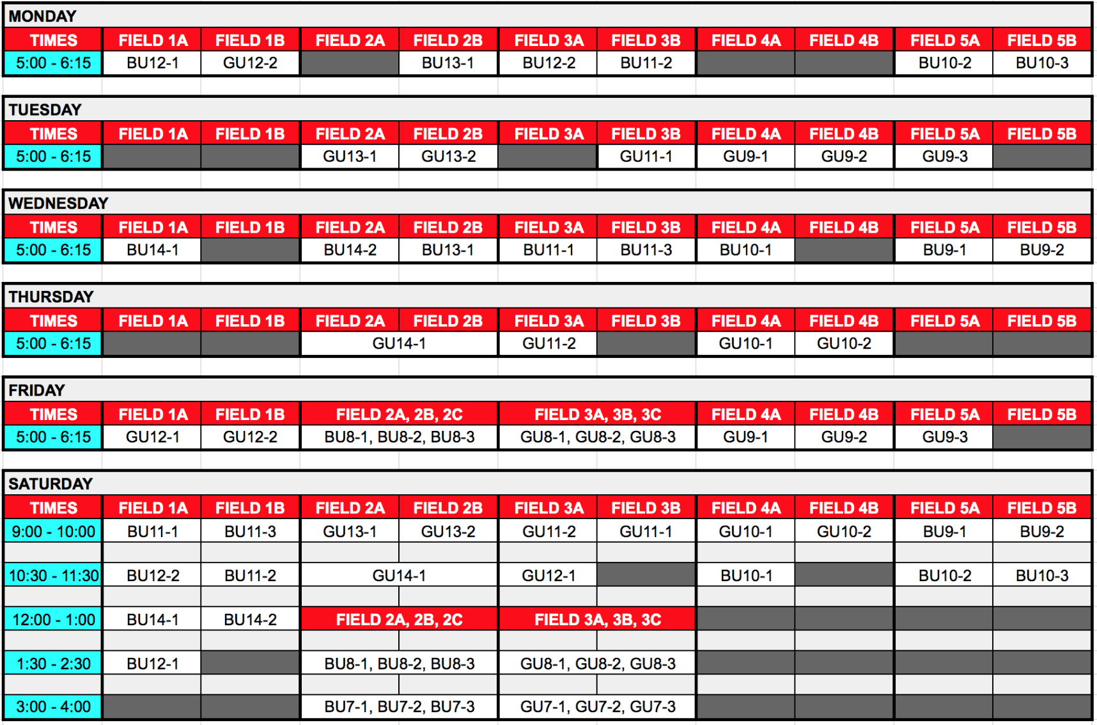
WALTHAM YOUTH SOCCER
SCHEDULE

Slide 11
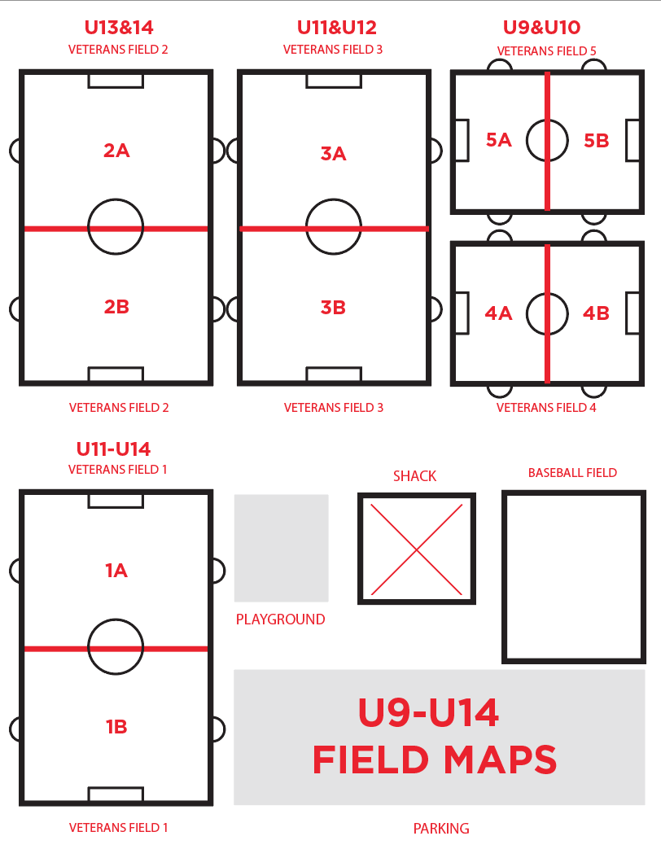
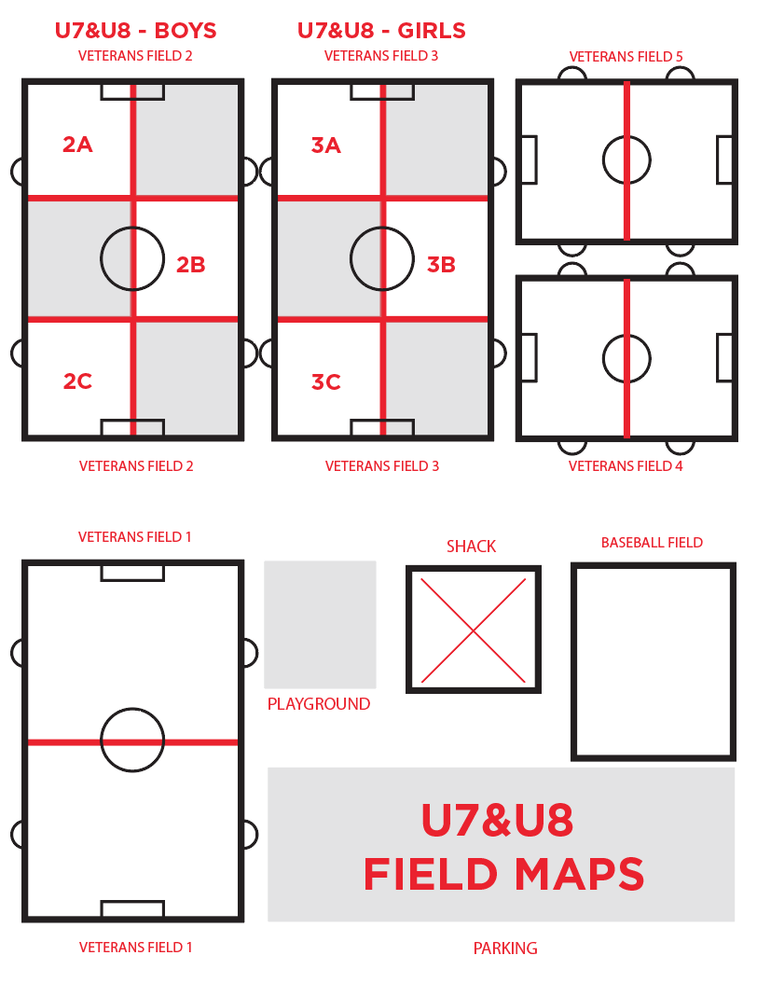
WALTHAM YOUTH SOCCER
FIELD MAPS

Slide 12
WALTHAM YOUTH SOCCER
ONE-WAY ENTRANCE AND EXIT
FIELD 1
FIELD 2, 3, 4, 5
ENTER
TO THE LEFT OF THE BLEACHERS
ENTER
TO THE RIGHT OF THE SHACK
EXIT
BETWEEN THE BLEACHERS
EXIT
BY THE PLAYGROUND

Slide 13
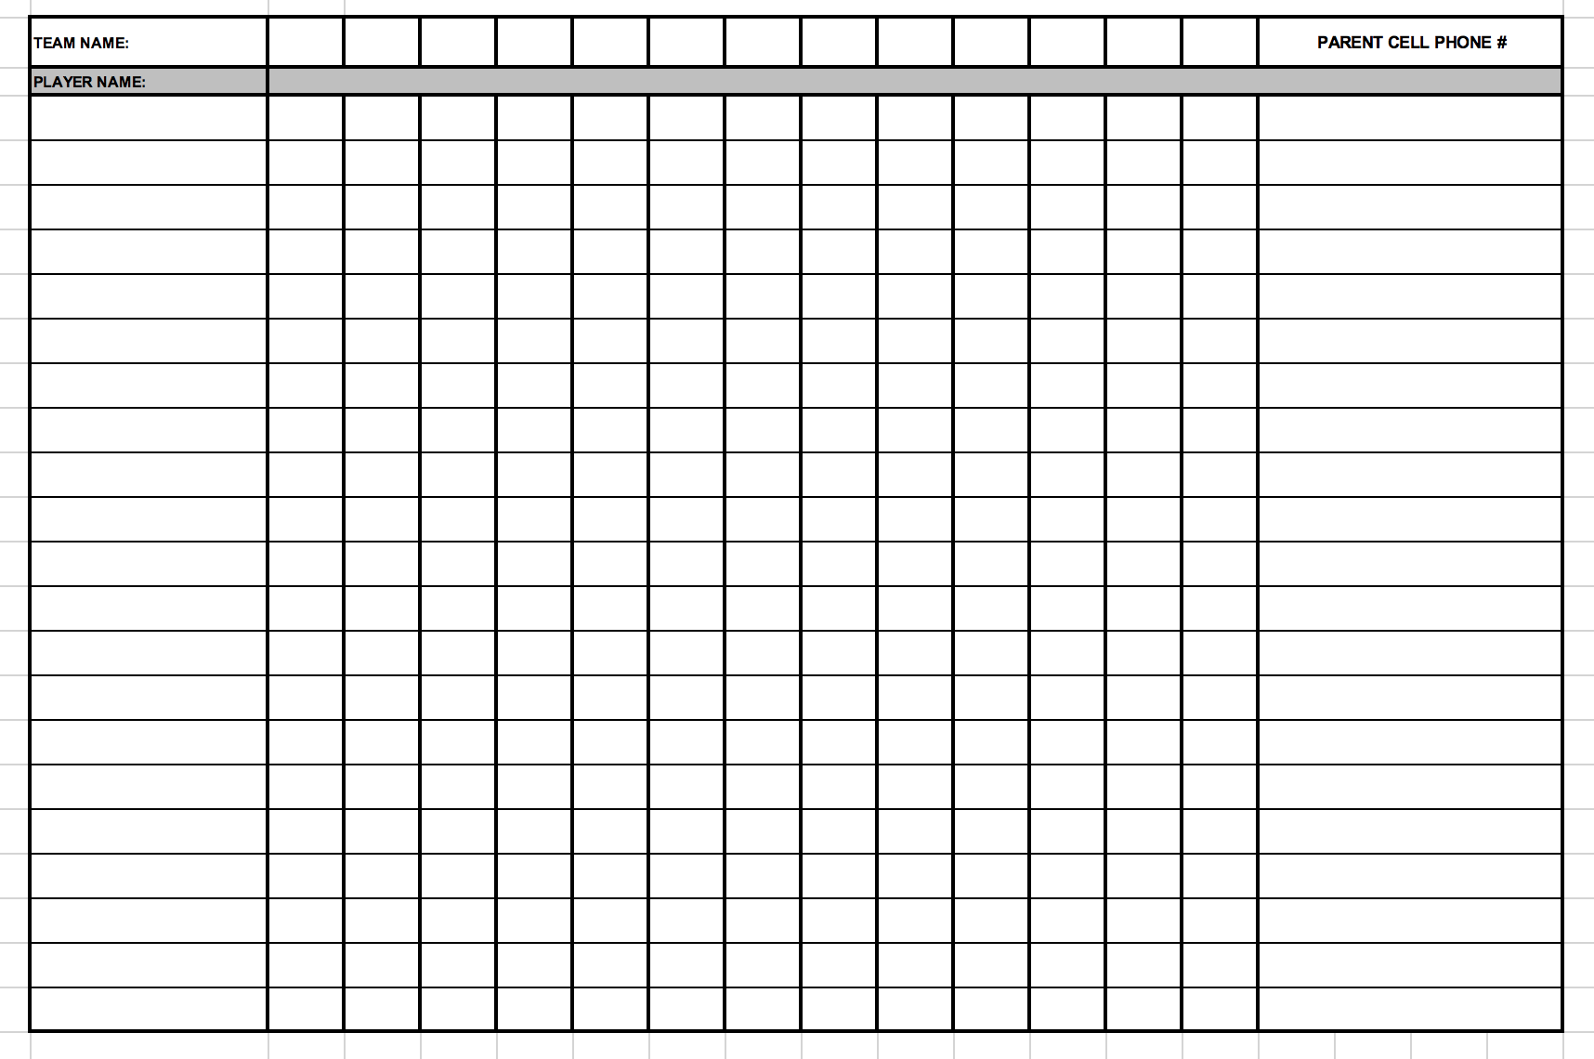
WALTHAM YOUTH SOCCER - Fall 2020 Training Attendance Sheet
DATE:

Slide 14
WALTHAM YOUTH SOCCER - Fall 2020 Training Attendance Sheet
WALTHAM YOUTH SOCCER - Fall 2020 Training Attendance Sheet
DATE:
DATE:
BU14-1
9
9
9
10
10
10
10
10
10
10
10
10
23
26
30
3
7
10
14
17
21
24
28
31
Noah Arkey
X
X
X
X
X
X
X
X
Stevie Carrell
X
X
X
X
X
X
X
Billy Ferrell
X
X
X
X
X
X
X
X
Jeremy Garcia
X
X
X
X
X
X
X
X
Indy Jones
X
X
X
X
X
X
X
Stu Little
X
X
X
X
X
X
X
Willy Madison
X
X
X
X
X
X
X
X
Lenny Messier
X
X
X
X
X
X
X
X
Henry Solo
X
X
X
X
X
X
X
X
Luke Walker
X
X
X
X
X
X
X

