Slide 1

Woburn Youth Soccer
Information Book
For the Parent/Coach
Kindergarten Level

Slide 2
Outline
First-Time Coaches
  Quick Tips
Understanding Your Players
Rules of the Game
Coaching Objectives
Practice Activities
Links to Videos
Additional Activities

Slide 3
First-Time Coaches
Do Not try to do it Alone!
  If you don’t have an Assistant Coach already find one!
  Ask your partner or significant other
  A parent from the team may be interested
Interacting with Parents/Guardians is important!
  Keep your parents in the know.
  Be upfront about team goals (even at this level).
  Make your expectations clear for both player and parent behavior.
  Engage your parents in understanding Best Soccer Practices.
    This will help better your players when playing at home too.

Slide 4
Understanding Your Players
These Players are 5 and 6 years old!
  They can get hurt easily – so be careful!
  Both physical and mental development for boys and girls are similar at this age.
Short attention spans are almost guaranteed!
  Keep activities short – 15 minutes max.
Often individually oriented.
  Me, my, and mine are very popular words.
  They will have little to no concern for team activities.
Consistently in motion.
  Keep them engaged!
  Make sure to give them breaks for water and rest!

Slide 5
Rules of the Game!
All players must wear correct uniform!
  This includes team shirt, team socks, shin guards, and soccer cleats (sneakers are ok).
Six players per team play at a time.
  There are two small fields.
  Each team has 3 players on each field.
  No goalies.
Game is split into 4 – 8 minute quarters.
  There will be a 2 or 5 minute break at the conclusion of each quarter.
  Each team will substitute all players from bench in at the end of each quarter.
  All players must play at least 50% of the game time.
Kindergarten uses a size 3 soccer ball.
All out of bounds will be followed by a kick-in from the opposite team.
Scores will not be recorded by the ref or coaches. This is meant to be fun!

Slide 6
Coaching Objectives
Dribbling
  Building confidence in running with a ball at their feet.
  Learning to dribble and not bump into other players.
Ball Movement
  Kicking the ball with the correct part of the foot.
  Kicking the ball in specific direction (accuracy).
  Stopping the ball on command.
Coordination/Movement
  Building up balance and coordination.

Slide 7
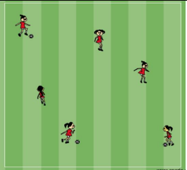
Practice Activities
Free Dribble
In a 15yd x 20yd grid each player has a ball and dribbles freely around the grid.
Players are instructed to keep the ball under control, stay in the grid, and do not bump into other players.
Movement education
Balance
Eye – foot coordination
Repetition of touches on the ball
Change of speed
Change of direction

Slide 8
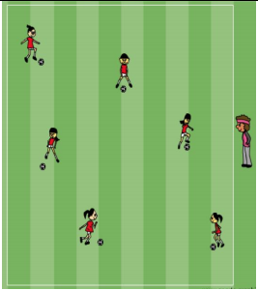
Practice Activities
Goofy Stop & Go
In a 15yd x 20yd grid each player has a ball and dribbles freely around the grid.
The coach will yeah stop and players will stop the ball as quickly as possible and stand in a goofy pose.
Ball control/stopping
Balance
Eye – foot coordination
Repetition of touches on the ball
Change of speed
Change of direction

Slide 9
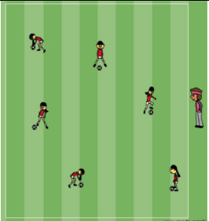
Practice Activities
Body Dribble
In a 15yd x 20yd grid each player has a ball and dribbles freely around the grid.
The coach will yeah stop and a body part. Players will then stop the ball as quickly as possible and put that body part on the ball.
Ball control/stopping
Balance
Eye – foot coordination
Repetition of touches on the ball
Change of speed & direction
Listening Skills

Slide 10
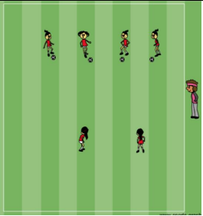
Practice Activities
Shark Attack
Set up a 15yd x 15yd grid.
All but one or two players will line up side by side one on edge of the grid with a ball.
One or two players will be selected to stand in the middle of the grid and be the sharks.
The players with the balls will dribble across the grid to the opposite side.
The “sharks” will attempt to kick the balls away from the players.
Any player that loses their ball becomes a shark.

Slide 11
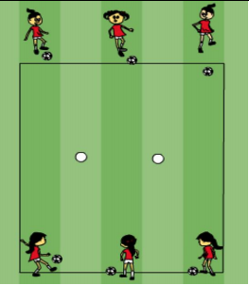
Practice Activities
Hit the Ball
Set up an 8yd x 8yd grid and place 2-4 soccer balls in the middle in a line.
Players will line up on opposite sides with a ball.
Players will one at a time try to kick their ball and hit one of the balls in the middle.
(Relaxation Activity)
Introducing aiming for a target.
Individual competition.

Slide 12
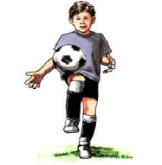
Practice Activities
Cool Down Juggling
Every player starts with a ball in their hands.
They drop the ball to their thigh, hit it, and try to catch it.
They work their way up to thigh to thigh juggling and then catching the ball.
Eventually they can work up to thigh to foot juggling.
(Relaxation Activity)
Balance and coordination
Fun and challenging.

Slide 13
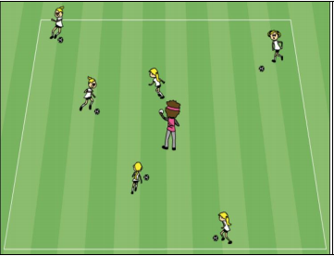
Practice Activities
Ball Master
In a 15yd x 15yd grid, players dribble their ball to the coach.
The coach then tosses their ball away and the player retrieves the ball and repeats.
(Added challenge 1) The coach moves position to increase dribbling skills.
(Added challenge 2) The coach can instruct the players to dribble with a specific foot.
Dribbling with ball.
Dribbling to a target.
Individual competition.

Slide 14
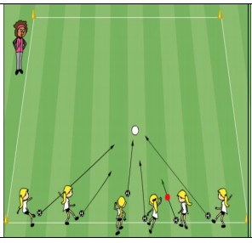
Practice Activities
Soccer Marbles
Use a larger ball (ex. Size 4 or 5 soccer ball) and place it in the middle of an 8yd x 8yd grid.
Each Player has a ball and tries to kick their ball and hit the larger ball out of the grid.
Introducing aiming for a target.
Individual competition.

Slide 15
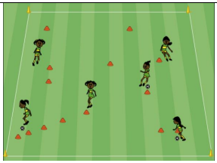
Practice Activities
Random Cones
In a 10yd x 10yd grid set up cones randomly. Some in pairs, trios, and solo cones.
Players first run throughout the grid with no ball weaving in and out and around all the cones.
Next players do the same while dribbling the soccer ball.
Introducing random running patterns.
Introducing dribbling in a non-straight line.
Individual competition.

Slide 16
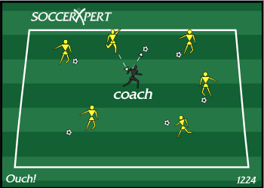
Practice Activities
Hit the Coach
You can use an open space or set up a grid.
Each player has a ball and dribbles around trying to hit the coach by kicking it at him/her.
Be sure to avoid some but not all kicks to ensure kids are having fun.
To make it more fun you tell the kids after they hit you to pick an animal for you to imitate.
Introducing aiming for a moving target.
Individual competition.

